Slide 1

Animal Features & Adaptations
Alabama Wildlife Federation Habitat Lab Field Journal Activity
To use this interactive PowerPoint with your students:
Click on “Enable Editing.”
Click the “Slide Show” tab at the top of the screen.
Then choose “From Beginning” from the menu.

Slide 2

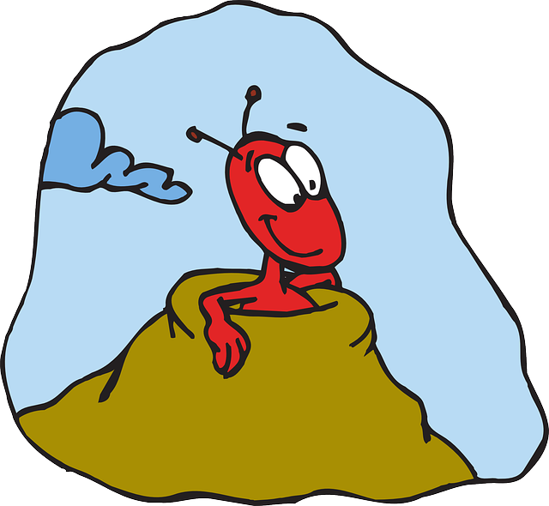
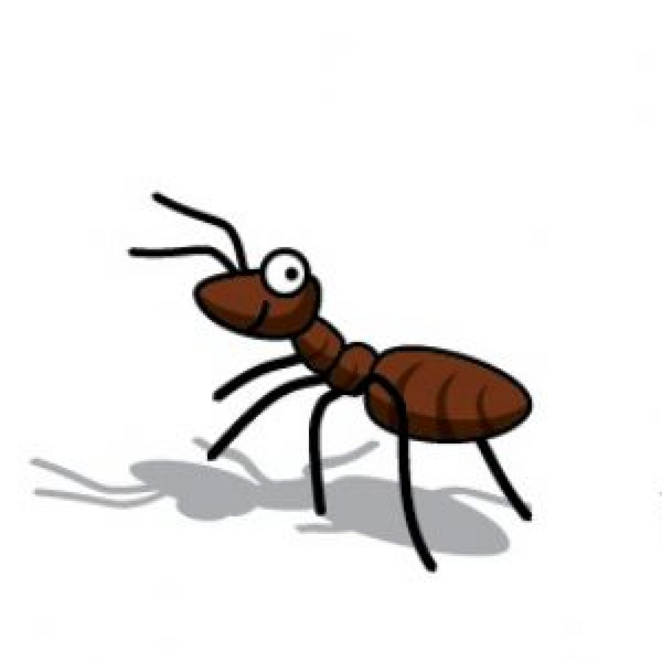
How does a tiny ant stay alive when everything is so much bigger?
It can hide in its anthill,
but it has to come out to search for food.

Slide 3
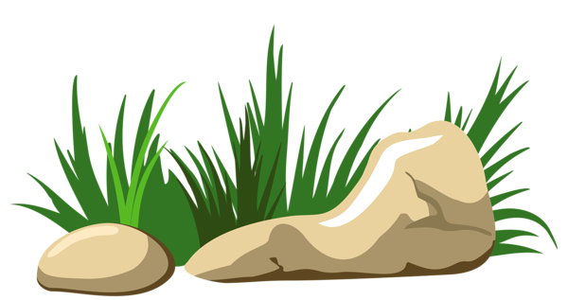
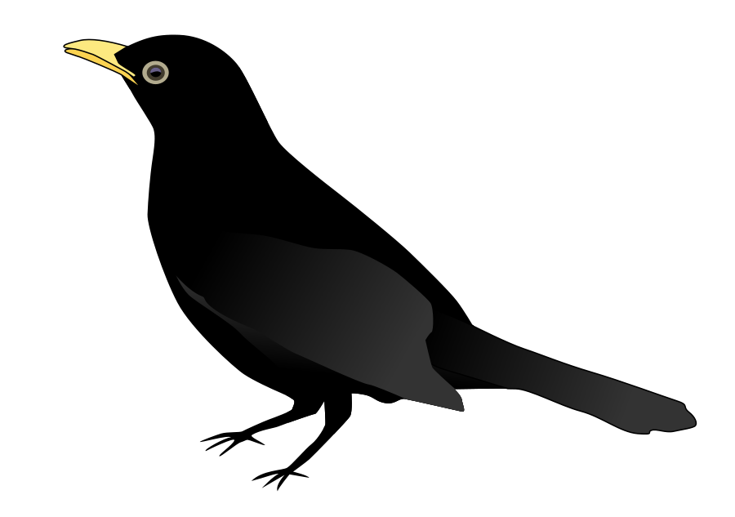
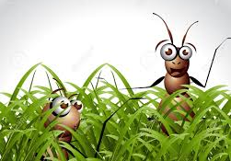
How does the ant’s size help it survive?
I am a predator. I eat other animals.
You can’t see us!
It can hide easily from predators,
and duck into small spaces.

Slide 4
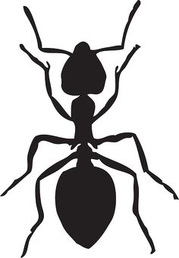
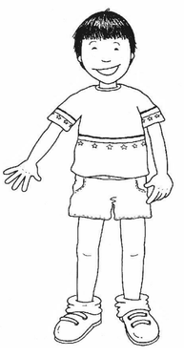
How is an ant’s body different than ours?
An ant’s body has a hard exoskeleton for support and protection.
Humans’ bodies have hair & soft skin.
https://askabiologist.asu.edu/explore/ant-anatomy

Slide 5
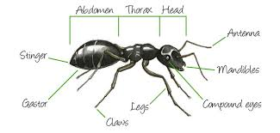
How is an ant’s body different than ours?
Humans’ bodies have:
2 arms & 2 hands to reach out to touch,
a mouth to taste &
a nose to smell.
An ant has 2 antennae on its head that reach out to touch, taste, and smell everything.
https://askabiologist.asu.edu/explore/ant-anatomy

Slide 6
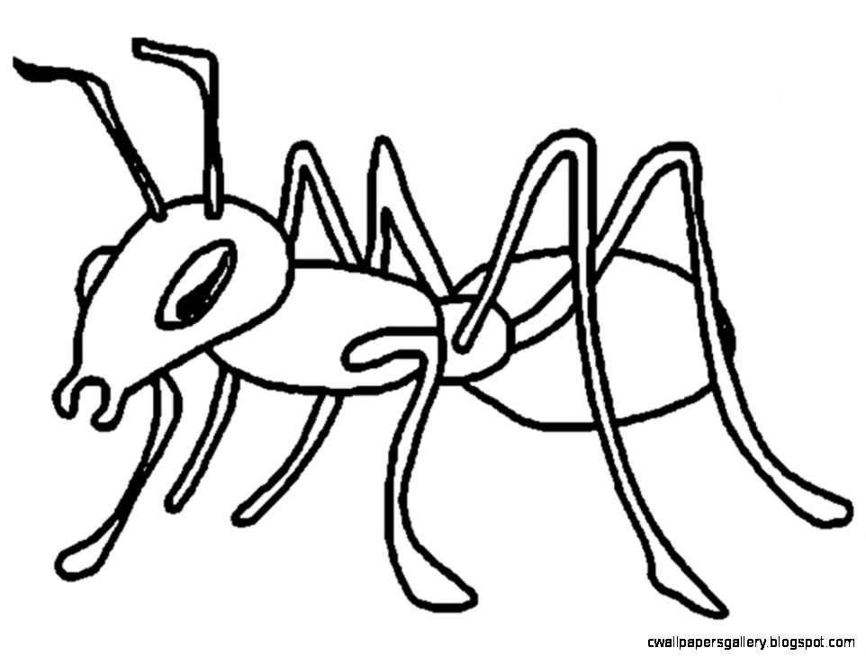
How is an ant’s body different than ours?
Humans’ bodies have 2 arms and 2 hands to hold and carry things, and we have teeth for biting.
mandibles
An ant’s body has mandibles for holding and carrying things, biting, and digging.
https://askabiologist.asu.edu/explore/ant-anatomy

Slide 7
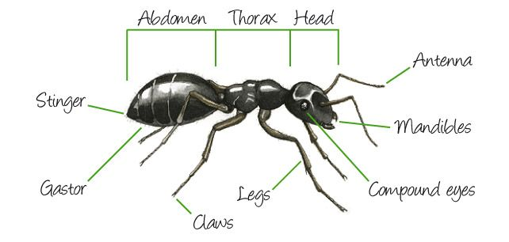
How is an ant’s body different than ours?
Humans have 2 eyes that have 1 camera-like lens that allows us to see in great detail, but we cannot see things next to us without moving our heads left or right.
An ant has 2 compound eyes that contain hundreds of camera-like lenses that help detect movement on both sides of the ant without it having to turn its head.
https://askabiologist.asu.edu/explore/ant-anatomy

Slide 8
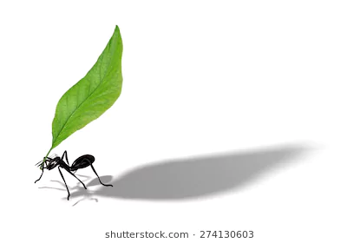
What is special about an ant’s body that helps it survive?
The neck joint of a common American field ant can withstand pressures up to 5,000 times greater than its own body weight,
so it can carry food back to its colony in the anthill.
https://entomologytoday.org/2014/02/11/ants-can-lift-up-to-5000-times-their-own-body-weight-new-study-suggests/

Slide 9
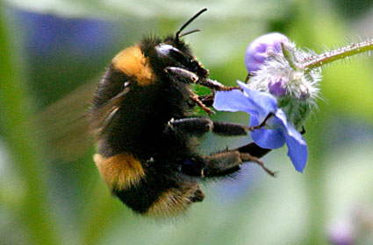
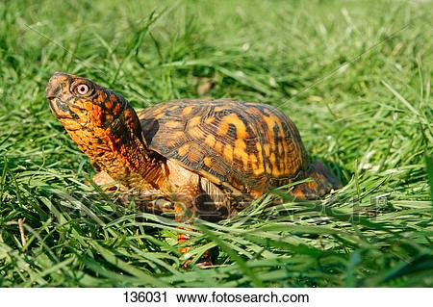
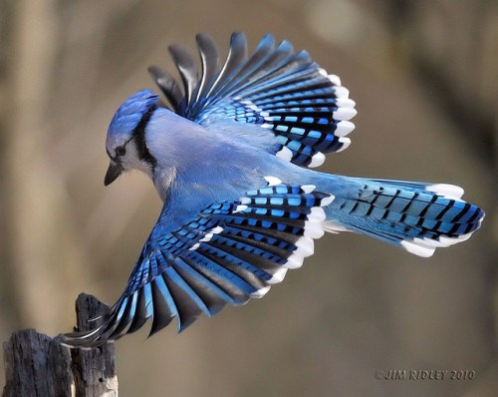
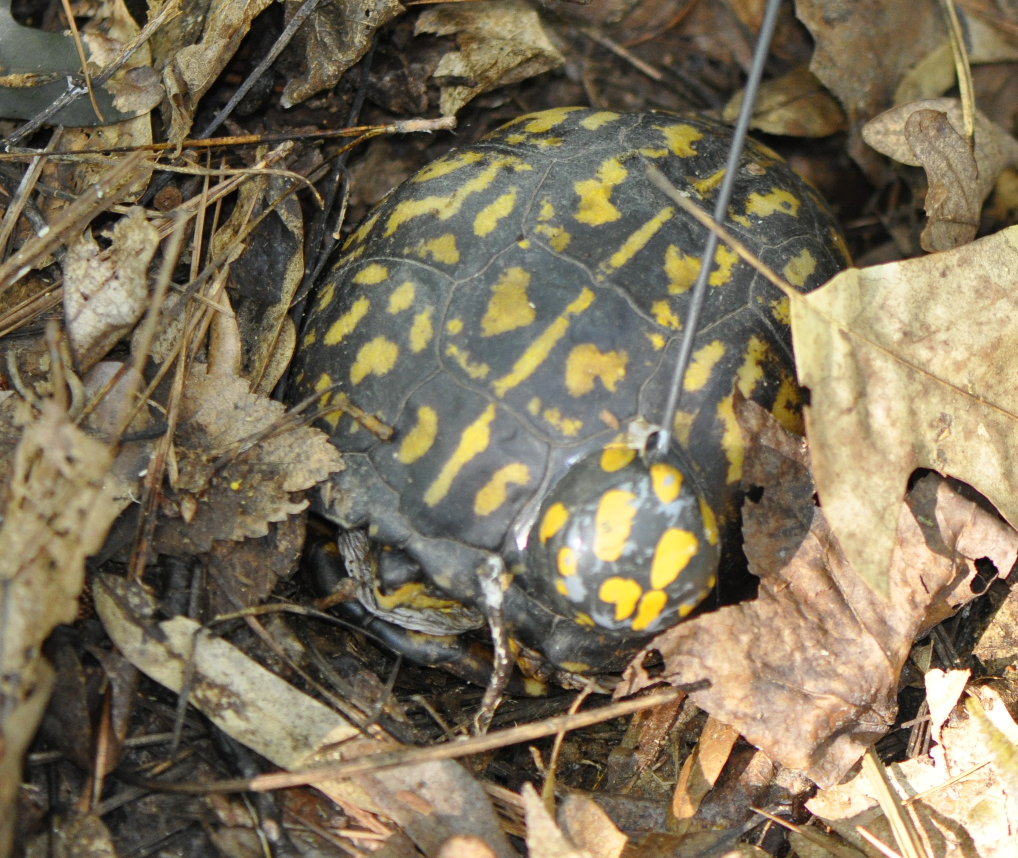
What other types of animals could we find in our outdoor classroom? How do their bodies help them live?
Bee’s Tongue:
long tube to suck out nectar from flowers
Turtle’s Hard Shell:
protection from predators & camouflage
Bird’s Feathers:
able to fly away from predators

