Slide 1

Birds & Their Adaptations
An Alabama Wildlife Federation Habitat Lab Field Journal Activity
To use this interactive PowerPoint with your students:
Click on “Enable Editing.”
Click the “Slide Show” tab at the top of the screen.
Then choose “From Beginning” from the menu.

Slide 2
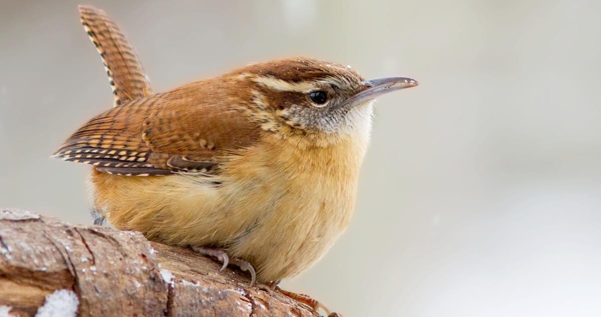
What are the characteristics or traits that make an organism a bird?
Are birds cold-blooded or warm-blooded?
Warm-blooded (or endothermic)
How many legs do birds have?
Two wings (instead of arms) & two legs
What kind of covering do birds have? Skin? Scales?
Did you know?
There are approximately
10,000 different
bird species in the world.
Feathers on their body & scales on their feet and legs
How do birds give birth? Live birth like humans?
Lay eggs
What type of mouth do they have? Is it like ours?
Beak or bill as a “mouth” with no teeth – the gizzard (stomach) grinds the food

Slide 3
How do biologists (scientists who study living organisms) group birds into different categories?
To distinguish one species from another, scientists use a taxonomy or classification system with levels that range from broad to very specific.
For example:
Kingdom – All Animals (Animalia in Latin)
Phylum – All Vertebrates (have a backbone) – (Chordata)
Class – All Birds (Aves)
Order – Perching Birds (Passeriformes)
Family – Wrens (Troglodytidea)
Latin Name: Thryothorus ludovicianus
Common Name: Carolina Wren
Genus – Reed (tall stiff grass) Jumper (Thryothorus)
Species – ludovicianus (refers to Louisiana where this bird was first found & identified)

Slide 4
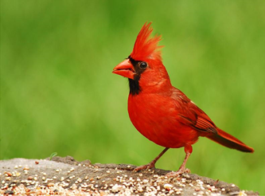
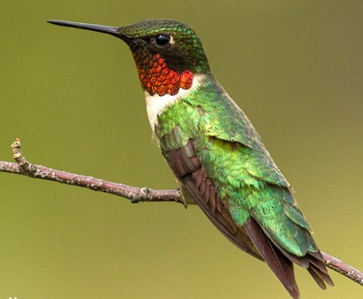
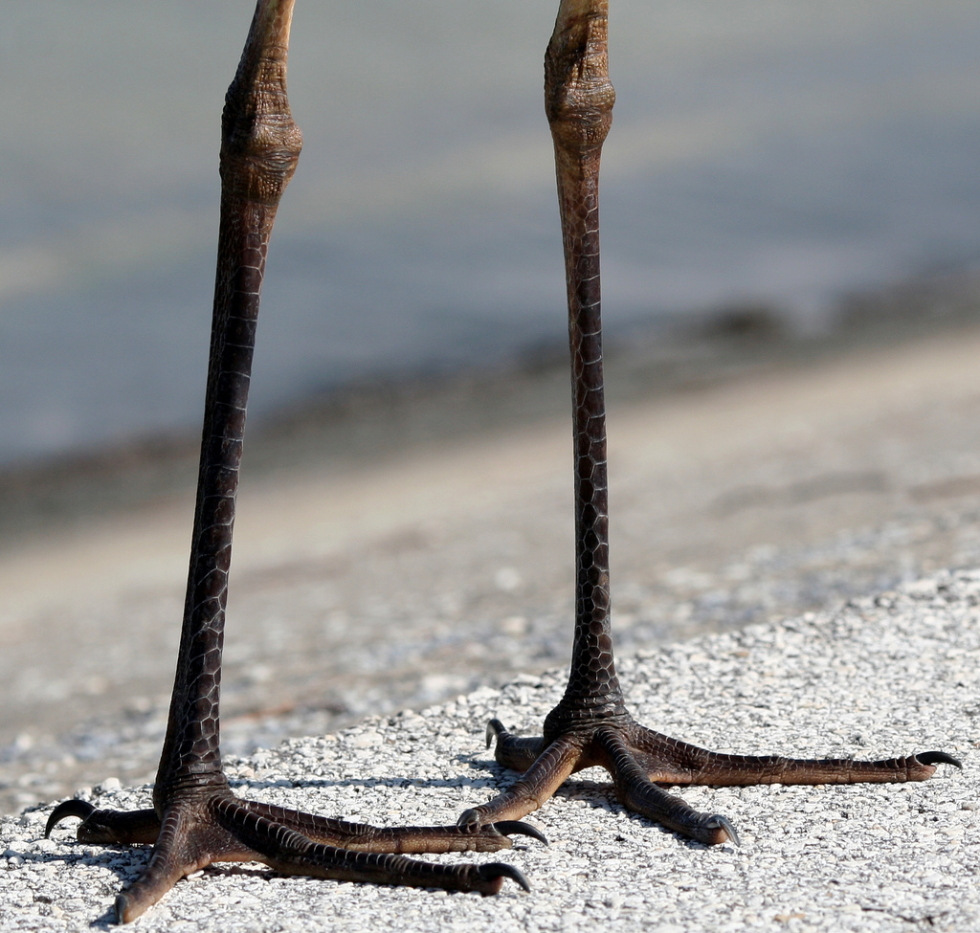
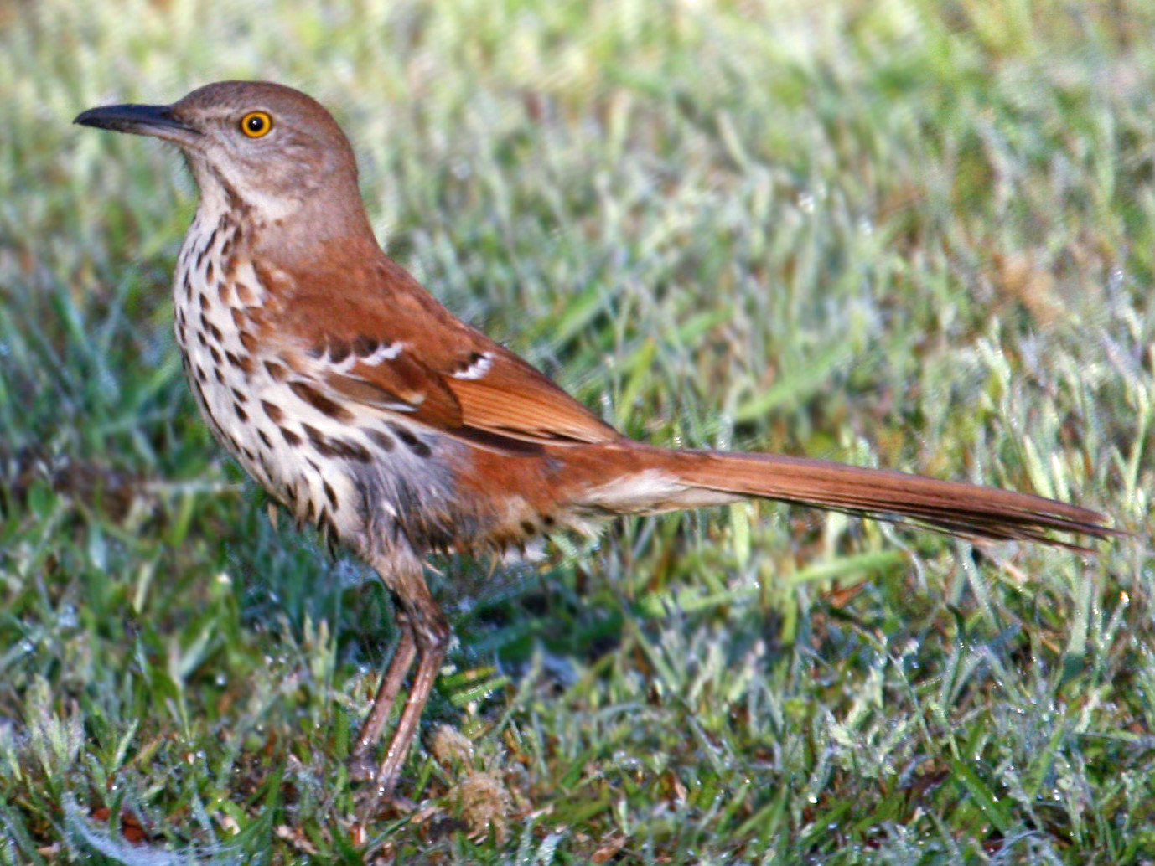
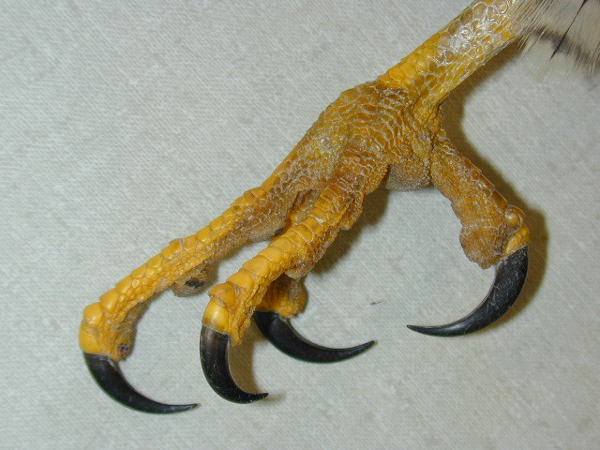
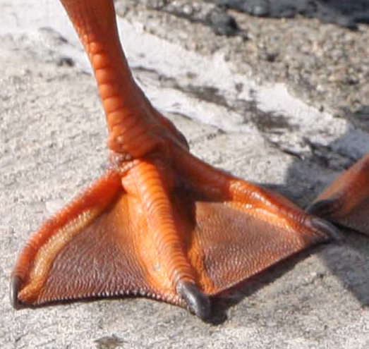
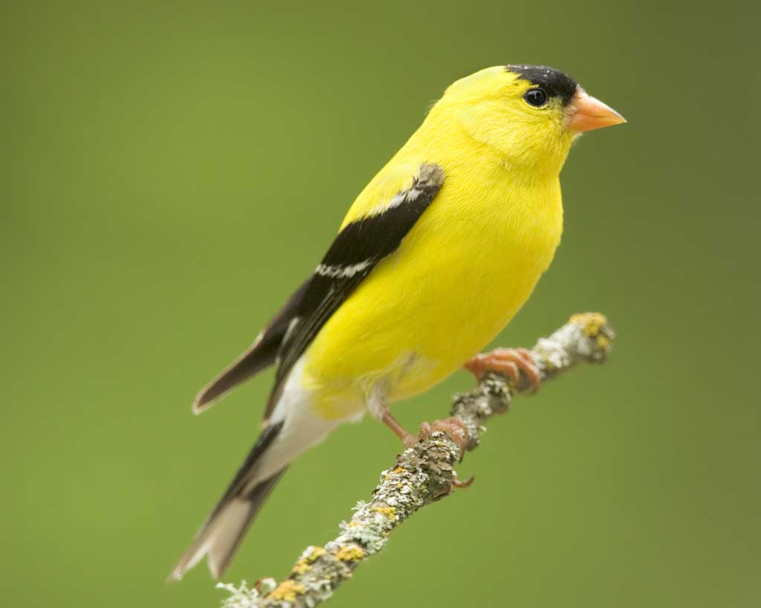
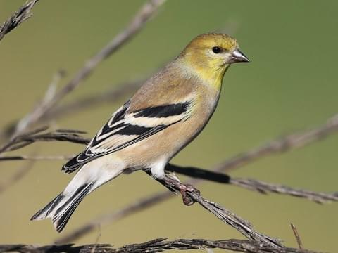
Do all birds look exactly alike?
How do birds look different from each other?
No!
Different bird species do NOT look alike!
Beaks come in many shapes and sizes depending on what the species eats.
Their legs can be different colors or lengths depending on its habitat.
Birds’ feet come in many shapes and sizes depending on what the bird eats and where it lives.
The color of a bird’s feathers depends on the species, and whether the bird is male or female.

Slide 5
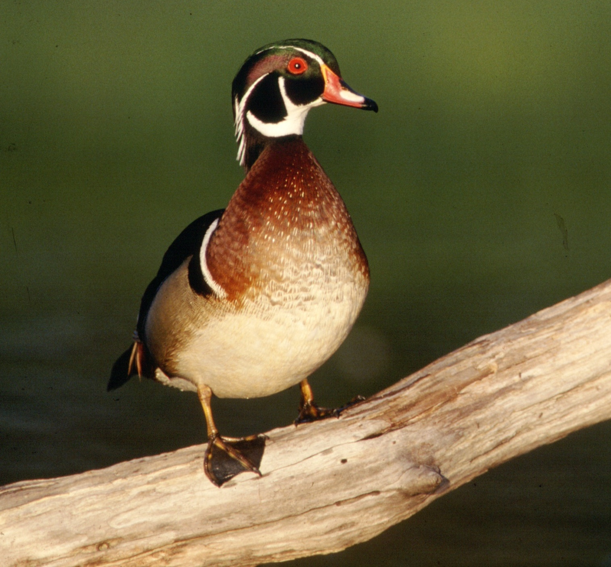
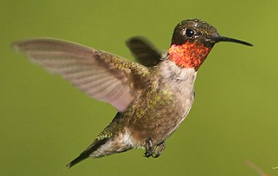
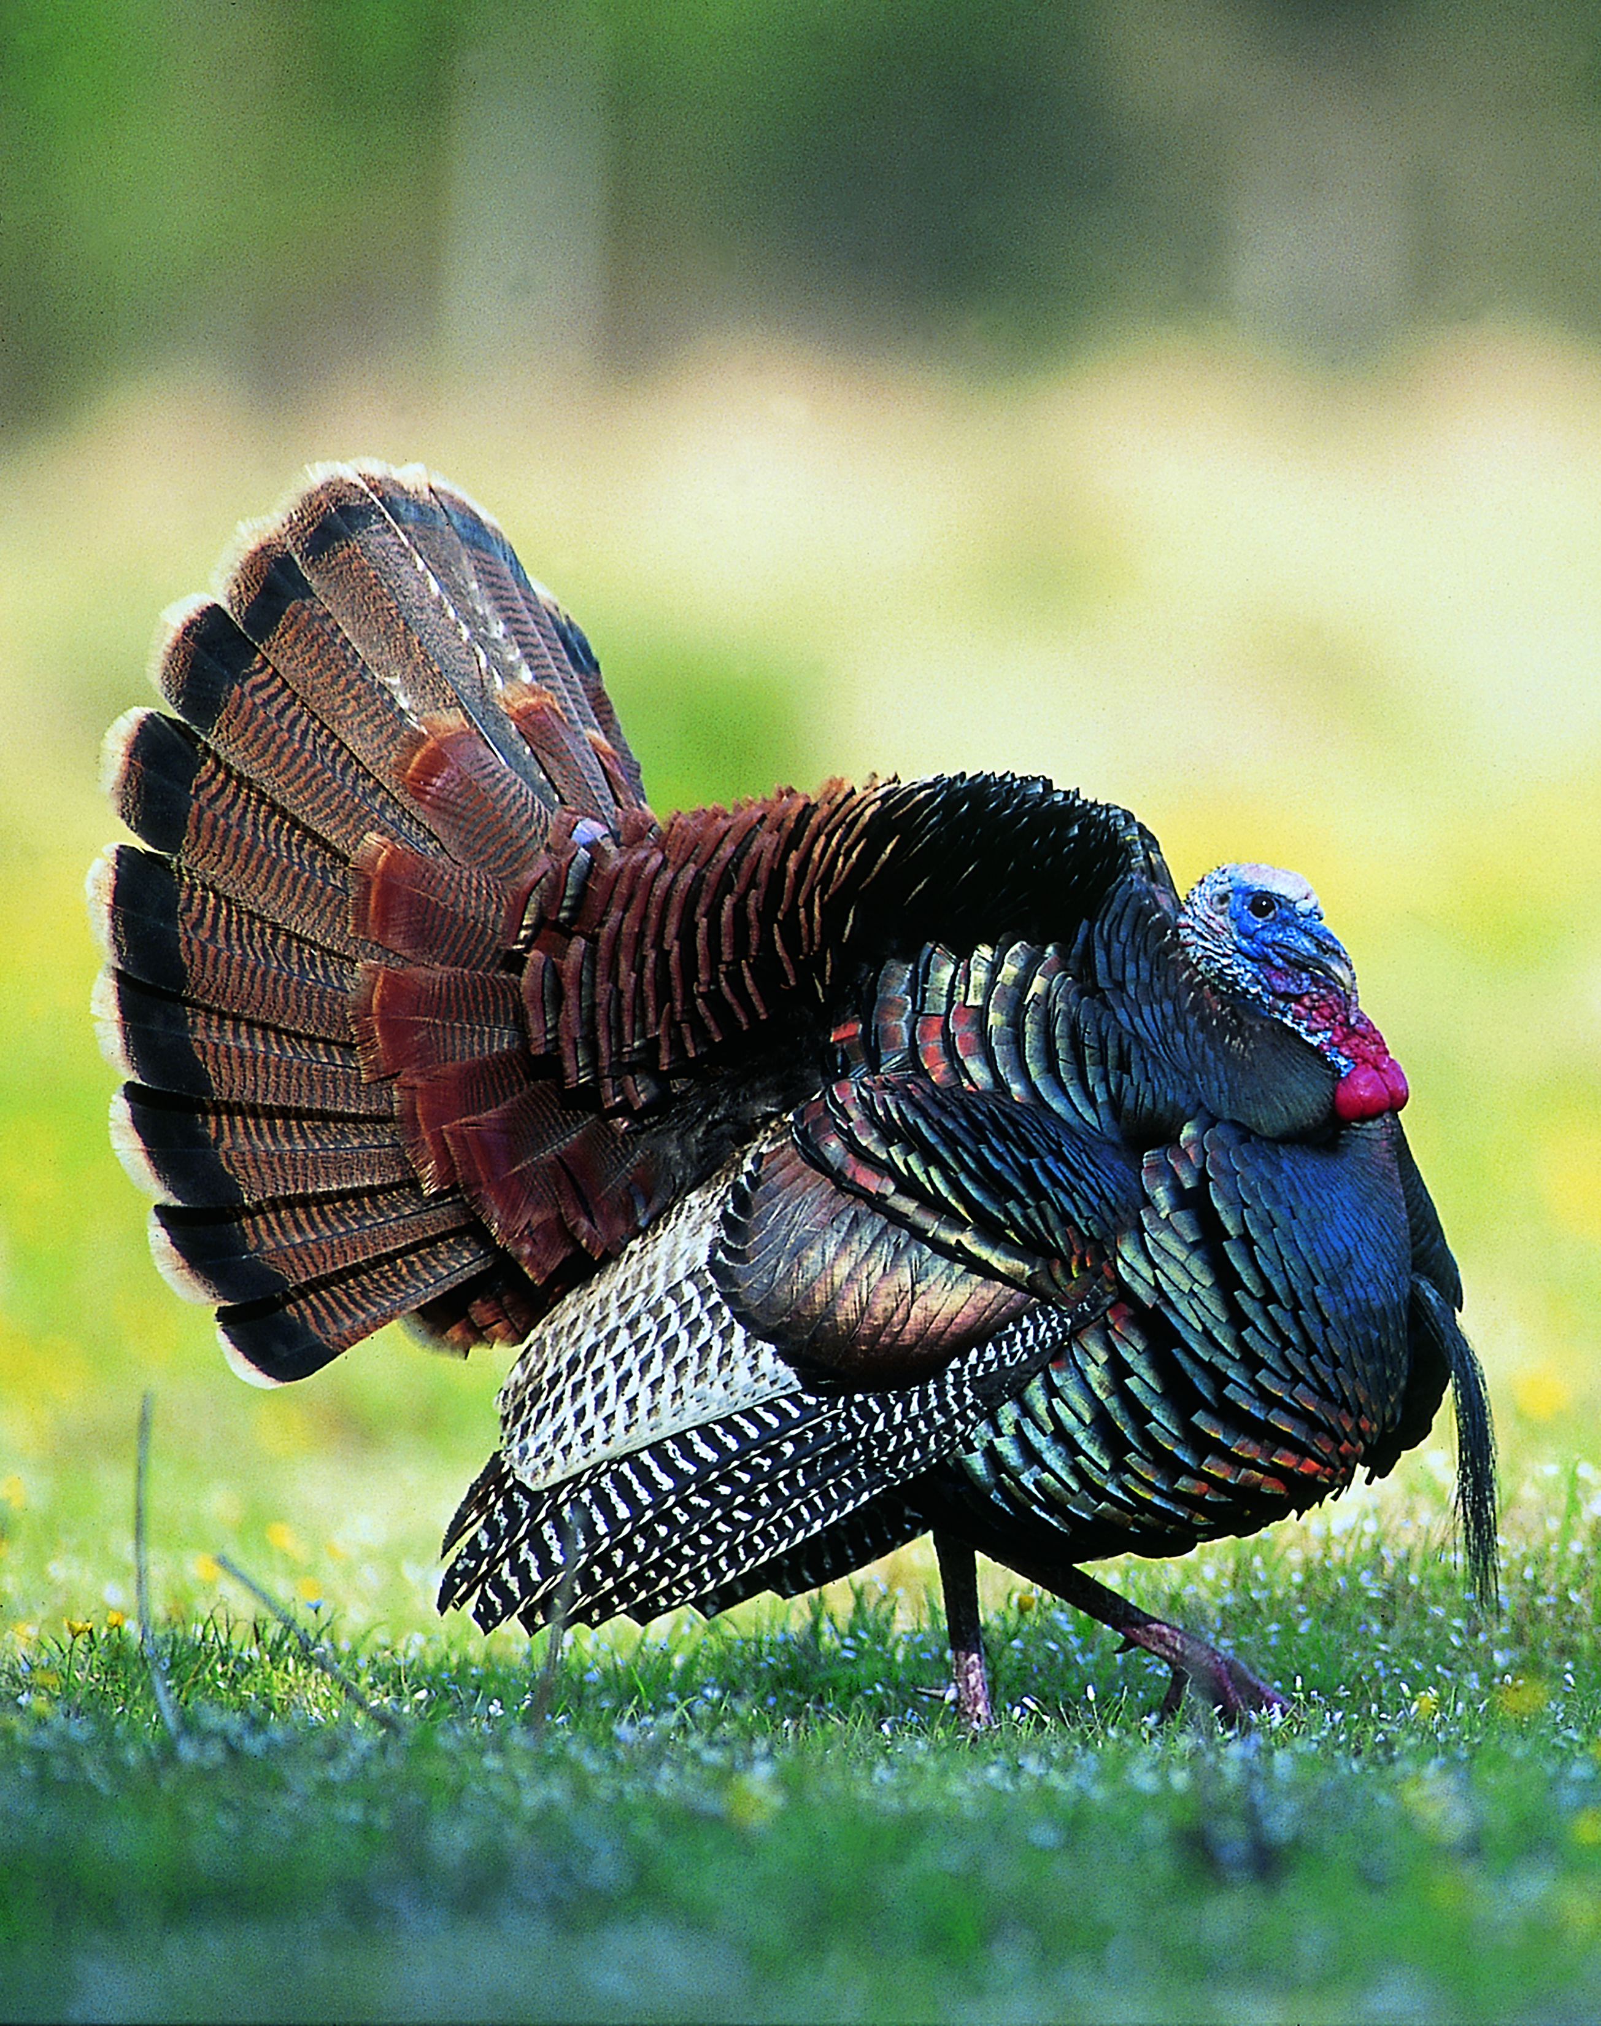
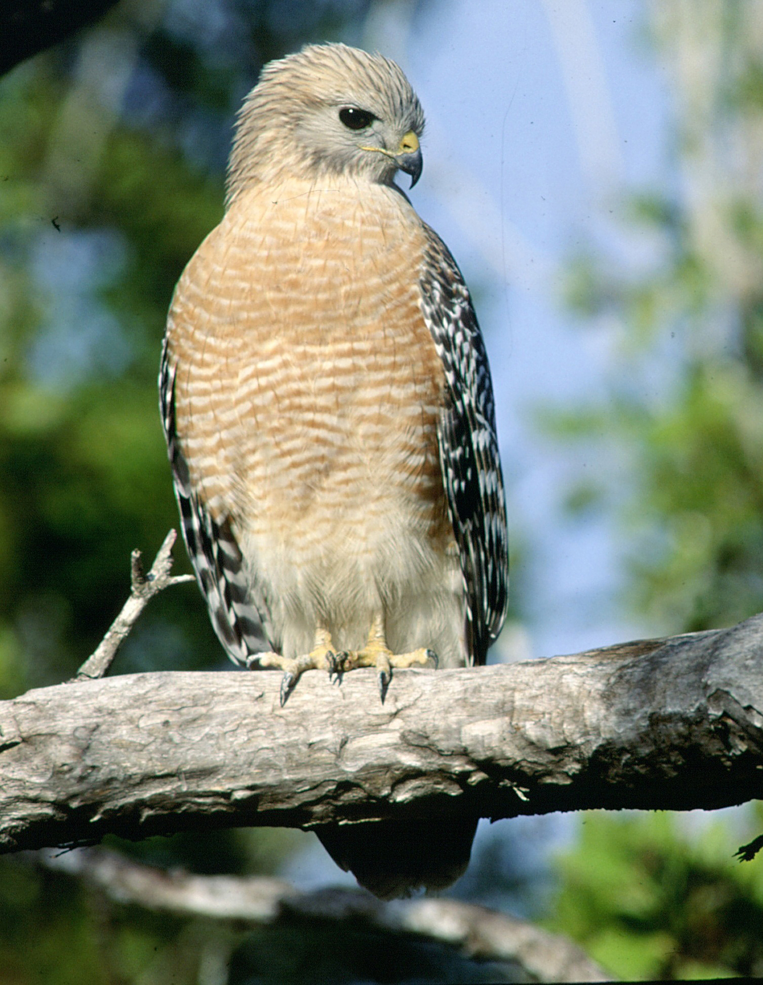
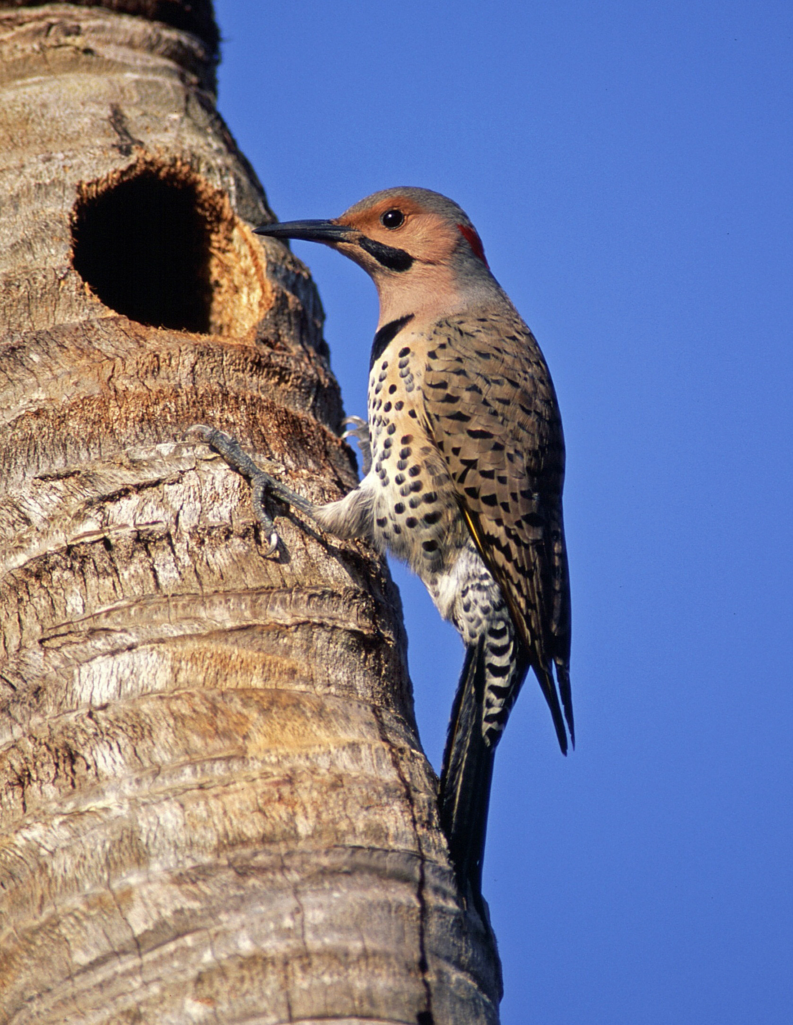
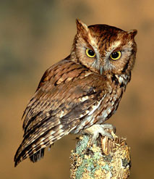
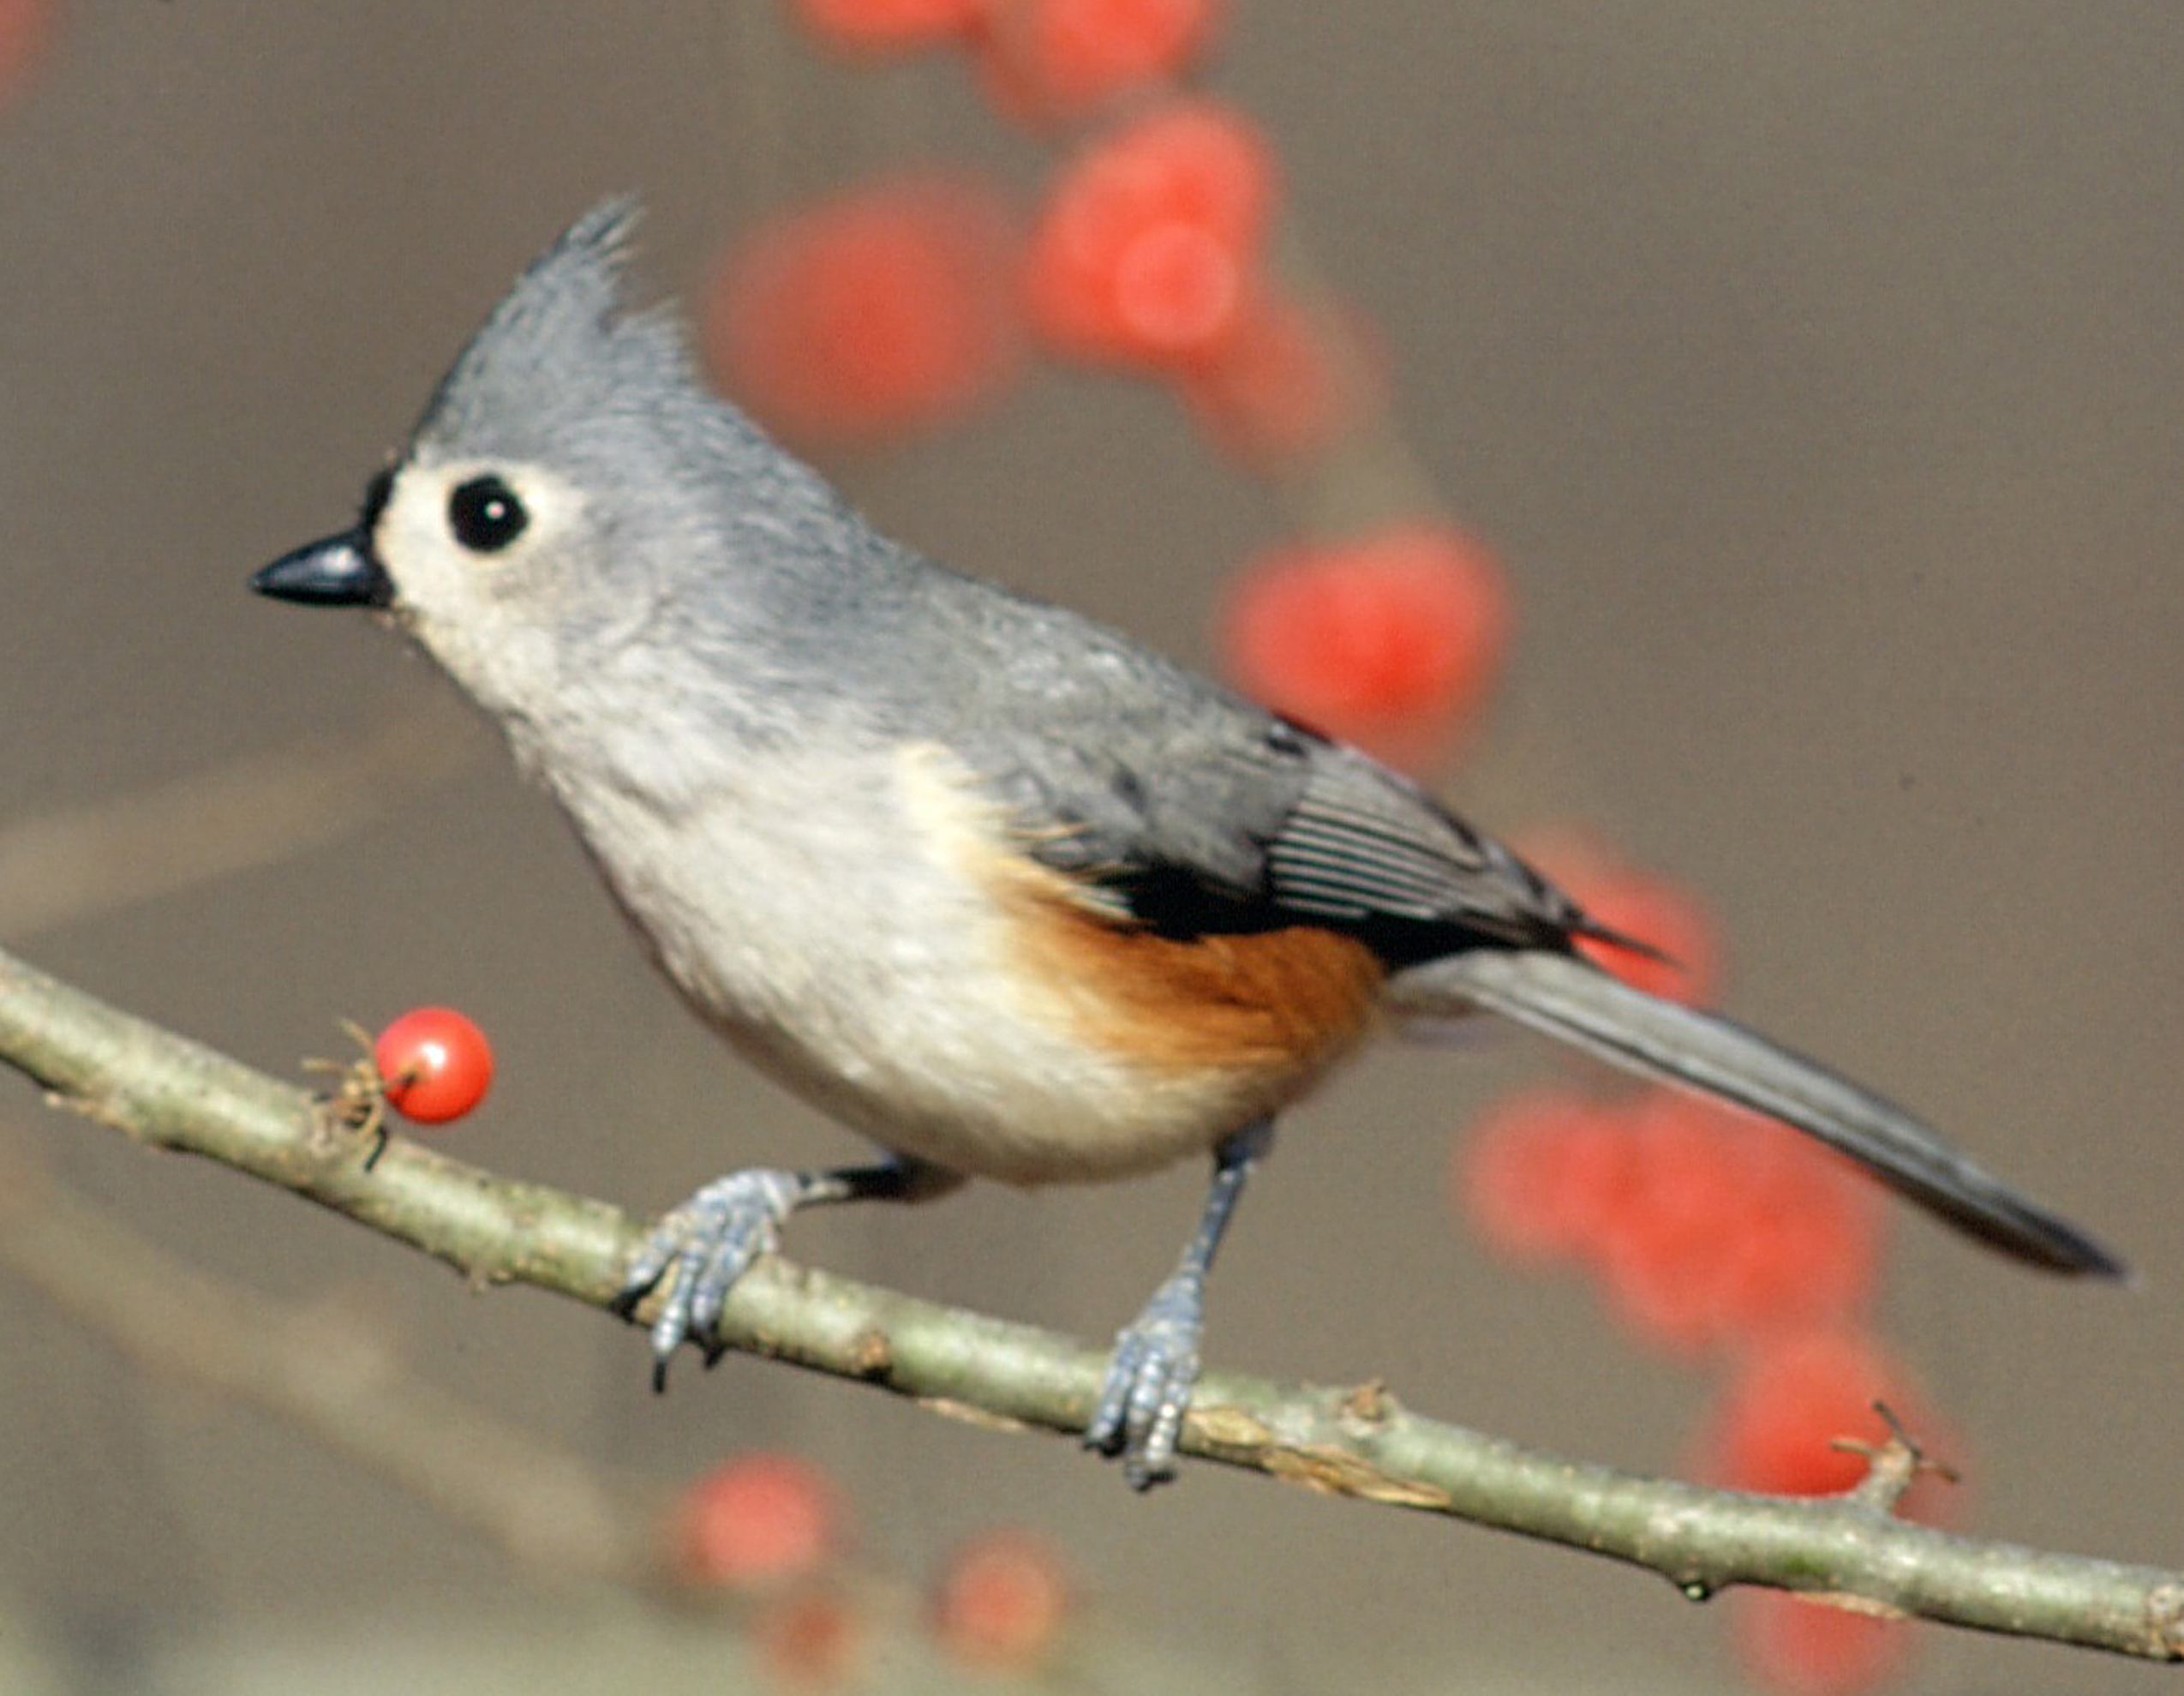
Why do birds look different from each other?
Scientists believe that over millions of years birds’ bodies and behaviors have changed and adapted to help them grow, reproduce and survive in a variety of habitats.
These physical and behavioral changes are called ADAPTATIONS.

Slide 6
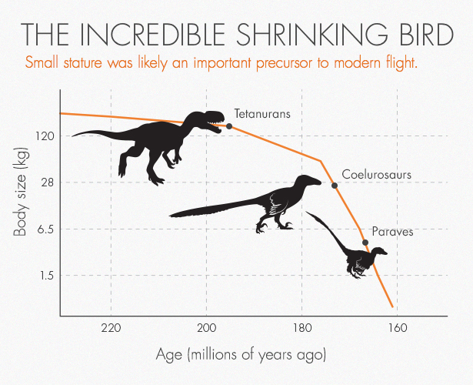
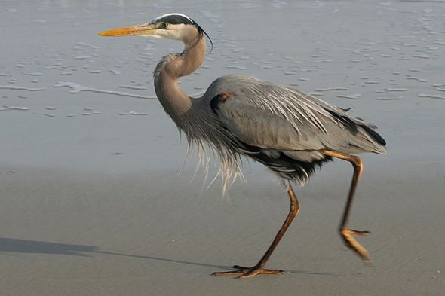
How have birds changed over time?
Scientists believe that dinosaurs evolved into birds!
Great Blue Heron
Their forelimbs (arms) slowly lost some of the functions such as grasping and gained other functions as they evolved into wings.
Over time they also grew feathers.

Slide 7
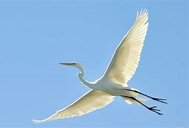
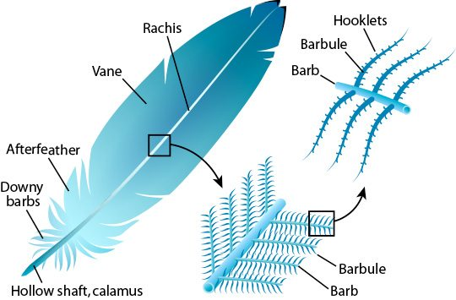
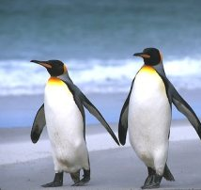
How do feathers help birds fly?
Great Egret
Feathers have long, thin barbs that come out from the shaft.
The barbs interlock like a zipper to create a smooth, flexible and resilient surface that makes flight possible.
Did you know?
Feathers are made of keratin, the same thing found in our hair and nails.
Although feathers are instrumental in helping birds fly, some birds such as penguins cannot fly.
The penguins’ feathers help protect their skin from water and provide insulation (like a coat) to keep them warm.

Slide 8
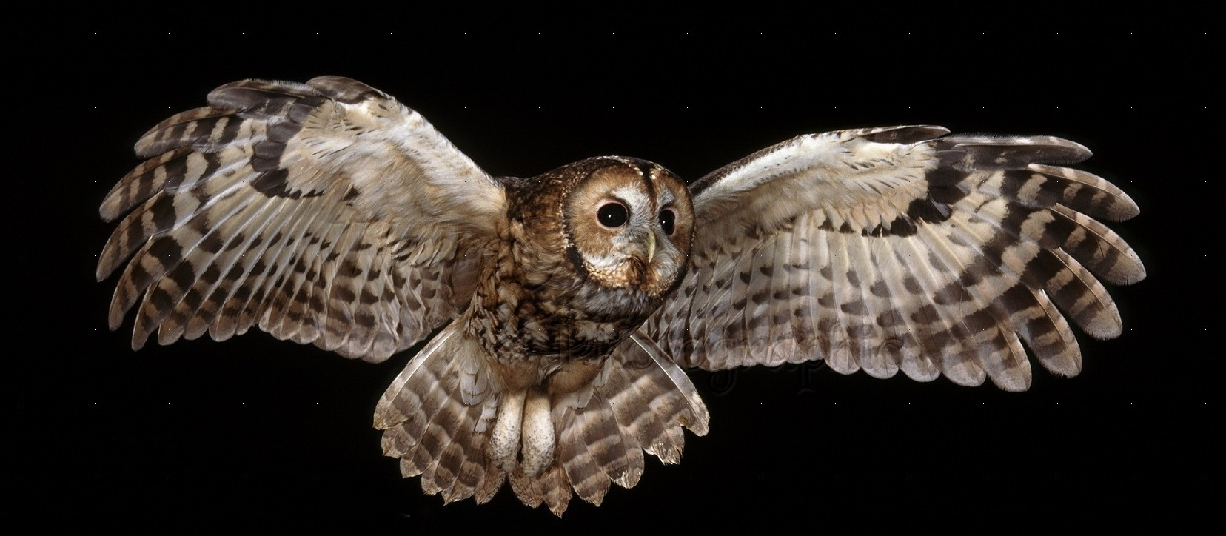
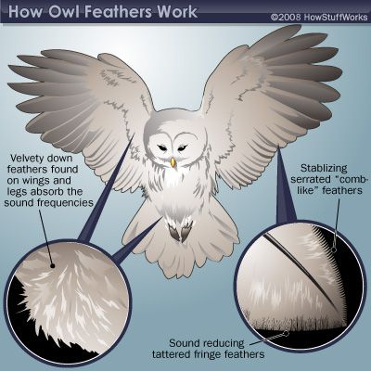
What other adaptations have taken place with birds’ feathers that help them survive?
Feathers can also vary in shape and purpose!
For example, owls have nearly silent wing feathers.
Barred Owl
They have comb-like serrations on the edge of their wing feathers that break up the air that typically creates a swooshing sound when a bird flaps its wings.
This helps owls approach their prey undetected.

Slide 9
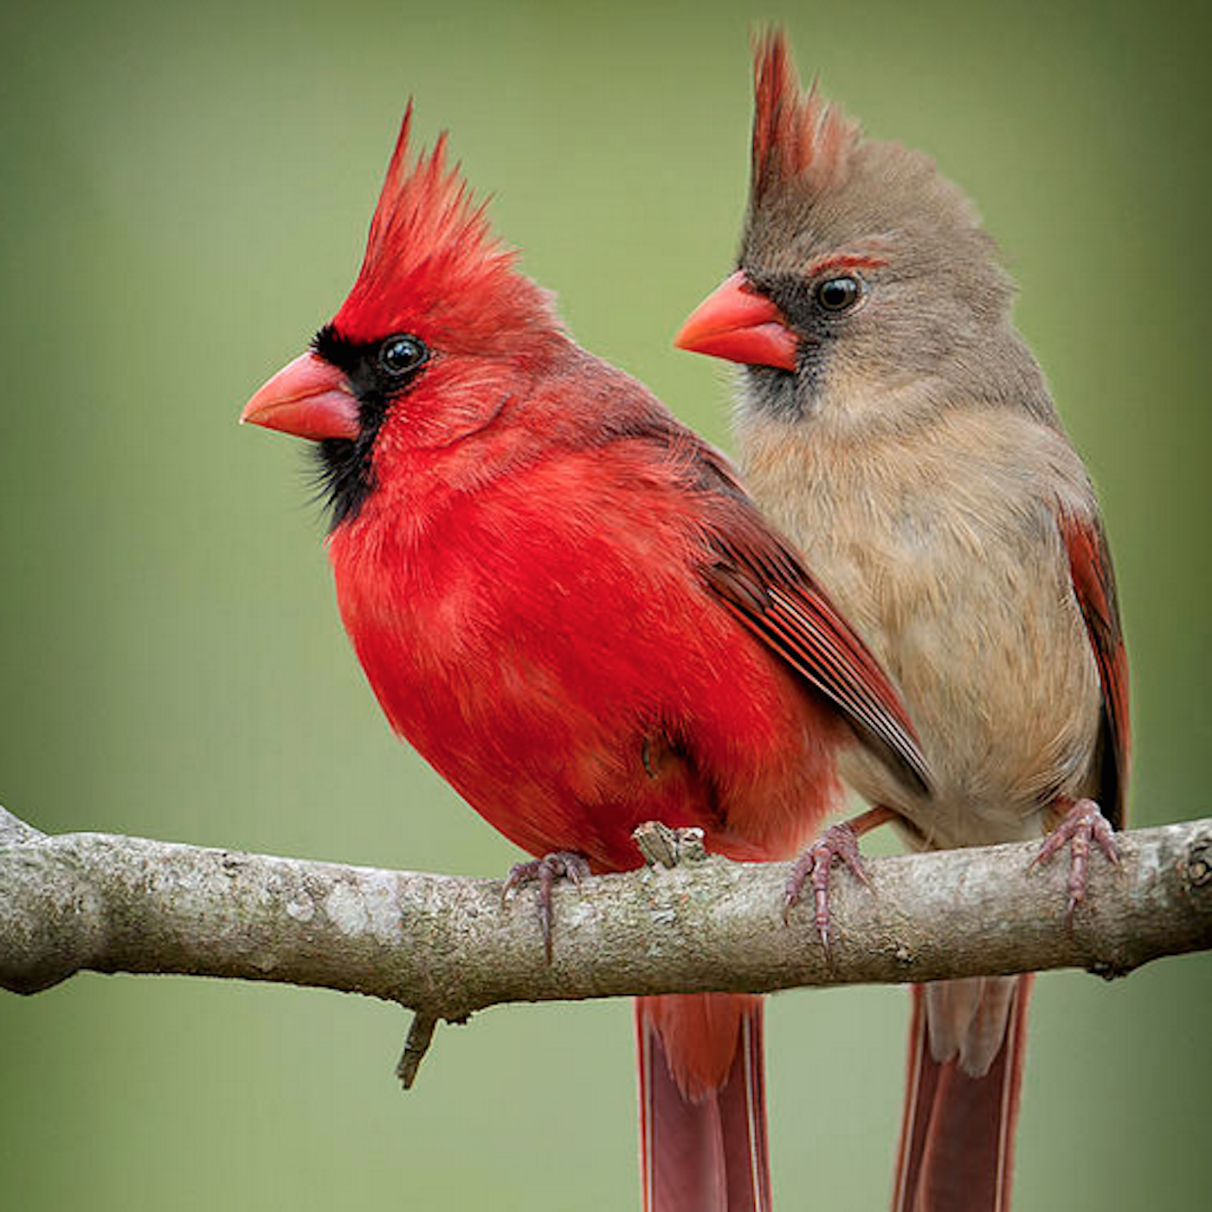
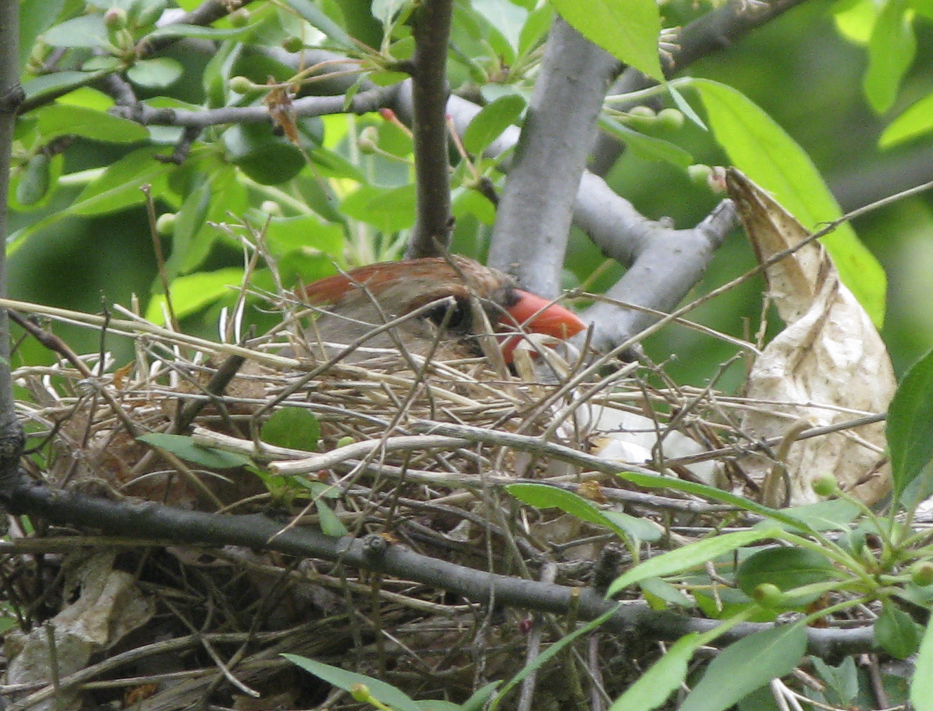
How does the color of birds’ feathers help them survive?
In many species the color of the male’s feathers are brighter than the female’s to help them attract a mate.
Also, the female’s muted colors help her blend in with her surroundings to provide camouflage to hide from predators while she sits on the nest.
Northern Cardinals
The male Eastern wild turkey has iridescent plumage (feathers) that become brighter in the sunlight to attract the females.
To attract females during mating season, the male will fan the feathers on his tail and then ruffle all the feathers on the rest of his body as it struts around the females.

Slide 10
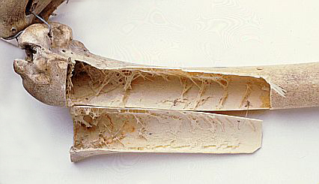
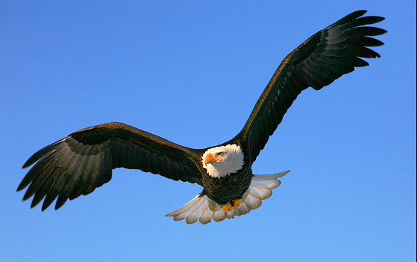
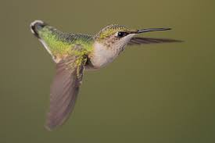
What is another adaptation that help birds fly?
A key adaptation that only birds have is hollow bones.
Our bones (like most animals’ bones) are dense with living tissue and minerals.
However, birds have hollow bones which make them weigh less and help them to fly.
Did you know?
The wingspan of a bald eagle is six feet but it only weighs 7-13 pounds!
Did you know?
Ruby-throated hummingbirds only weigh 0.1-0.2 ounces (same as a nickel), and they can fly over 500 miles without stopping.

Slide 11
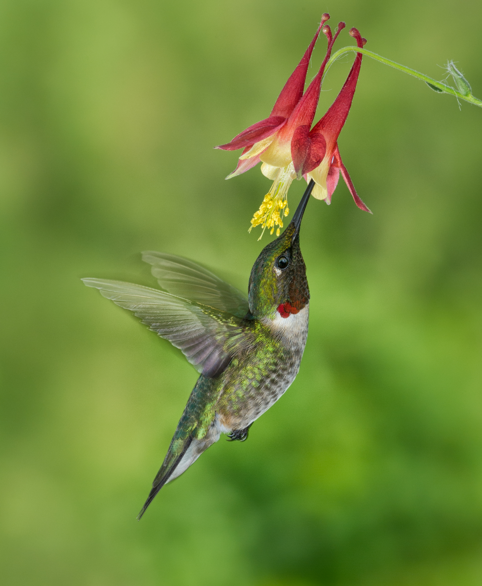
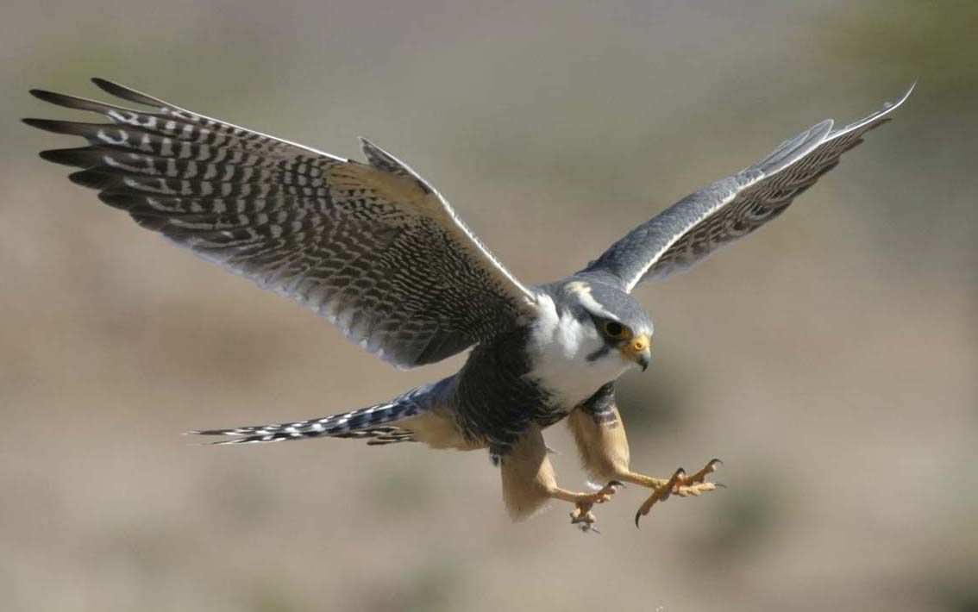
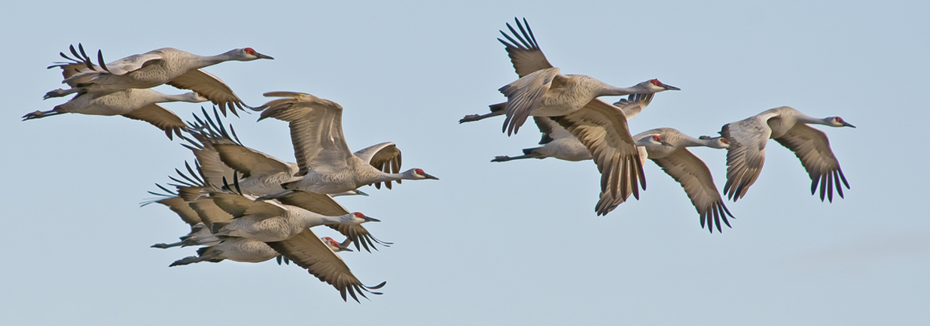
How does the ability to fly help birds survive?
Wings help birds escape from predators, hunt for food, and travel long distances in search of suitable habitat.
Birds of prey like the peregrine falcon are able to hunt from high in the air, diving towards the ground quickly when prey is spotted, grasping the targeted prey with their talons (claws).
Unlike most birds, hummingbirds move their wings forwards and backwards in a figure-8 pattern that allows them to hover and fly backwards as they search for nectar.
Sandhill Cranes

Slide 12
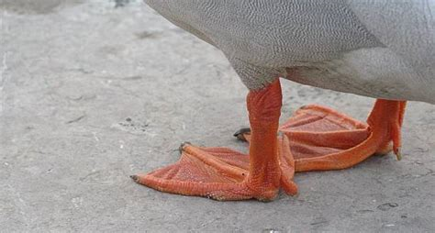
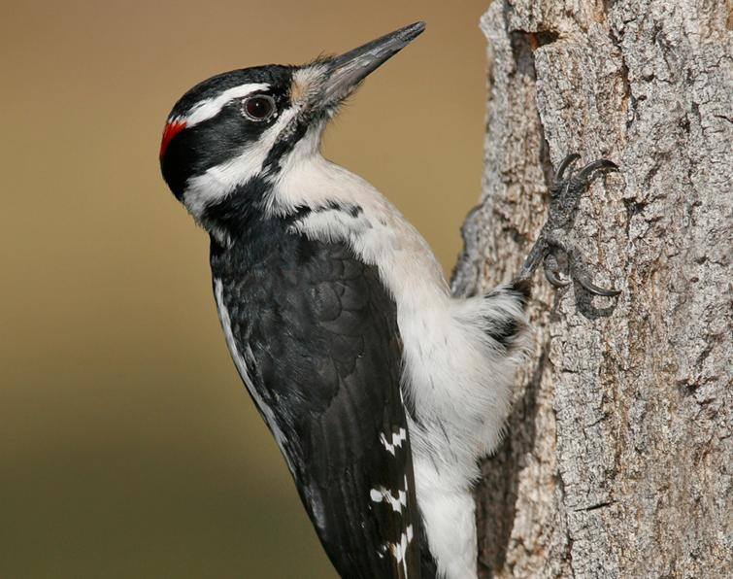
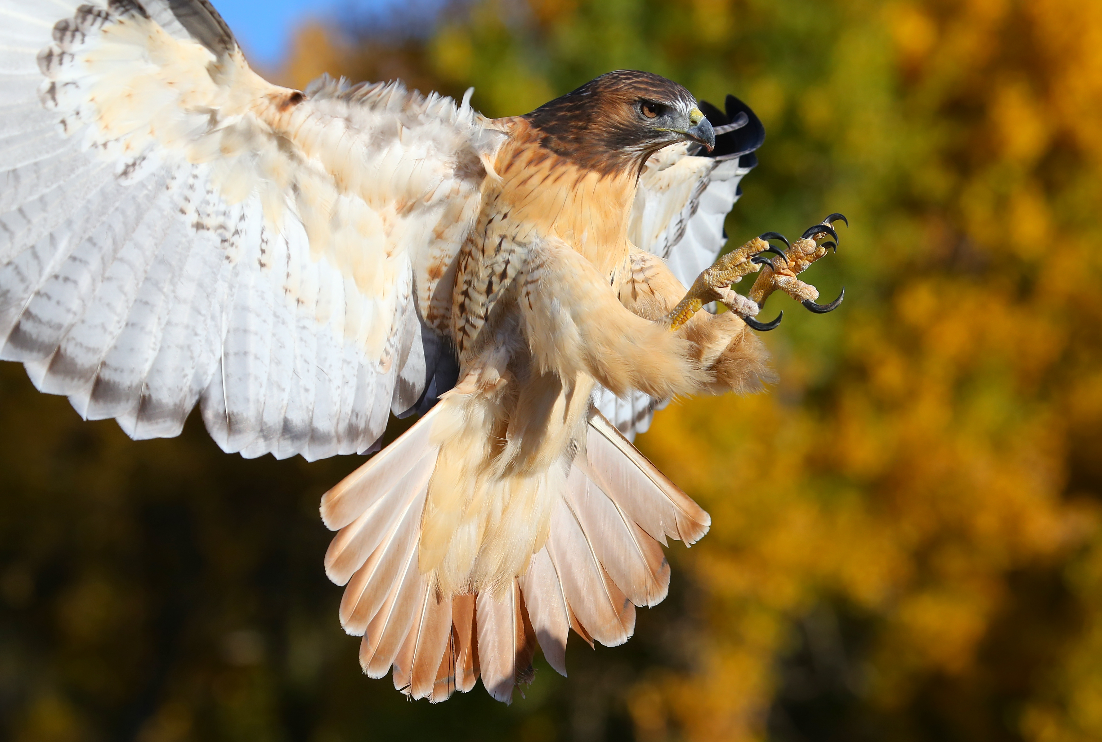
How do birds’ feet look different from each other? How do these differences help them survive?
Most birds have three to four toes, and the placement of the toes depends on the species of bird.
Many species of waterfowl have webbing between their toes which helps them move through water such as this duck.
Hairy woodpeckers have two toes in front and two behind which helps them grasp the bark of a tree.
Birds of prey such as hawks have three toes forward and one back with very large talons (claws) used to grasp prey.

Slide 13
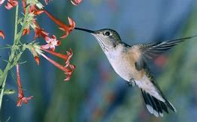
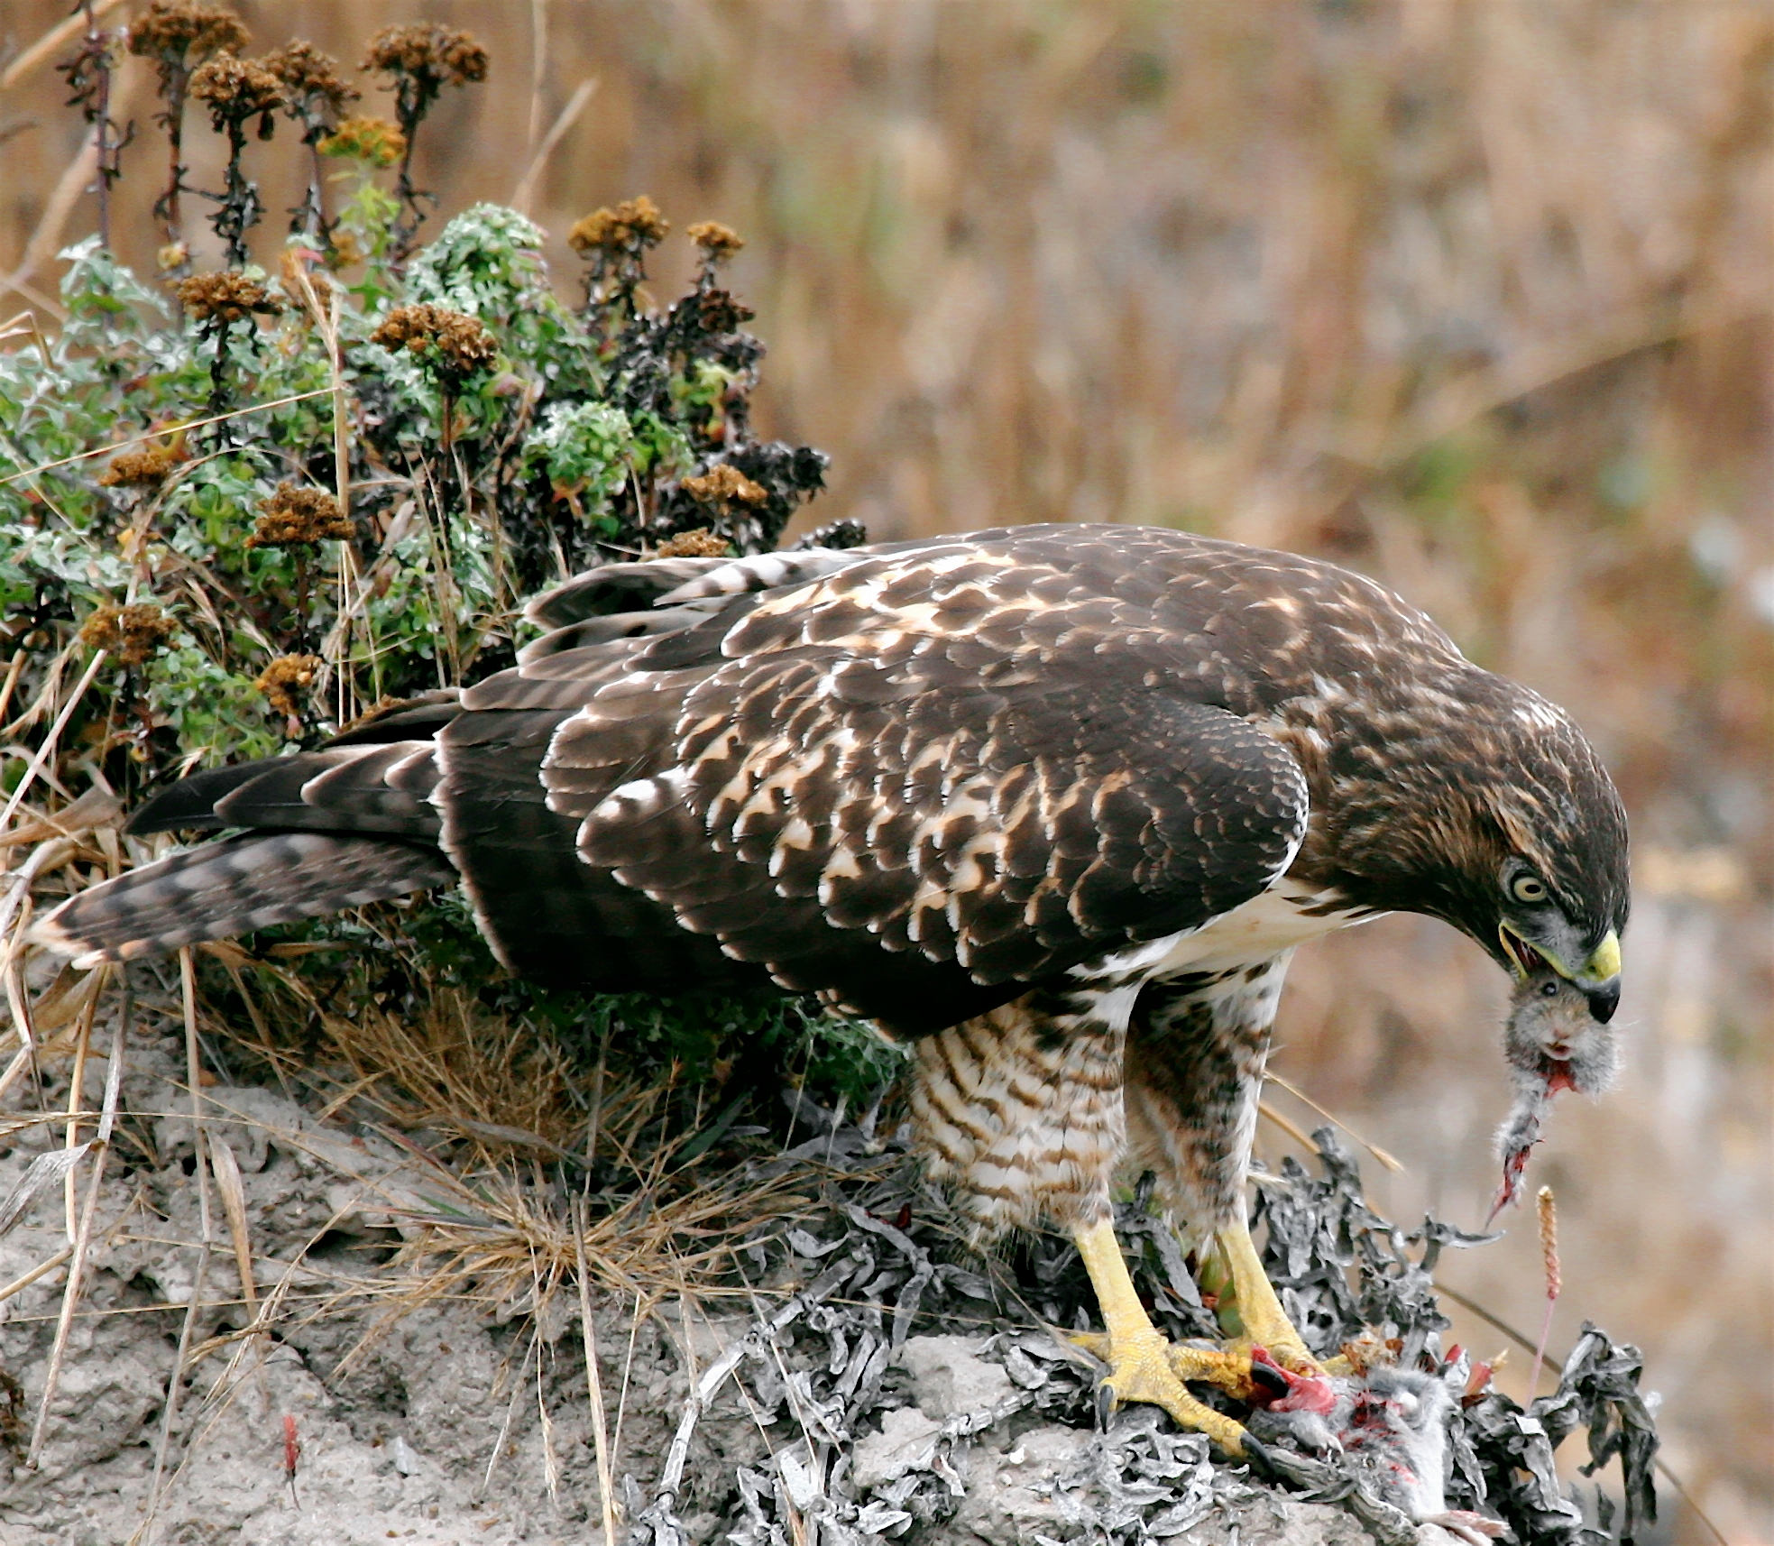
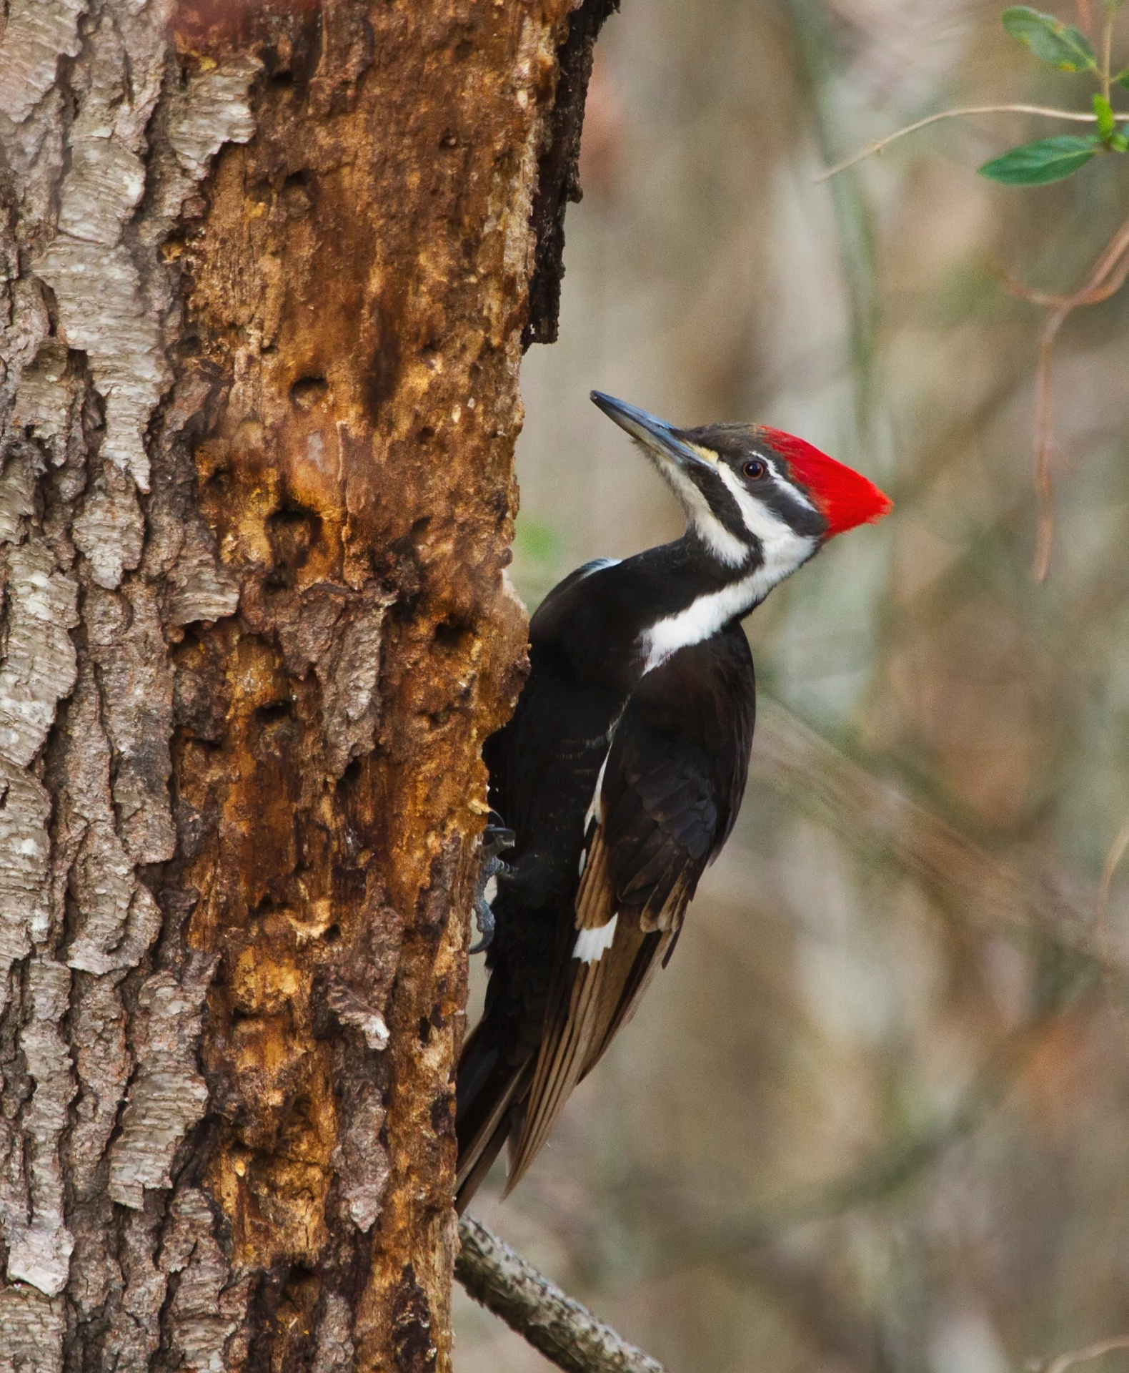
Are all birds’ beaks the same?
No! Bird’s mouths have evolved into beaks (also called bills) that do not have teeth, and differ from one bird species to another based on what they eat.
Hummingbirds have long beaks and tubular tongues (called a proboscis) for reaching deep into a flower to reach the nectar within.
Birds of prey such as hawks use their beak to help tear prey apart for food.
Woodpeckers like this pileated woodpecker use their beak to break apart dead trees as they look for insects.
The tufted titmouse has a short thin beak for eating insects, seeds and berries.

Slide 14
What is another adaptation that helps birds survive?
Another adaptation that many birds have developed is excellent eyesight.
Birds’ eyes are larger than ours in comparison to our body size.
Birds can see objects in fine detail 2 ½ to 3 times farther away than people can.
The Eastern screech owl’s big, round eyes helps it hunt at night.
Hawks like the red-shouldered hawk uses its sharp eyesight to capture prey.
They can also see a greater variety of colors and light far beyond that of humans.

Slide 15
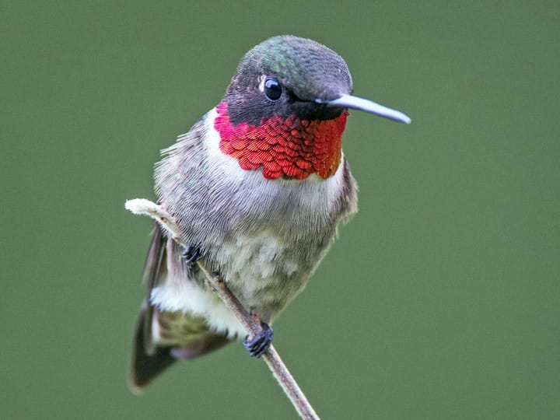
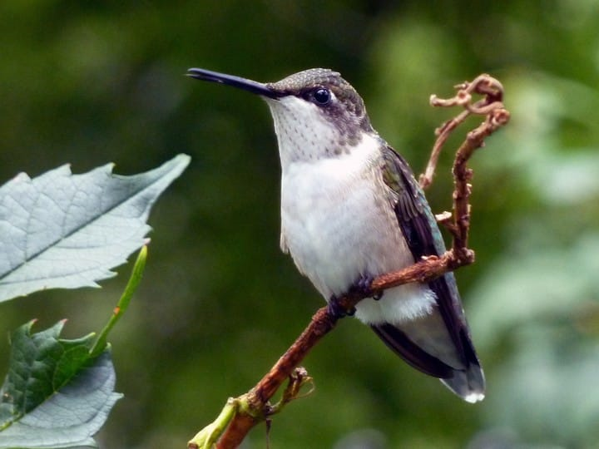
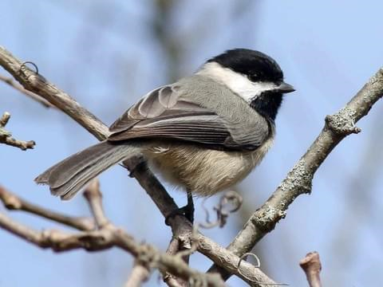
What types of bird species could we find living in our outdoor classroom?
Slide 1 of 4
There are many species of birds that can be spotted around your school’s outdoor classroom. Here are a few of the more common species that you may see from smallest to largest.
(Male)
(Female)
Ruby-throated Hummingbird
Length: 2.8 - 3.5”
Carolina Chickadee
Length: 3.9 - 4.7”

Slide 16
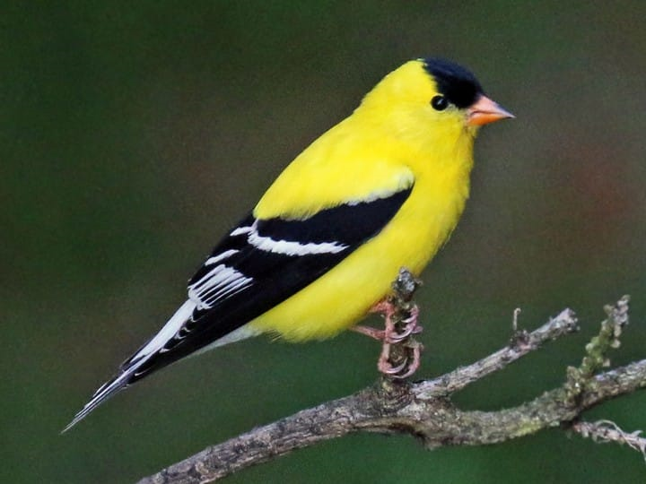
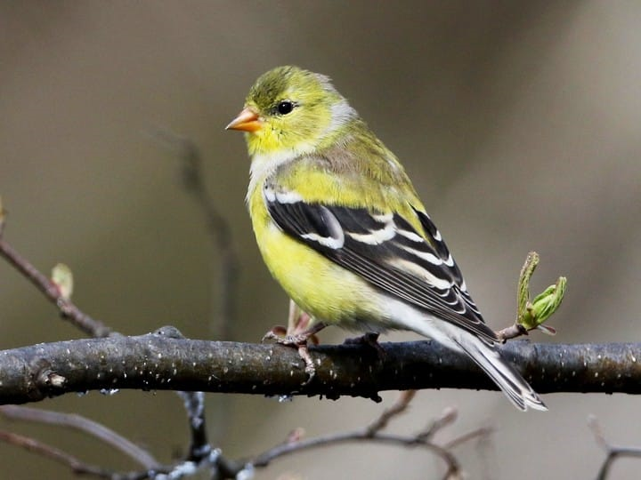
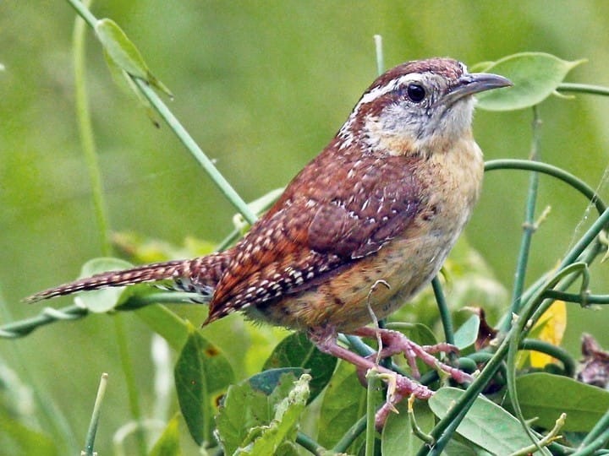
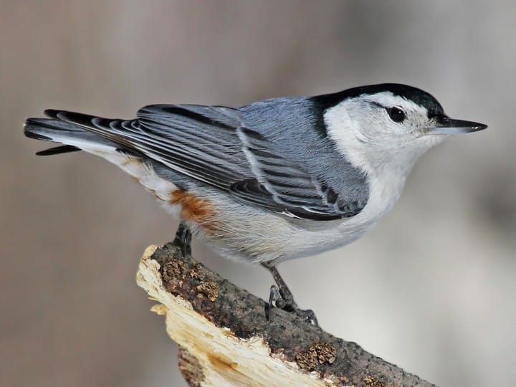
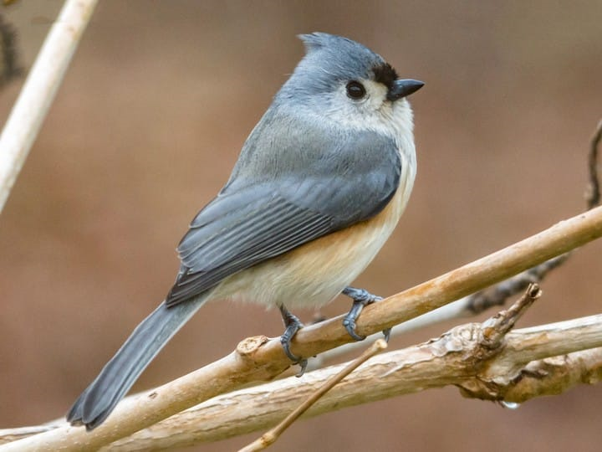
More Common Backyard Birds…
Slide 2 of 4
(Male)
(Female)
Carolina Wren
Length: 4.7 – 5.5”
American Goldfinch
Length: 4.3 – 5.1”
White-breasted Nuthatch
Length: 5.1 - 5.5”
Tufted Titmouse
Length: 5.5 – 6.3”

Slide 17
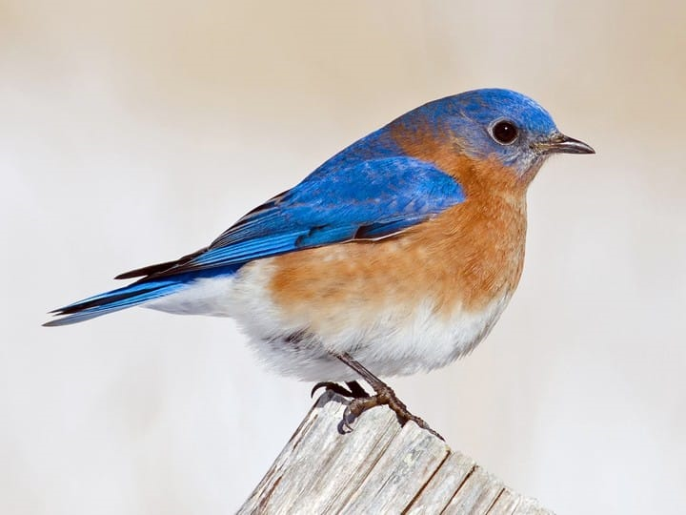
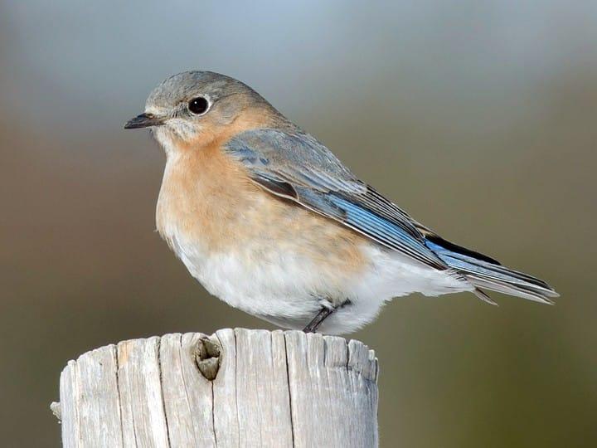
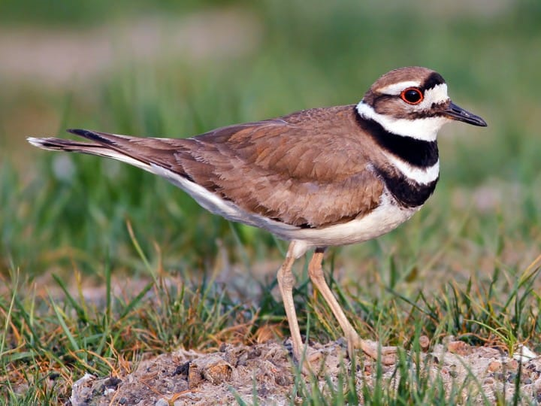
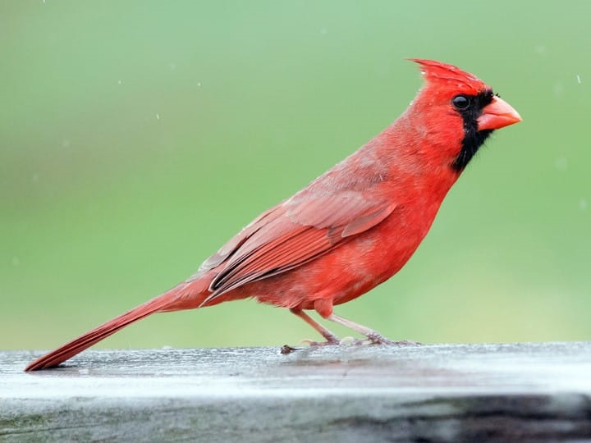
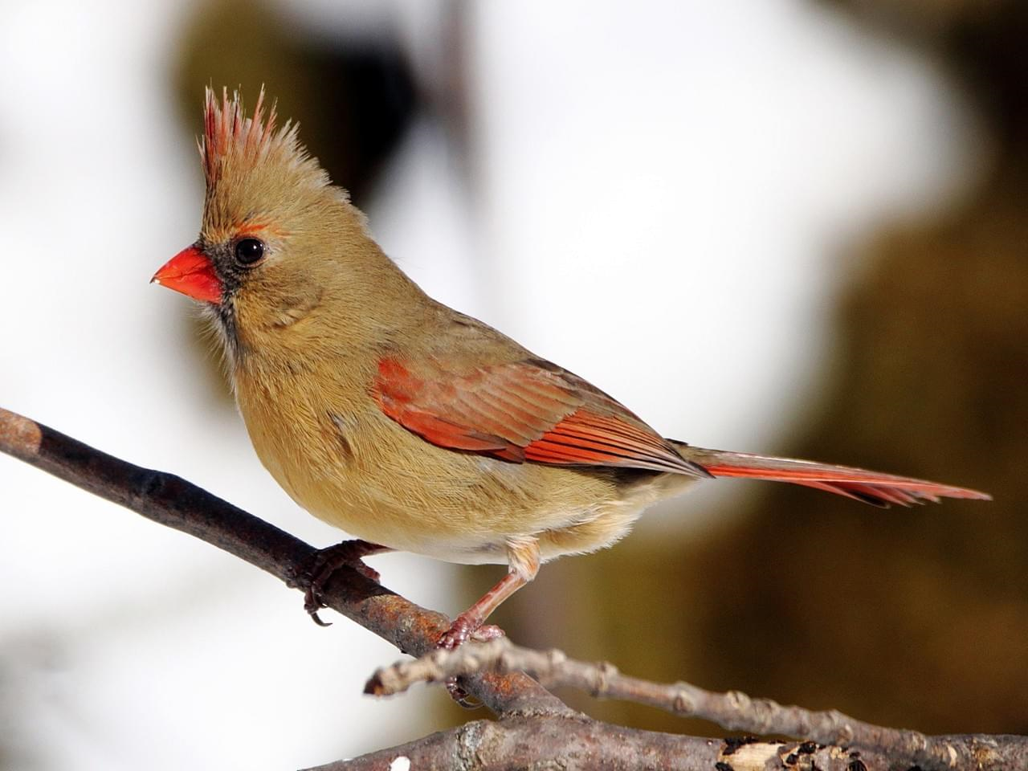
More Common Backyard Birds…
Slide 3 of 4
(Female)
Killdeer
Length: 7.9-11.0”
(Male)
Eastern Bluebird
Length: 6.3 - 8.3”
(Male)
(Female)
Norther Cardinal (AKA “Red Bird”)
Length: 8.3 – 9.1”

Slide 18





More Common Backyard Birds…
Slide 4 of 4
American Robin
Length: 7.9 – 11.0”
Mourning Dove
Length: 9.1 – 13.4”
Red-bellied Woodpecker
Length: 9.4 – 11.0”
Blue Jay
Length: 9.8 – 11.8”
Did you know?
The Northern flicker is Alabama’s State Bird.
Northern Flicker (“AKA Yellow Hammer”)
Length: 11.0 – 12.2”
For additional information on birds, go to
https://www.allaboutbirds.org/

