Slide 1

Comparing Adult to Offspring
Alabama Wildlife Federation Habitat Lab Field Journal Activity
To use this interactive PowerPoint with your students:
Click on “Enable Editing.”
Click the “Slide Show” tab at the top of the screen.
Then choose “From Beginning” from the menu.

Slide 2
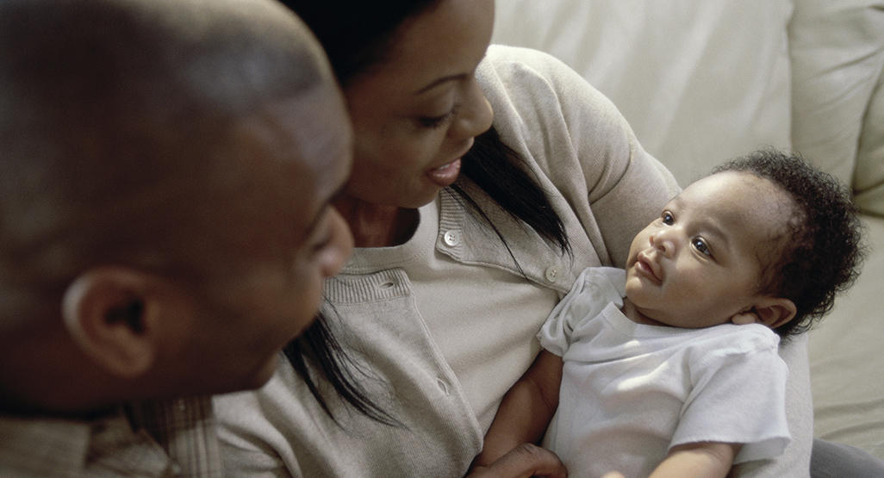
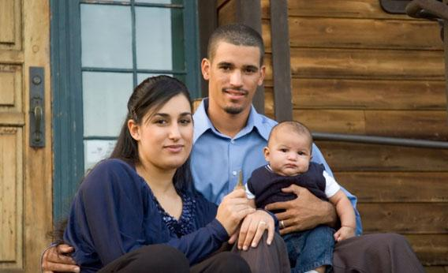
When a human baby is born, does the baby look like an exact copy of the parents?
Although some babies look a lot like their parents, they are not exact copies of their parents.

Slide 3

How do children look similar to their parents?
How do they look different from their parents?
Similar
2 legs
2 arms
2 ears
2 eyes
Different
hair color
eye color
height
weight

Slide 4
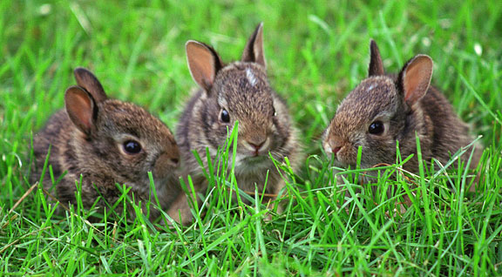
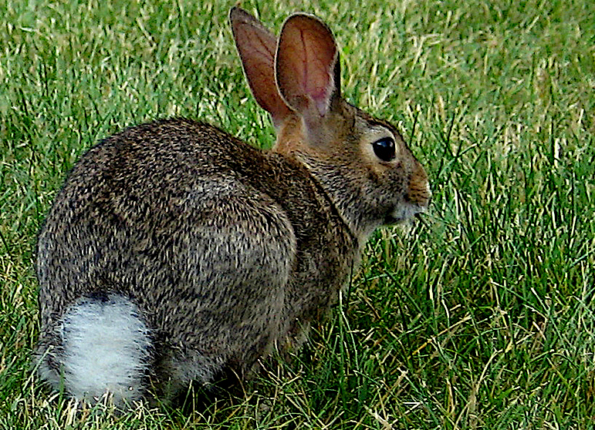
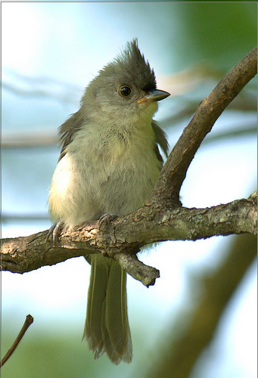
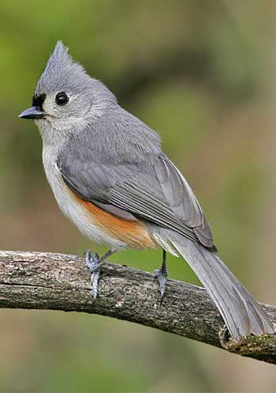
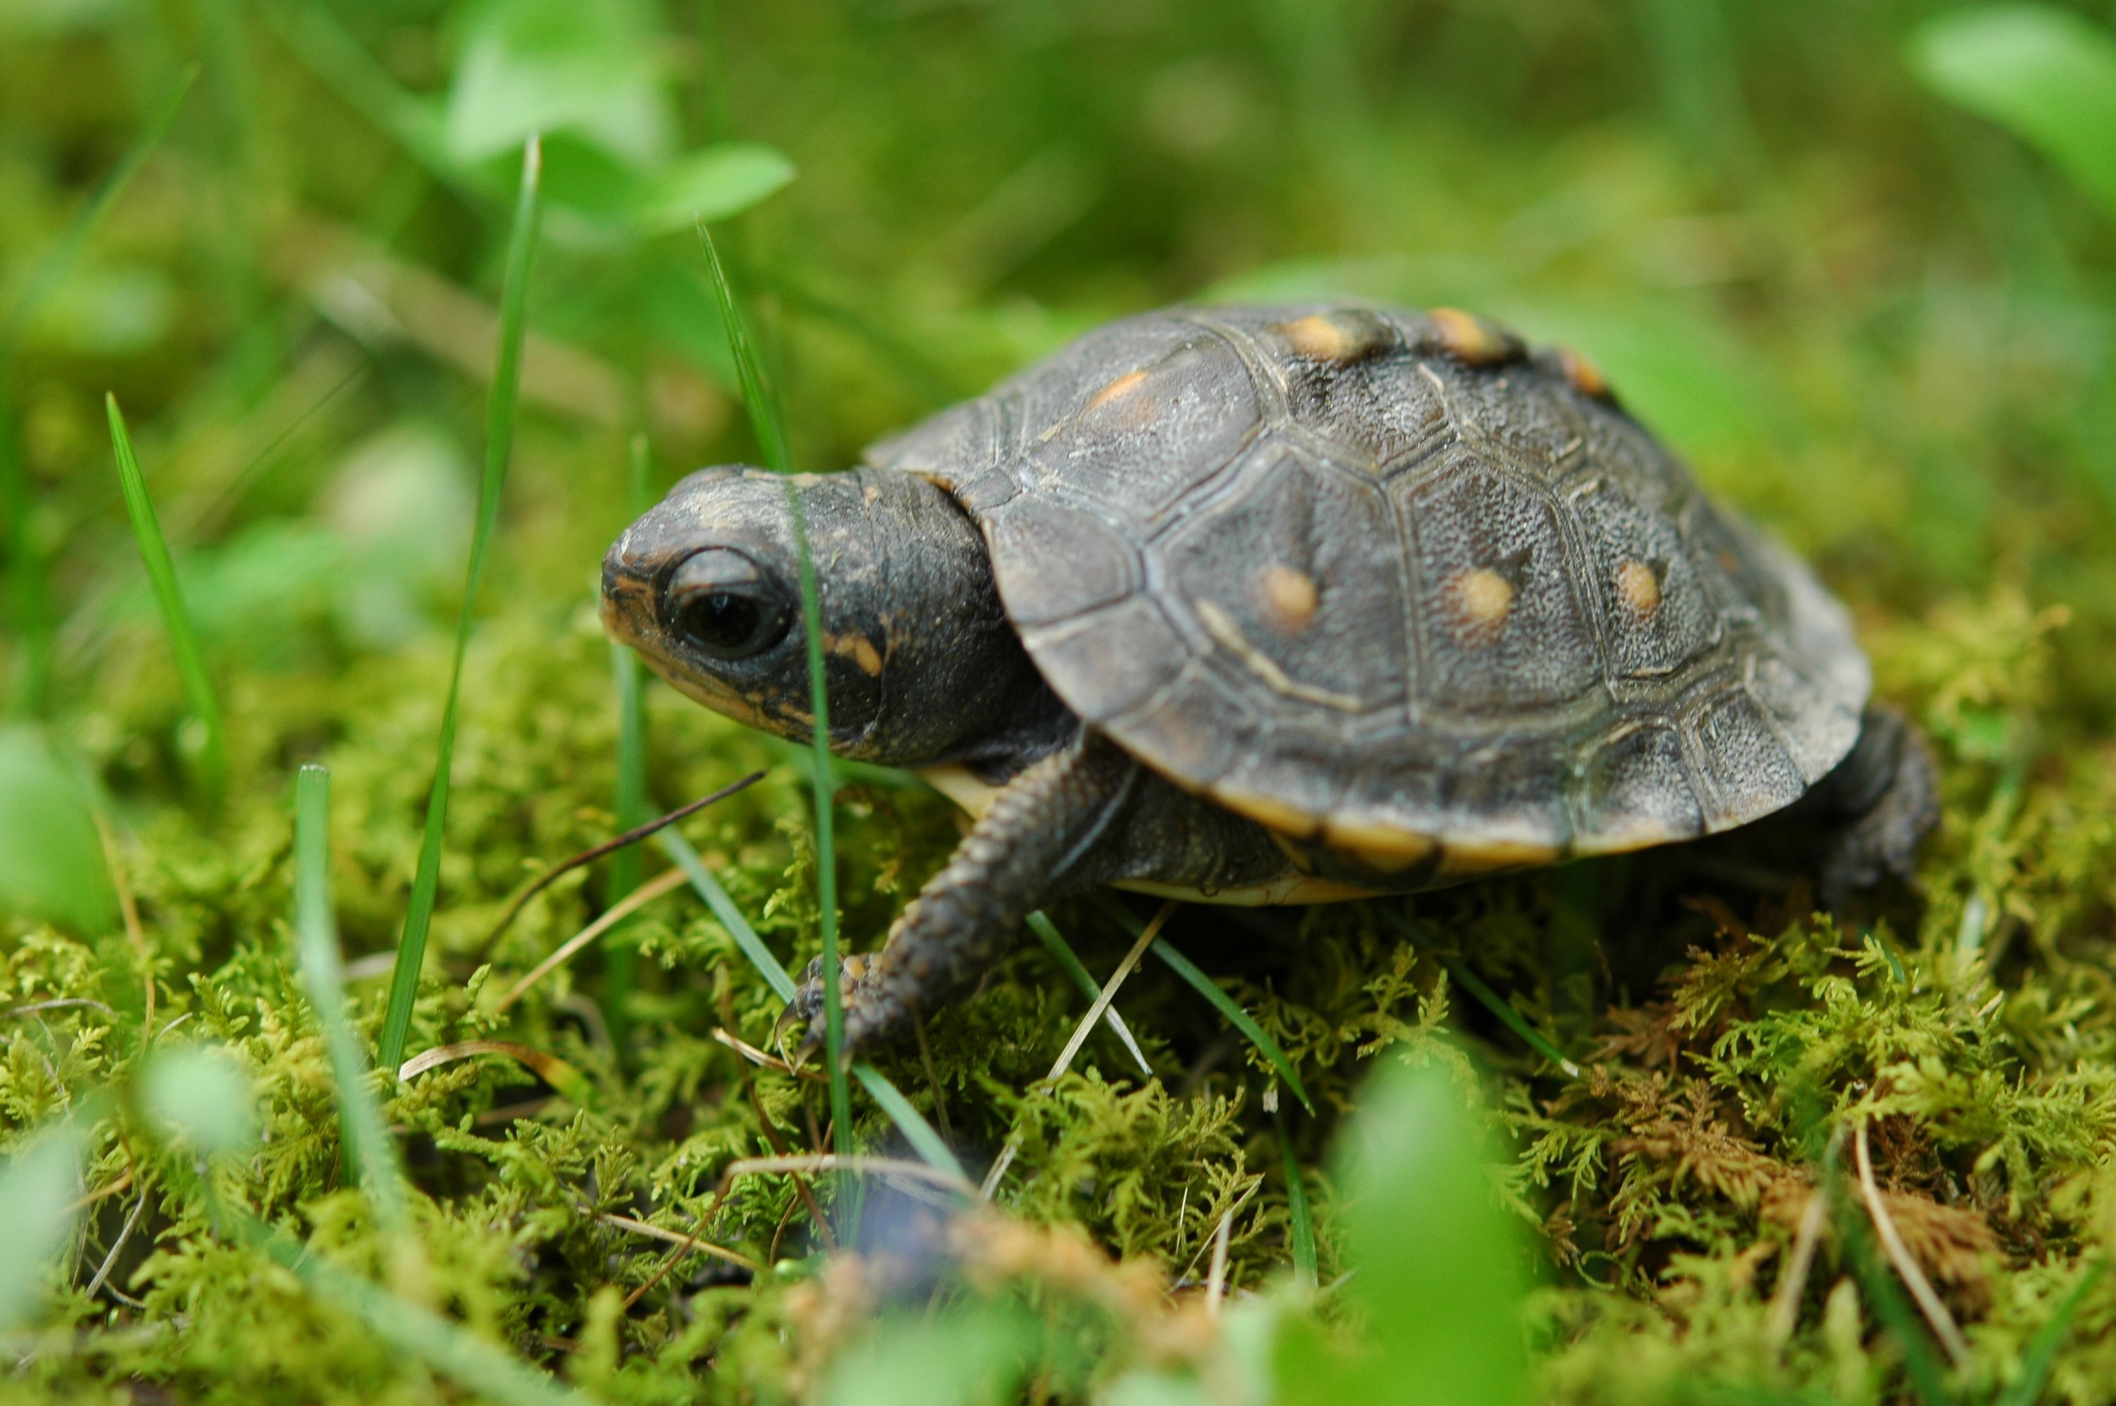
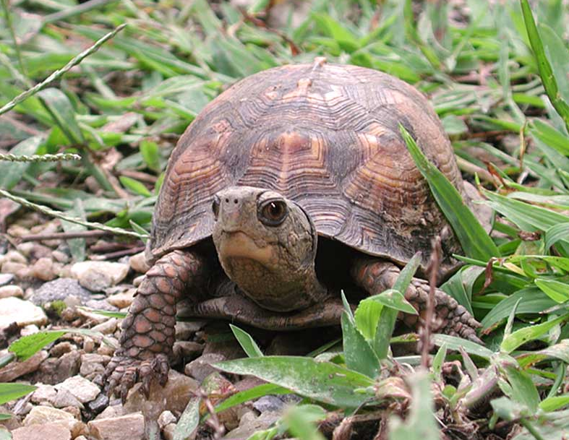
What are other examples of animals that look similar as offspring and adult parents?
rabbits
songbirds
turtles

Slide 5
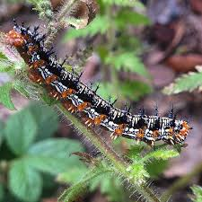
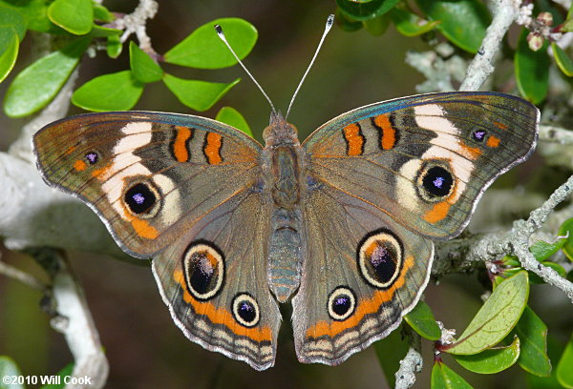
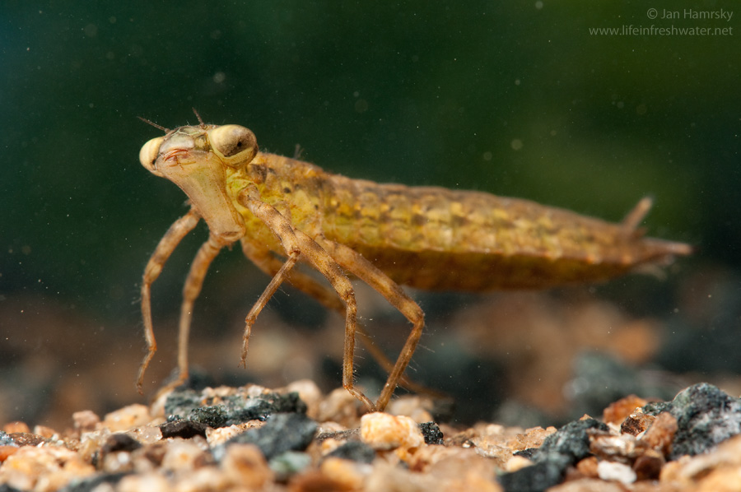
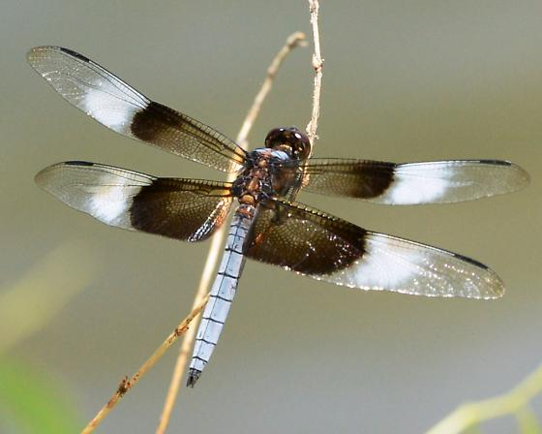
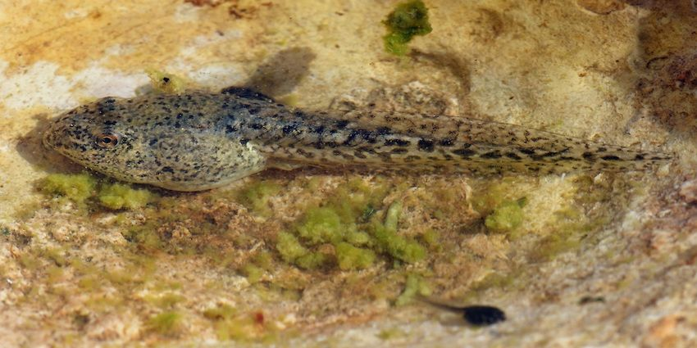
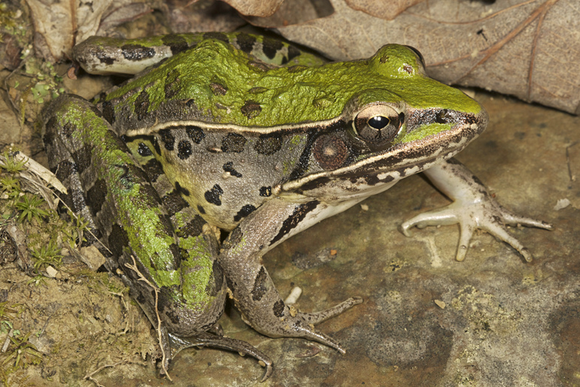
Which animals look different as offspring and adults?
caterpillar and butterfly
nymph and dragonfly
tadpole and frog

Slide 6
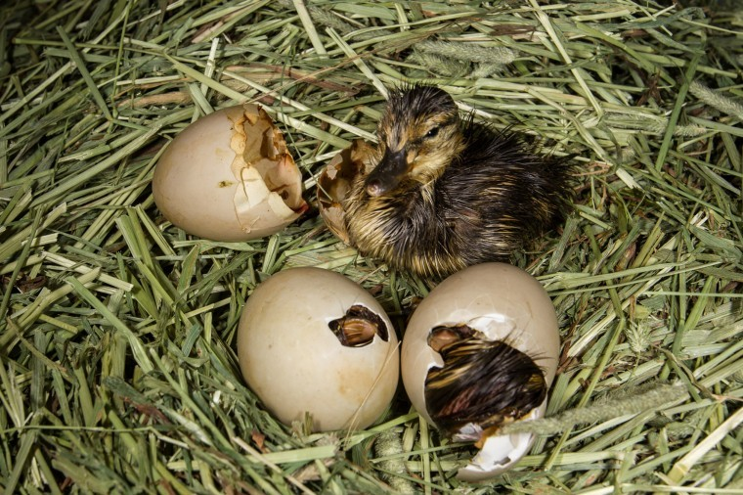
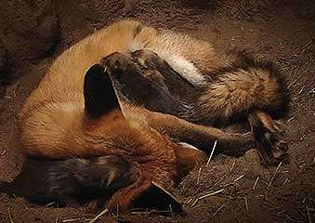
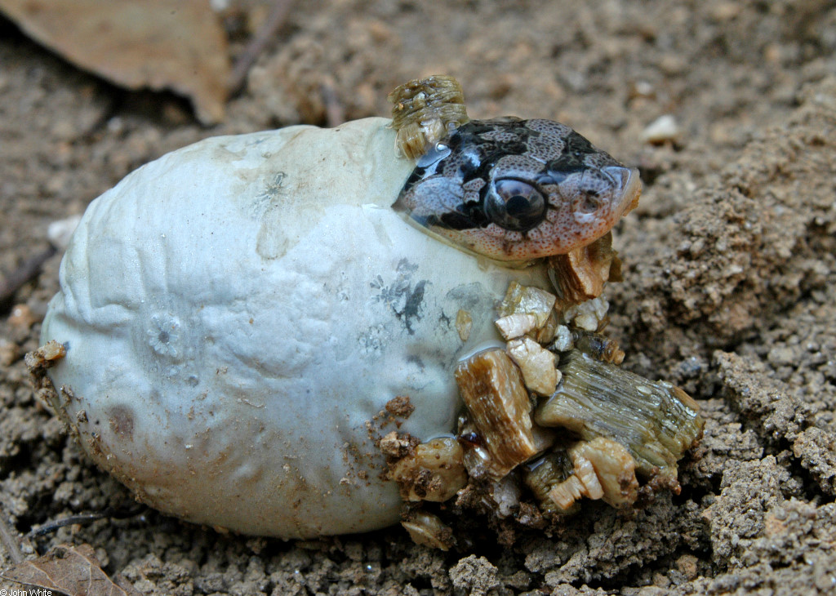
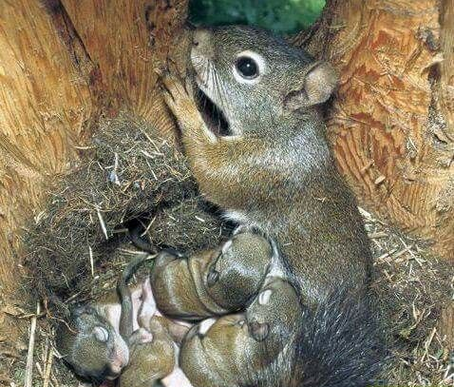
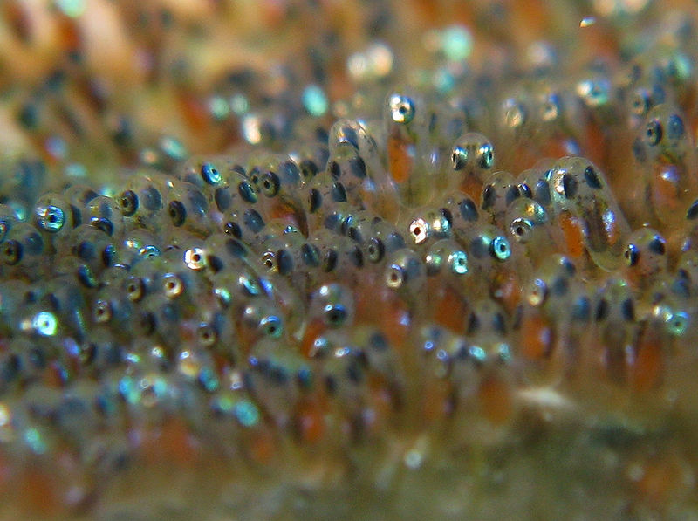
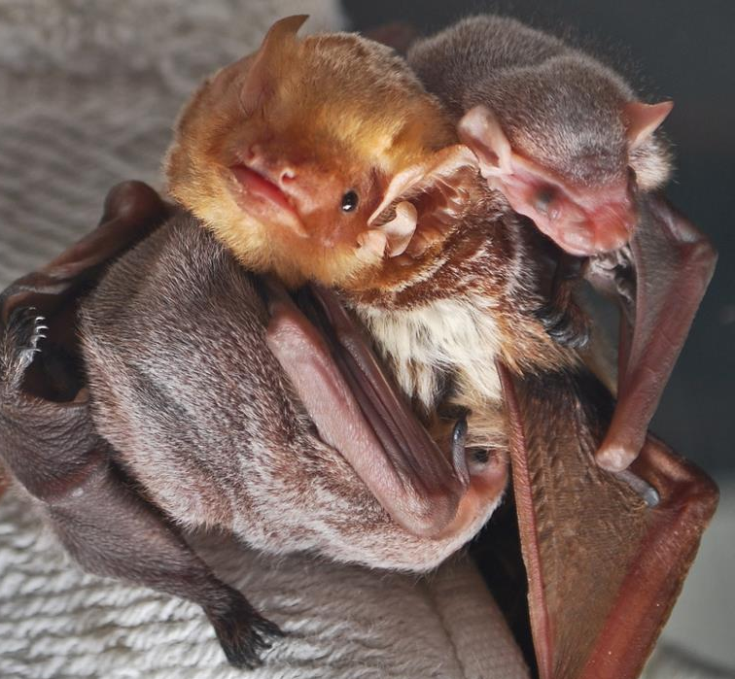
Are all animals born the same way?
No, some animals hatch from eggs.
Some animals have live birth.
ducks
foxes
snakes
squirrels
fish
bats

Slide 7
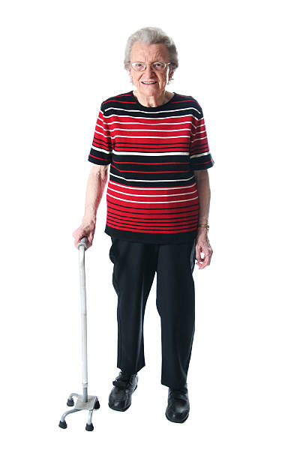
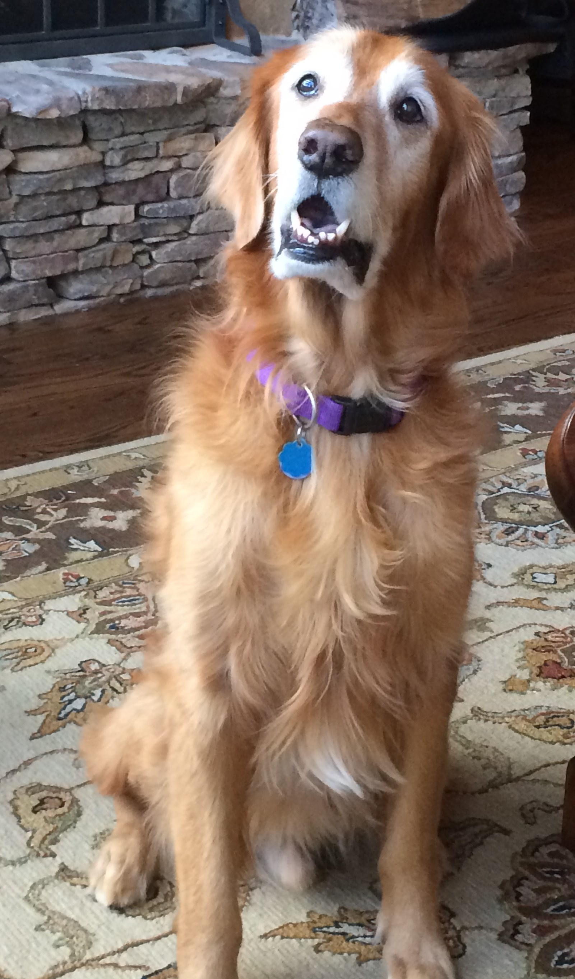
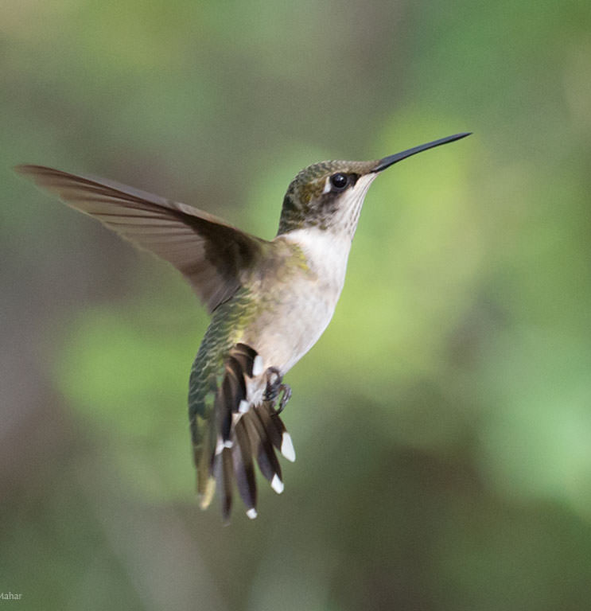
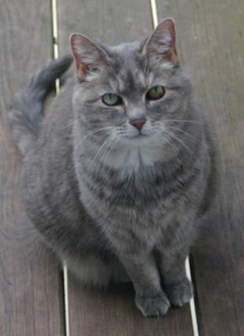
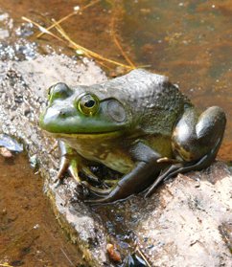
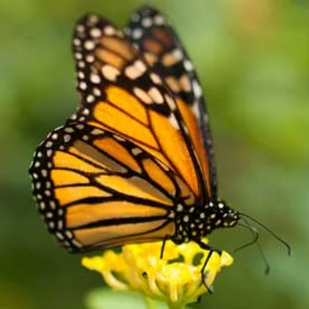
Do all animals live the same amount of time?
Do they have the same “lifespan”?
No!
Humans 70-80 yrs
Dogs 10-12 yrs
Hummingbird 3-5 yrs
Cats 13-18 yrs
Frogs 7-9 yrs
Butterfly 6 wks-1 yr

Slide 8
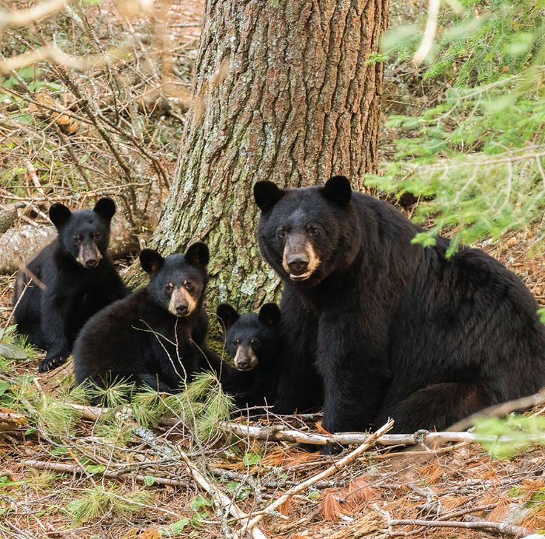
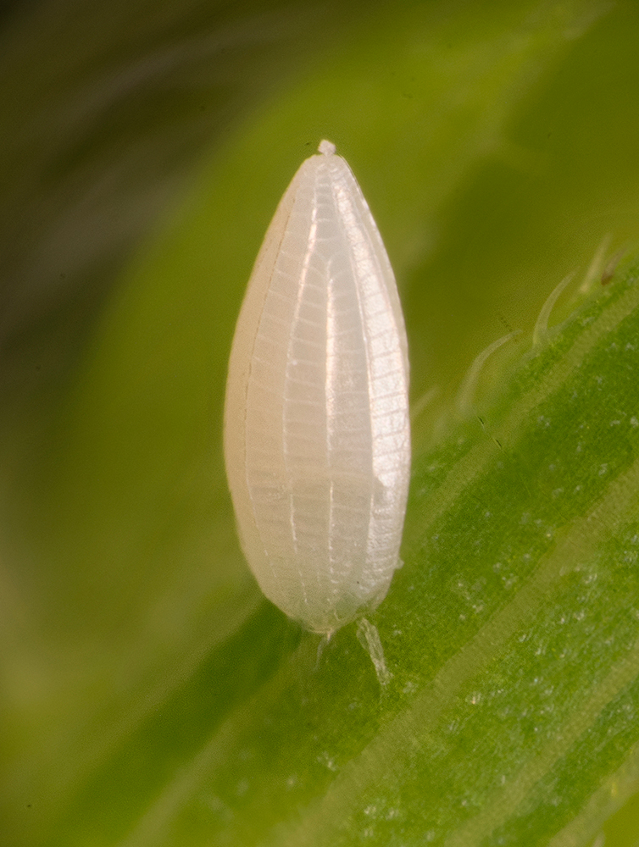
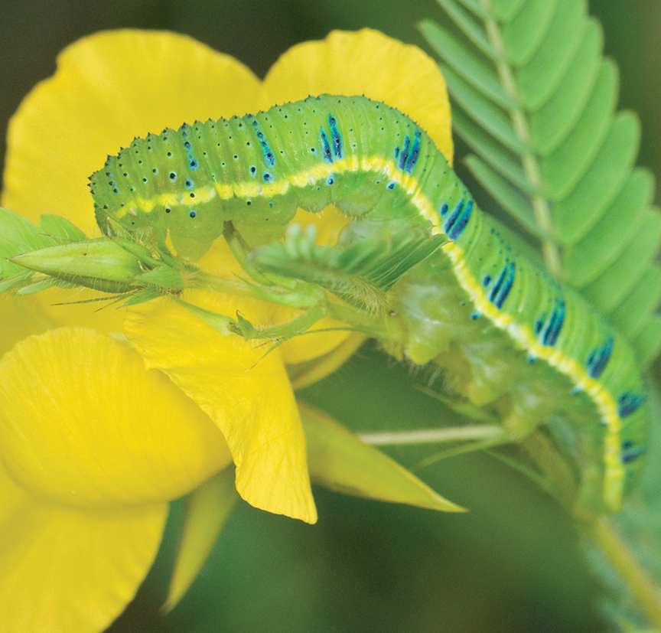
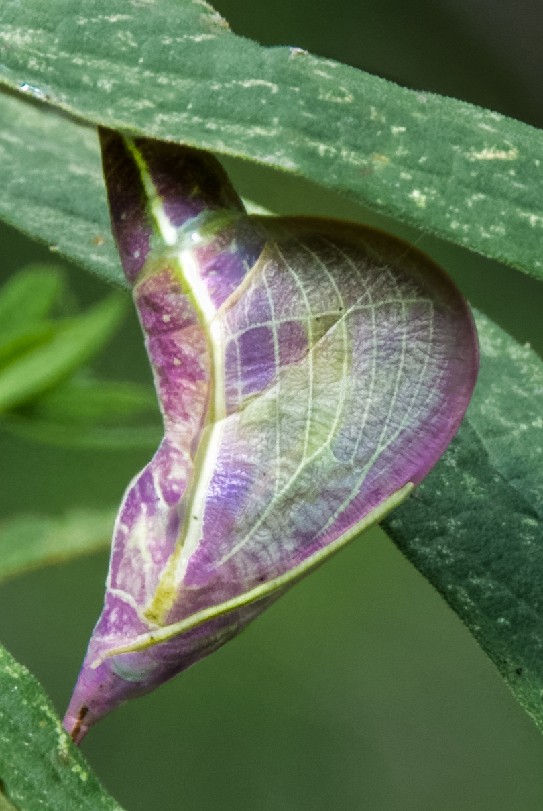
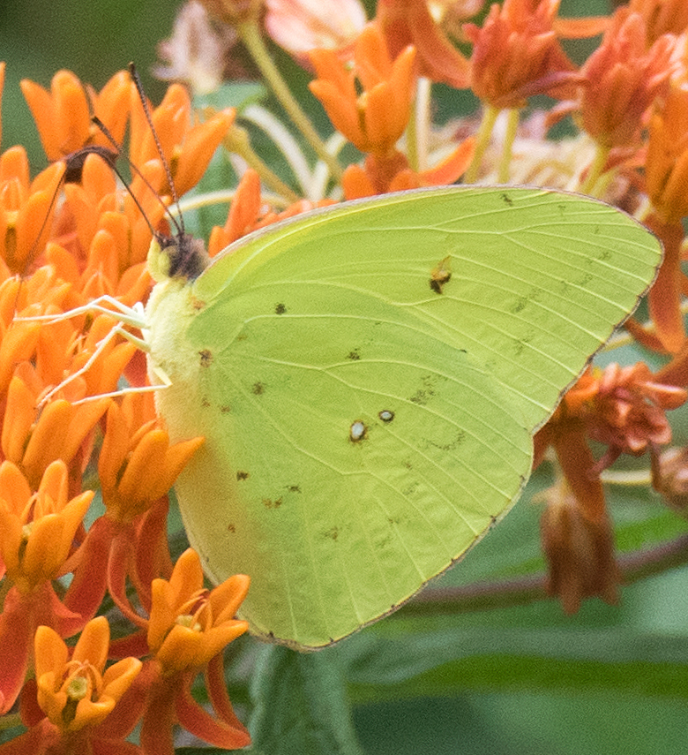
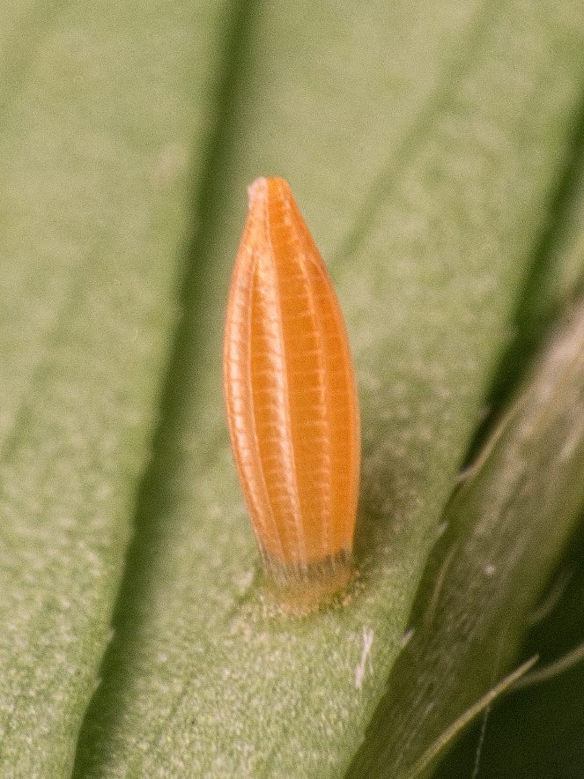
Do animals grow into adults in the same way? How are their life cycles Similar? Different?
Different species (types) of animals have different life cycles.
Some animals do not change very much and just grow larger.
Some go through multiple life cycle stages.
egg
larva (caterpillar)
chrysalis
butterfly

Slide 9
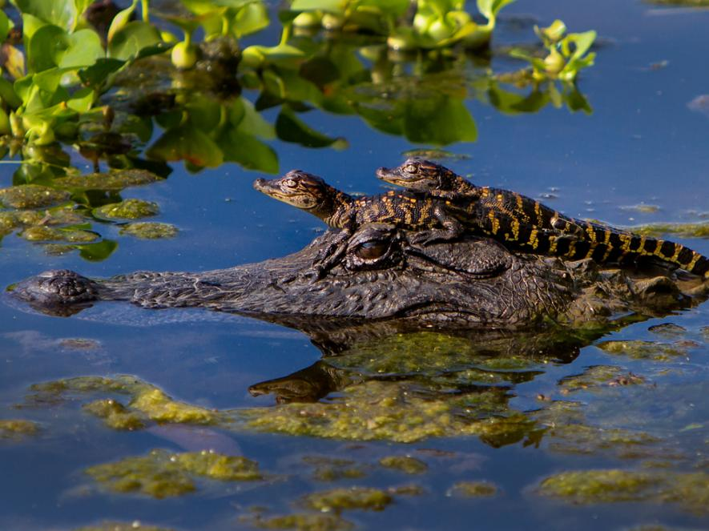
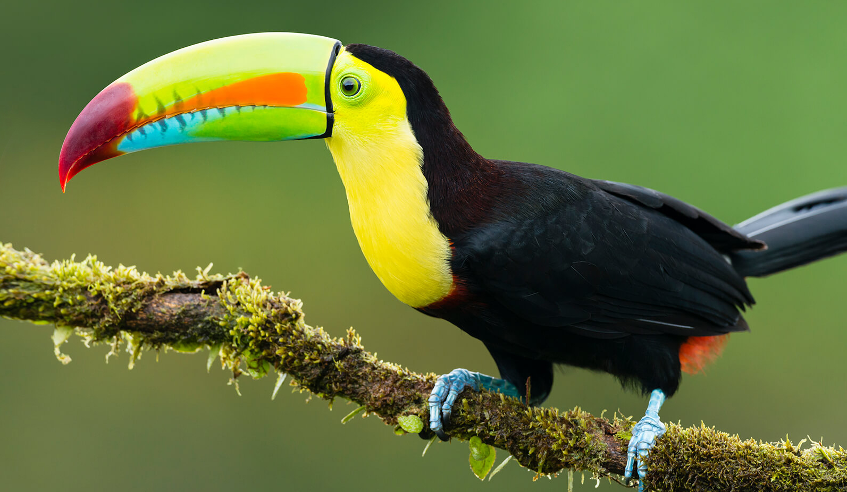
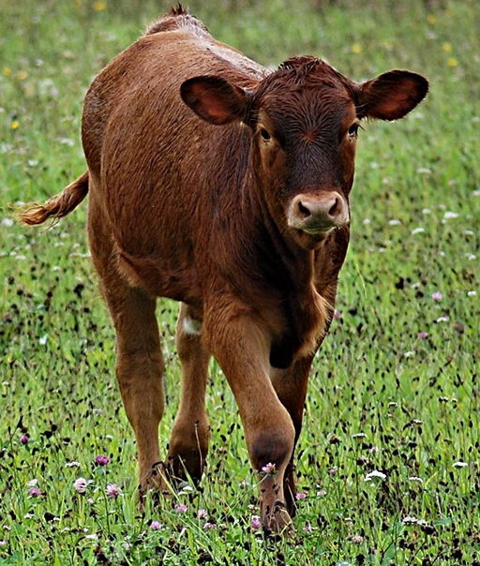
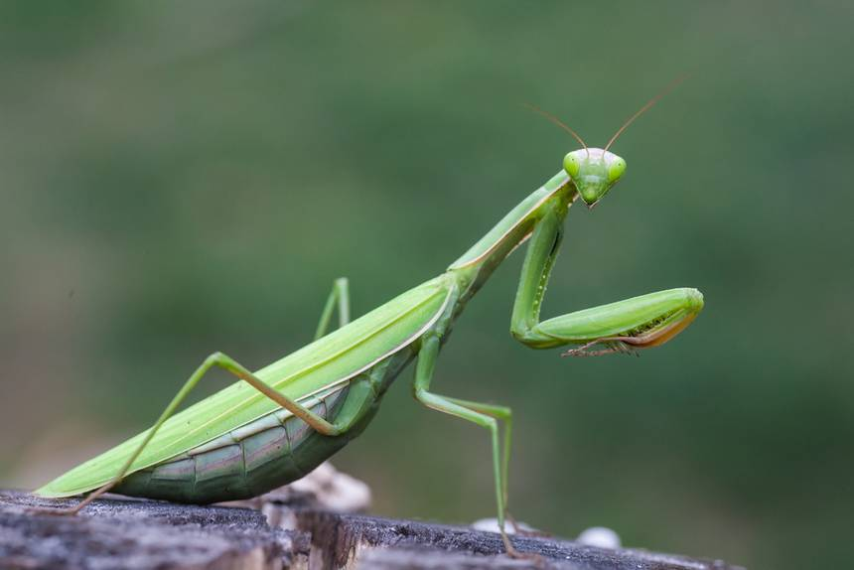
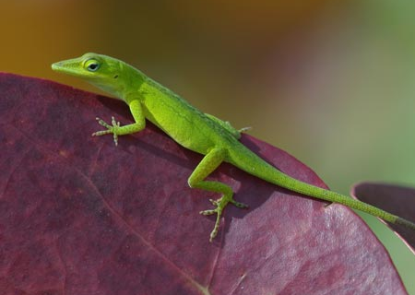
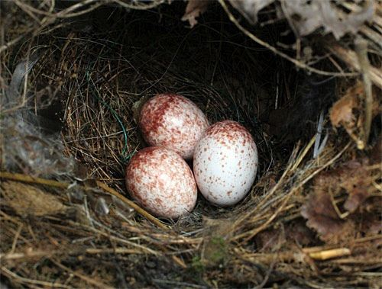
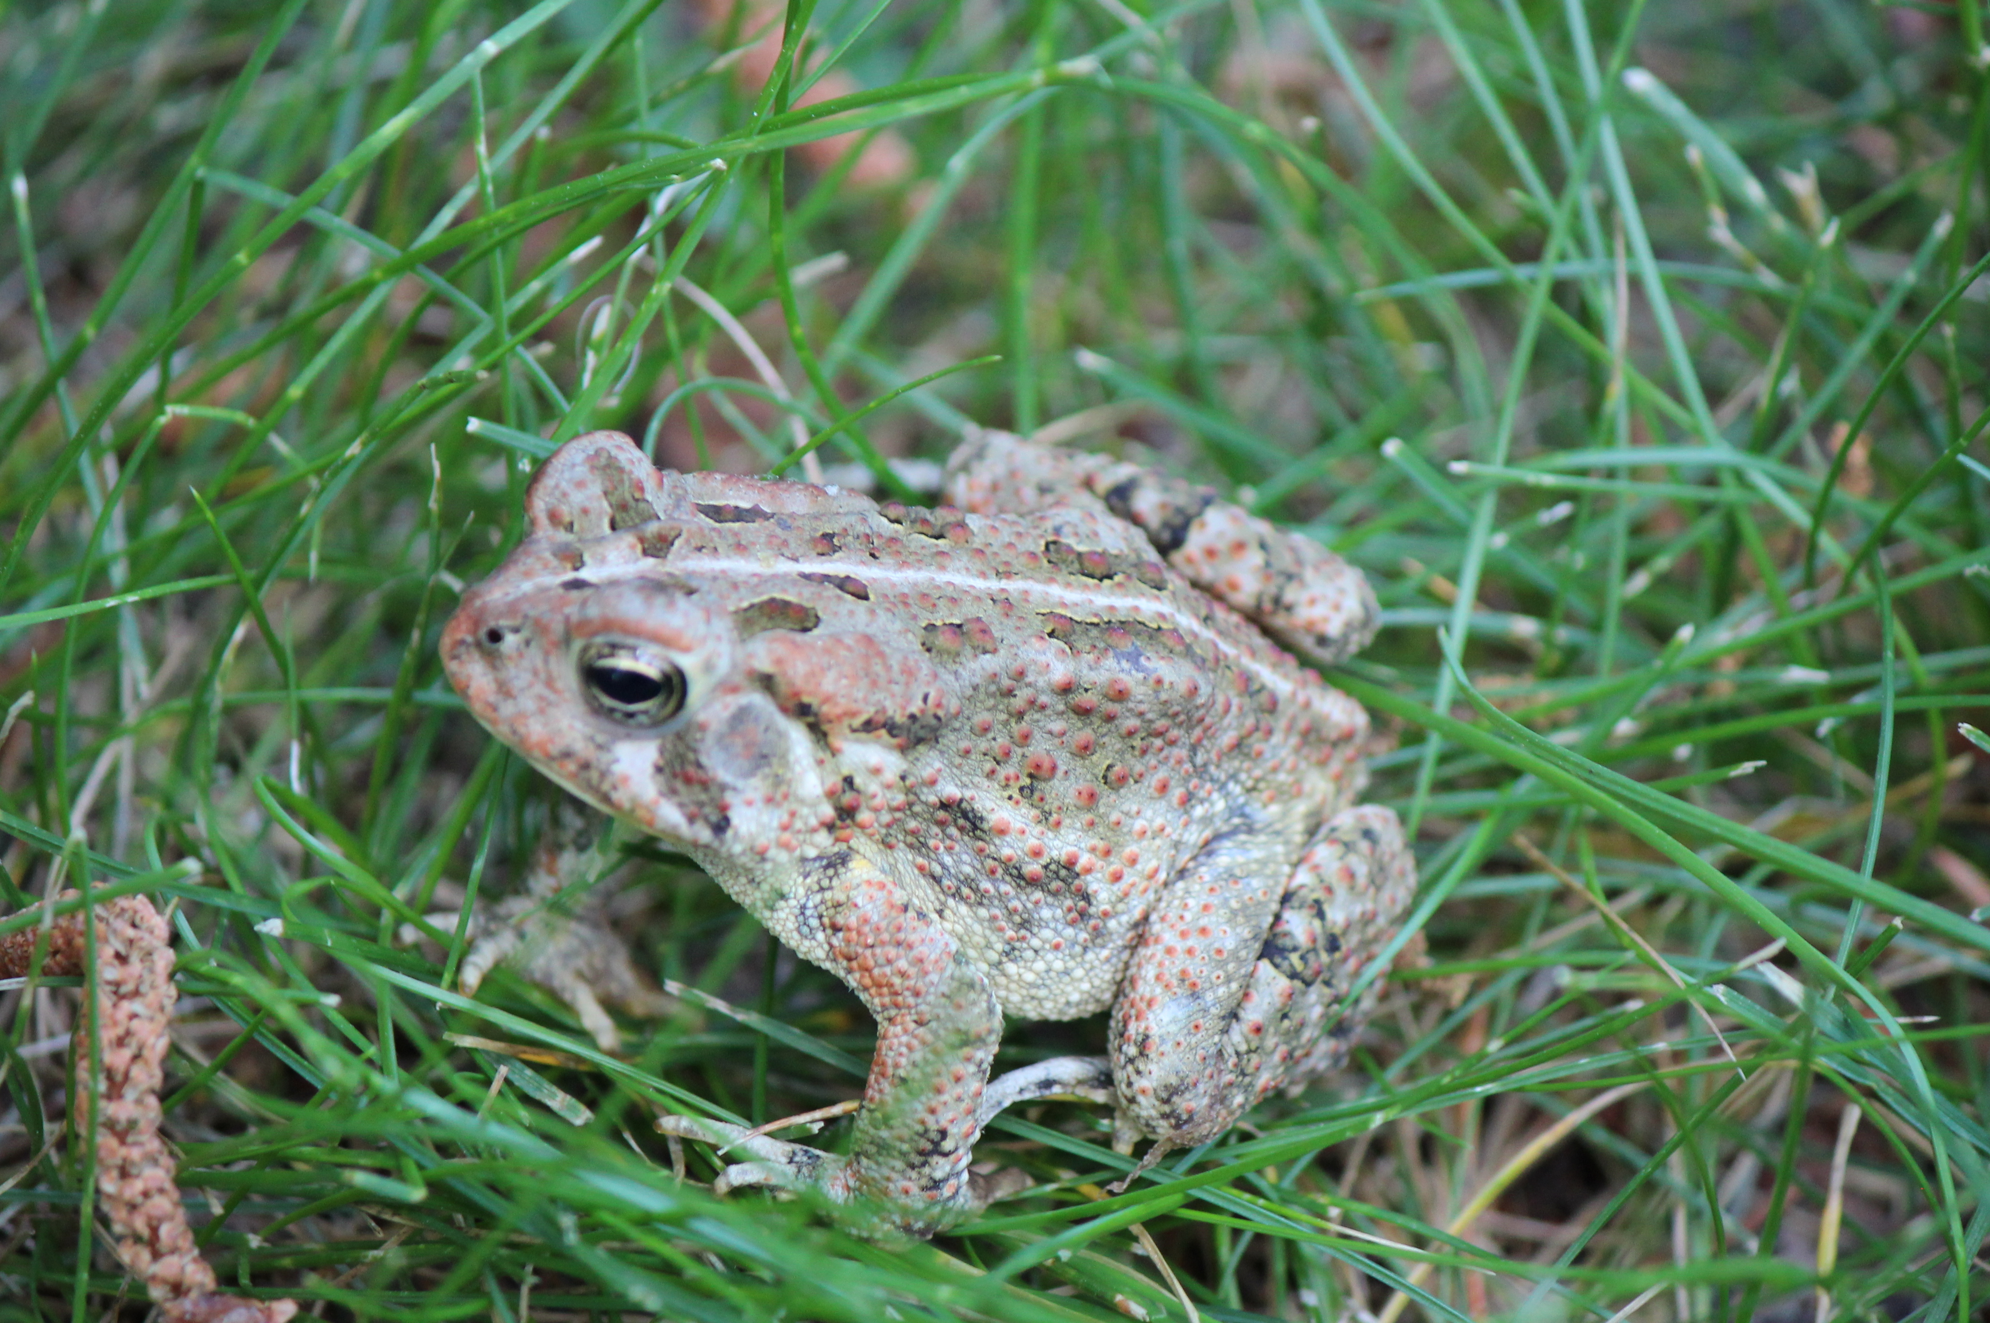
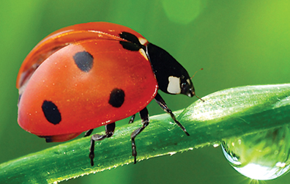
What animals might we find in the outdoor classroom? Can we find adults & offspring?
Toucan – No!
Praying Mantis – Yes!
Cow – No!
Alligator – No!
Green Anole – Yes!
Carolina Wren Nest – Yes!
Ladybug – Yes!
Fowler’s Toad – Yes!

