Slide 1

Find a Food Chain
Alabama Wildlife Federation Habitat Lab Field Journal Activity
To use this interactive PowerPoint with your students:
Click on “Enable Editing.”
Click the “Slide Show” tab at the top of the screen.
Then choose “From Beginning” from the menu.

Slide 2
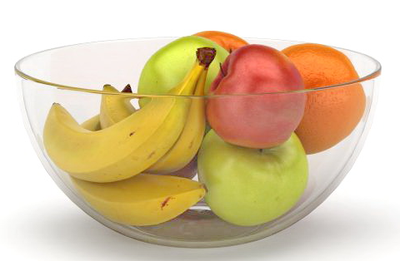

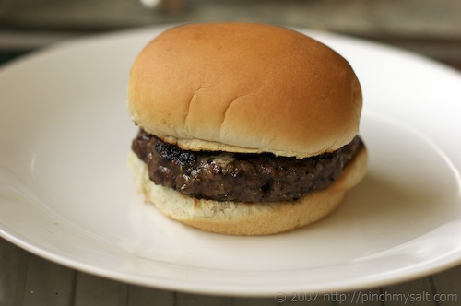
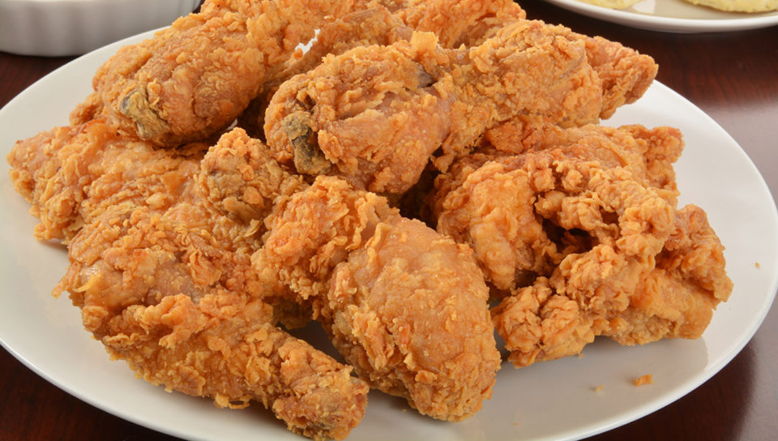
What are some of the plants and animals that you eat? Raise your hands if you eat…
Fruit like apples or bananas?
Vegetables like broccoli or carrots?
Hamburgers?
Fried chicken?
Fruits and vegetables are parts of plants.
Hamburgers and fried chicken come from animals.

Slide 3
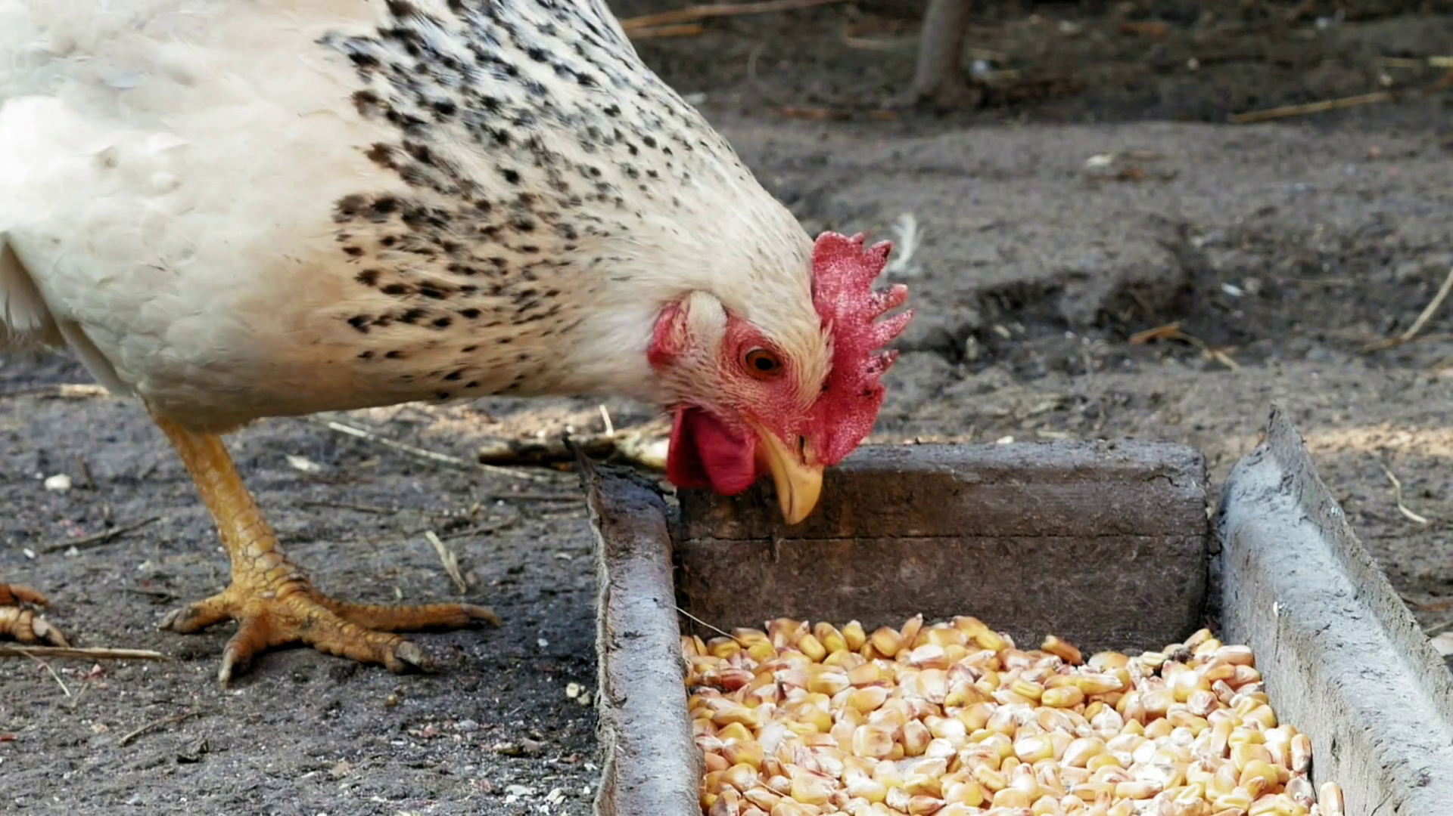
What do you think the chicken ate?
How does your body use the chicken you ate?
The chicken could have eaten corn or other plant material.
After you eat the chicken, your body uses the nutrients and energy from the chicken to give you energy to move, grow and stay warm.

Slide 4
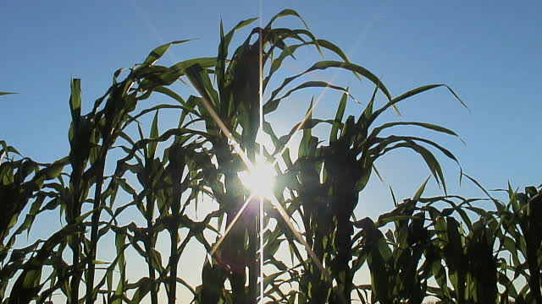
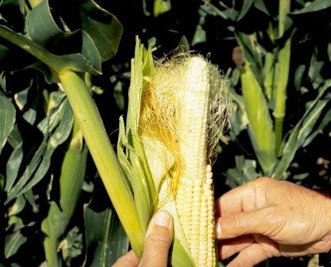
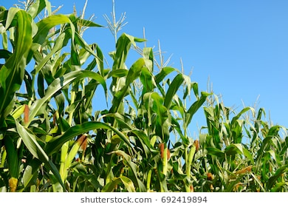
How did the energy get inside the corn before the chicken ate the corn?
The energy in the corn (or other plants) originally comes from the sun.
This forms a food chain, and YOU are part of that food chain.
Example Food Chain:
Sun → Corn → Chicken → Human

Slide 5
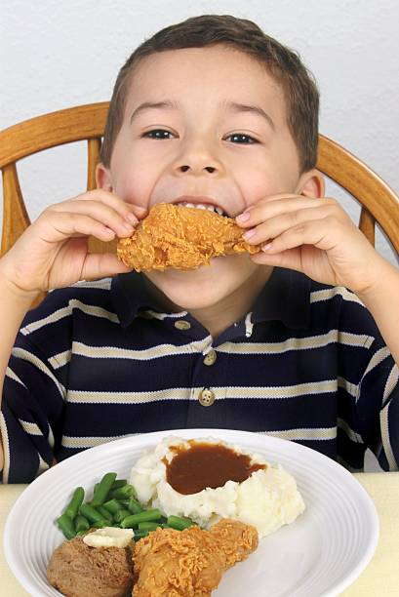
What is a Food Chain?
A food chain is the path of energy in the form of food from one organism to the next, linking the organisms in a chain with each dependent on the next as a source of food and energy.
For instance, a food chain is created when animals eat other animals that have eaten plants...
Human eats the chicken…
The corn plant gets energy…
Chicken eats the corn…
…from the sun!

Slide 6

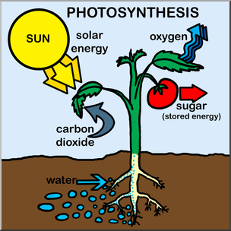
What is the original source of energy in all food chains?
THE SUN!
Plants are the original “producers” of energy in the food chain through photosynthesis.
The plants use the energy from the sun to convert water and carbon dioxide from the air into sugars (or food) for the plant.

Slide 7
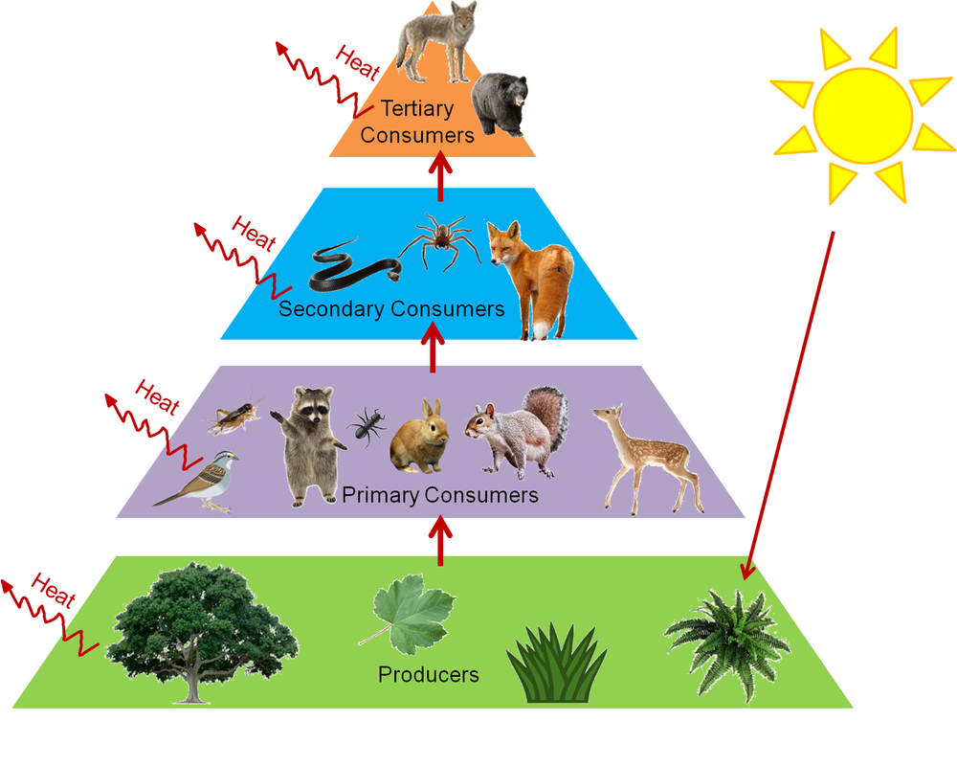
What are the different levels of a food chain?
The “producers” (plants) are eaten by
“Apex
Predator”
Energy
“primary consumers” (herbivores & omnivores),
which are eaten by
“secondary consumers” (omnivores & carnivores),
Energy
which are eaten by
“tertiary consumers” (omnivores & carnivores).
The energy is passed on until you reach the ”apex predator.”
Energy
The “apex predator” does not have any other animals that hunt it for food. It is the top predator.
Energy

Slide 8

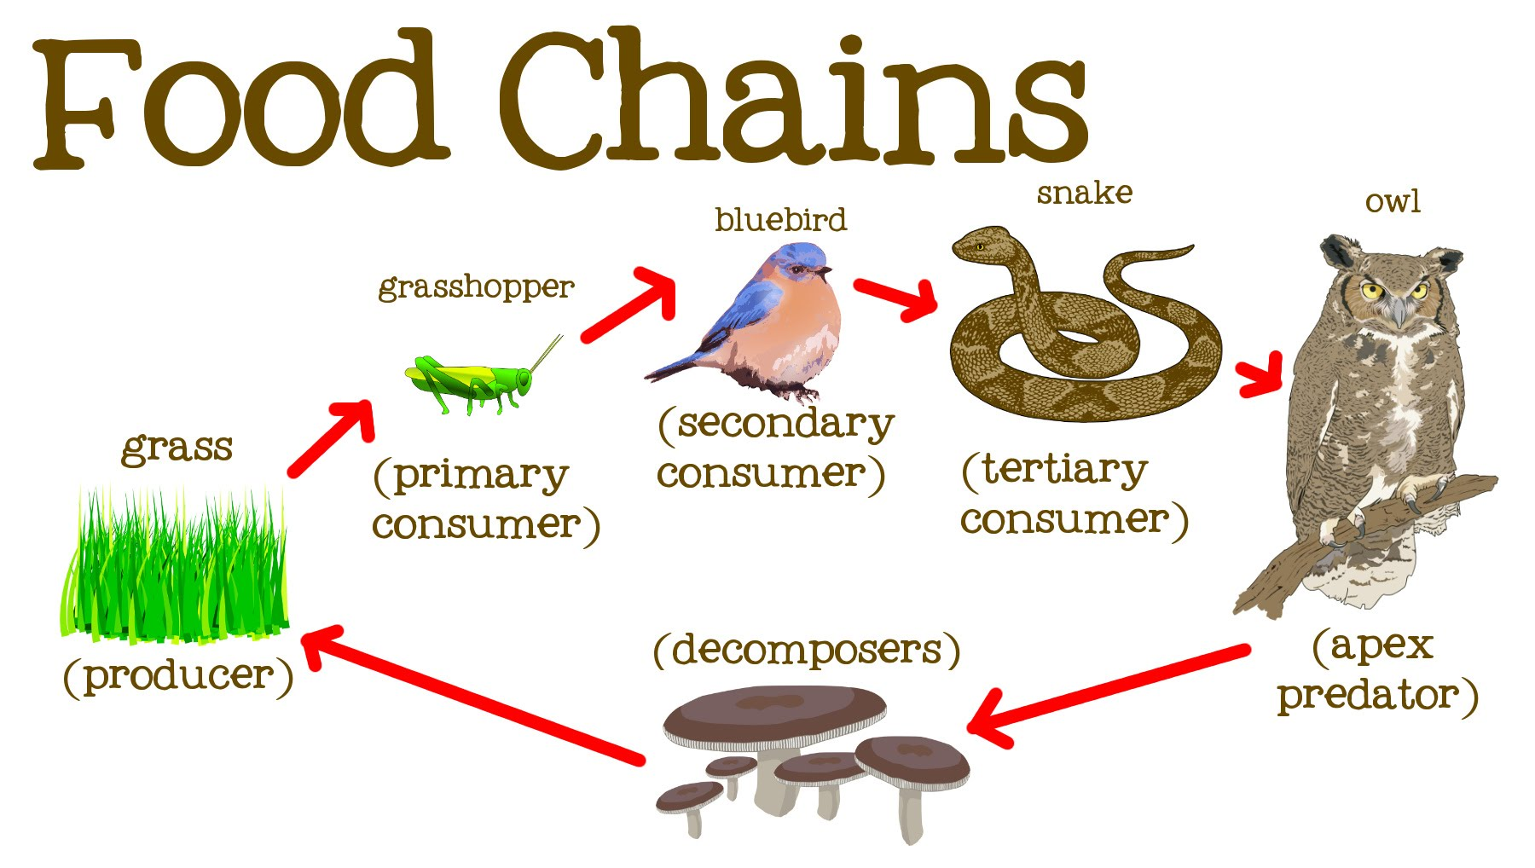
How does energy flow within a food chain?
The energy flows from the sun through the producers (plants) to the consumers (animals).
Sun
Producer (Plant)
Primary Consumer
(Animal: Herbivore or Omnivore)
Secondary Consumer
(Animal: Carnivore or Omnivore)
Tertiary Consumer
or Apex Predator (Animal)
Decomposer or Scavenger

Slide 9
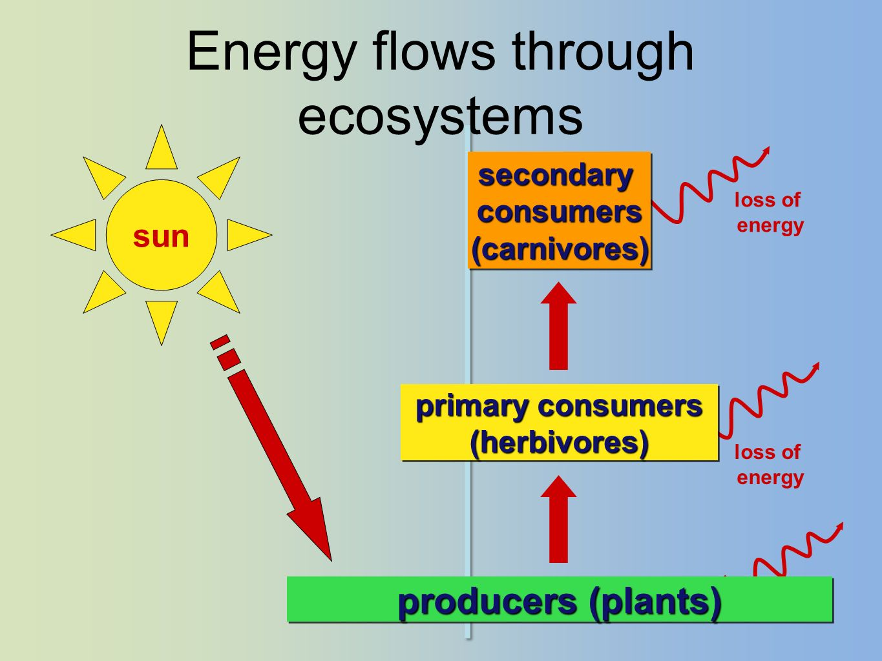
How much energy is passed on at each level?
Through all of these levels, only ~10% of the energy is passed on to the next level or consumer each time.
Sun
Producer (Plant)
Primary Consumer
(Animal: Herbivore or Omnivore)
Secondary Consumer
(Animal: Carnivore or Omnivore)
Tertiary Consumer
or Apex Predator (Animal)
Decomposer or Scavenger
10%
10%
10%
10%
10%

Slide 10
Where are we (humans) in Food Chains?
Can we be…Producers?
Consumers?
Apex Predator?
Yes, we are the apex predator because there are
no other animals in Alabama that would eat us.
Black bears are considered omnivores, but they do not hunt humans as prey.
Energy
Apex
Predator
Yes, we can be the primary consumers
if we eat plants (fruit & vegetables), or
we can be the secondary consumers
if we eat animals (chicken, cows, deer, etc.)
that eat plants.
Energy
Energy
No, we cannot be producers!
We cannot produce or make our own energy from the sun like plants can.
Energy

Slide 11
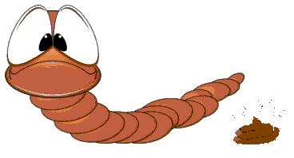
Does the Apex Predator complete the food chain?
No! The final link in the food chain is the “decomposers”.
When the animals die, then decomposers and scavengers eat the dead animals.
Then the decomposers’ excrement or “poop” returns the nutrients (energy) back to the soil.
For example, the “castings” (poop) of earthworms are considered rich fertilizer (food) for plants.
“Mine don’t stink!”

Slide 12
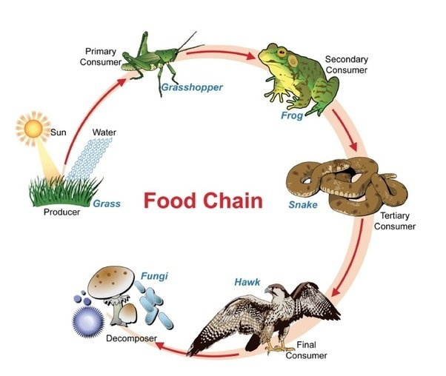
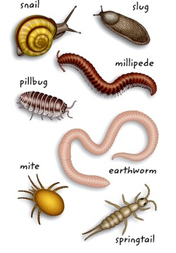
What are Decomposers? Why are they important?
Decomposers:
Are the last stop on the food chain.
Eat the things no one else wants to.
Are very small so they can break down large pieces of dead stuff.
Are referred to as nature’s recyclers because they help return nutrients to the soil for the plants.
Some of the most common decomposers are bacteria, worms, slugs, snails, and fungi like mushrooms.
If they didn’t do their job the ground would be covered with junk.

Slide 13
What food chains could we find in our outdoor classroom? What should you look for outside?
Producers like…
grass
trees
flowers.
Consumers like…
birds
squirrels
spiders.
Decomposers like…
pill bugs
worms
mushrooms.
*Be sure to use the Example Food Chain Components Chart with your activity sheets.

