Slide 1

Critter Characteristics & Habitats
Alabama Wildlife Federation Habitat Lab Field Journal Activity
To use this interactive PowerPoint with your students:
Click on “Enable Editing.”
Click the “Slide Show” tab at the top of the screen.
Then choose “From Beginning” from the menu.

Slide 2
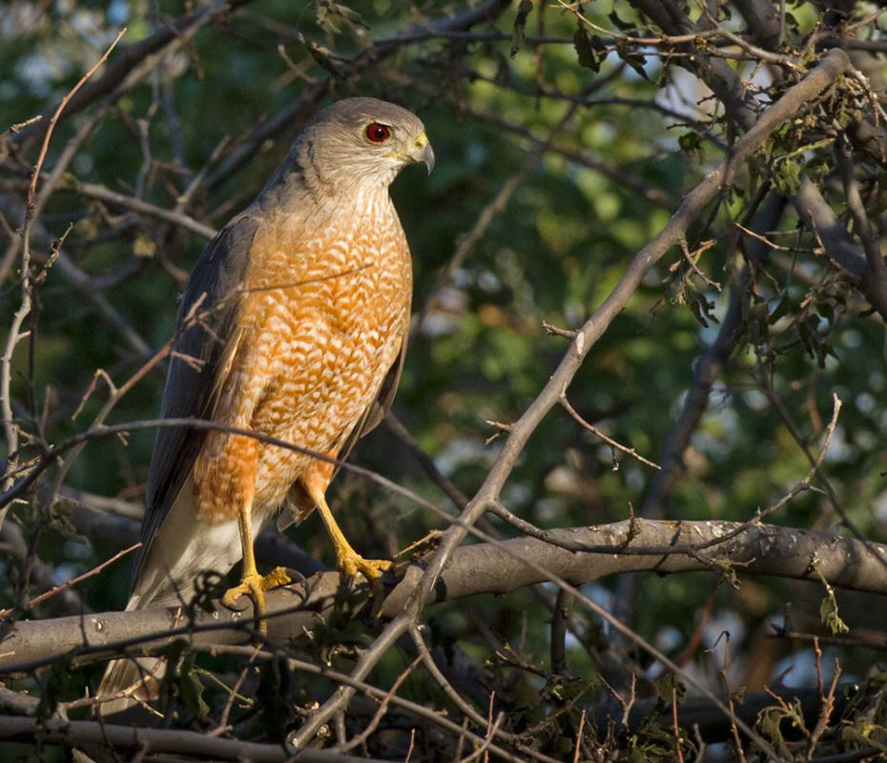
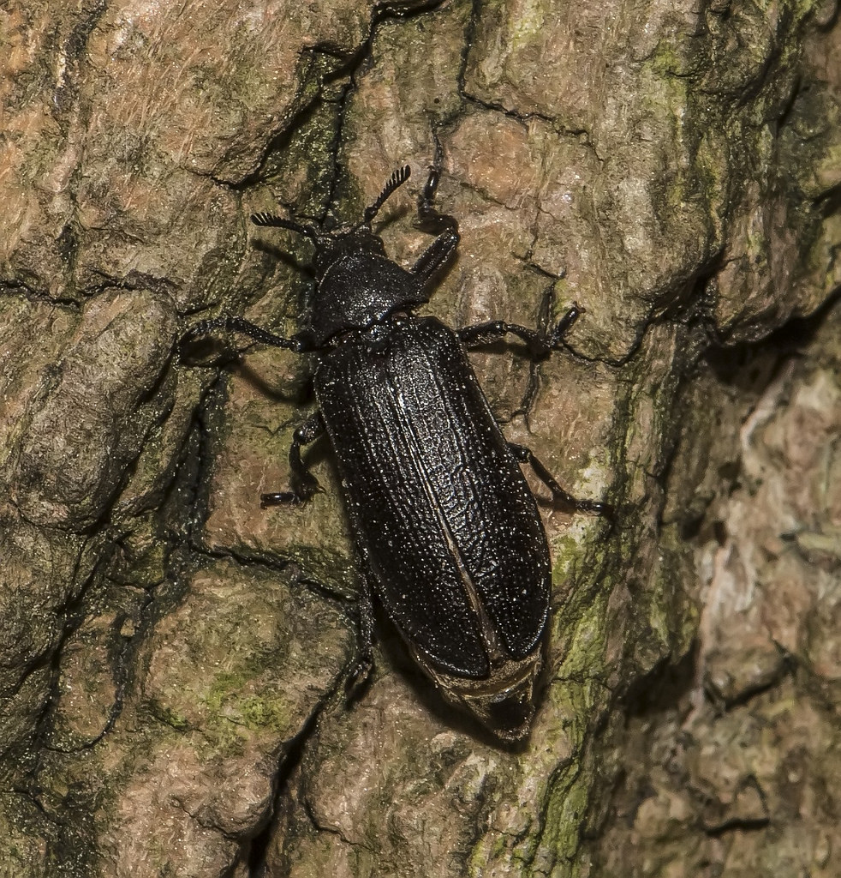
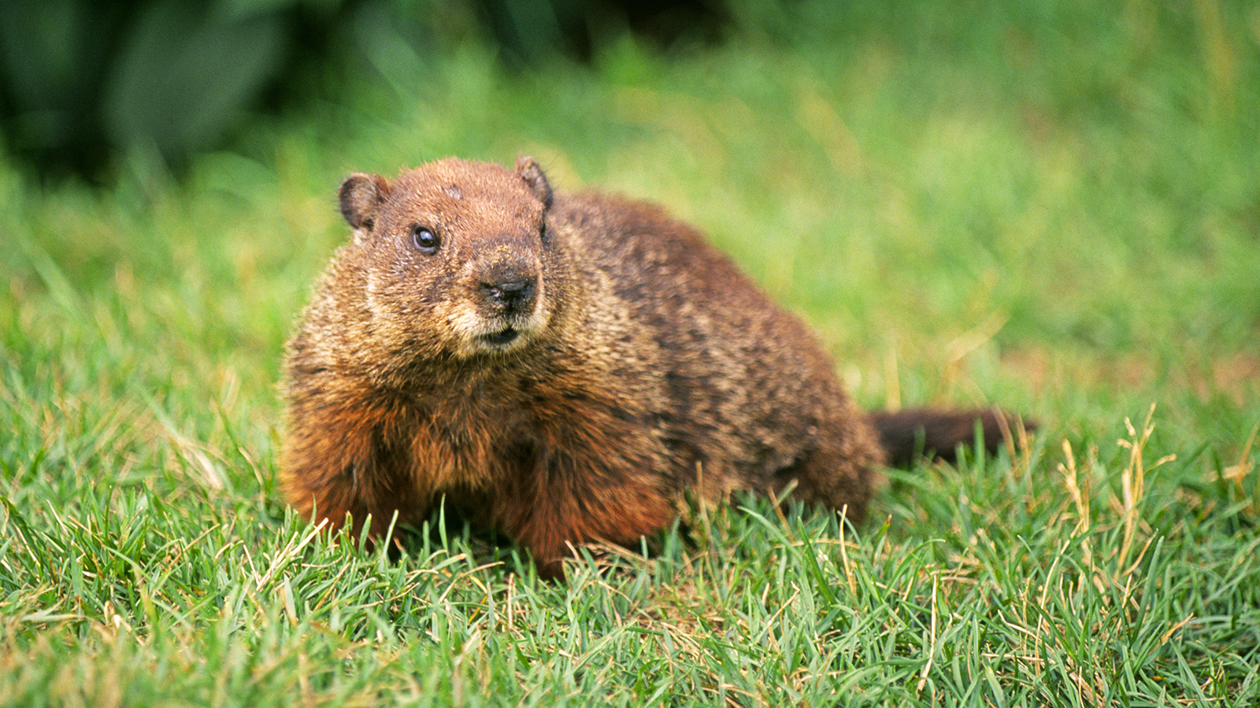
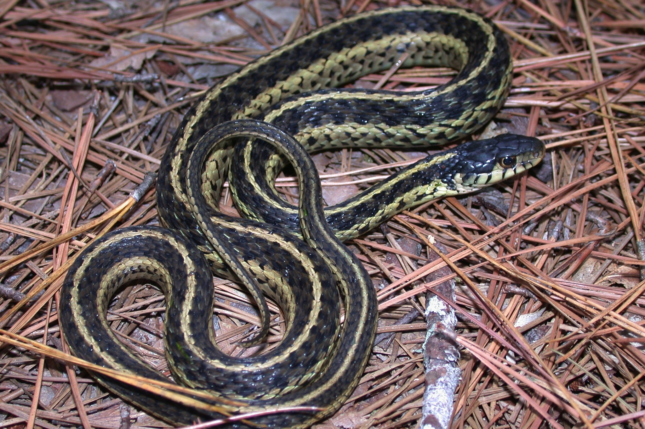
What are living things?
Things that eat, breathe, grow and reproduce.
Eastern garter snake
Groundhog
Cooper’s hawk
Cedar beetle

Slide 3
What are the different types of animals? How do we categorize or classify them?
To categorize or classify animals you need to think about the characteristics that they share and how they are different.
Example Characteristics
spine/vertebrates
number of eyes
wings
skin covering
how they give birth
size
number of legs
how they breathe

Slide 4
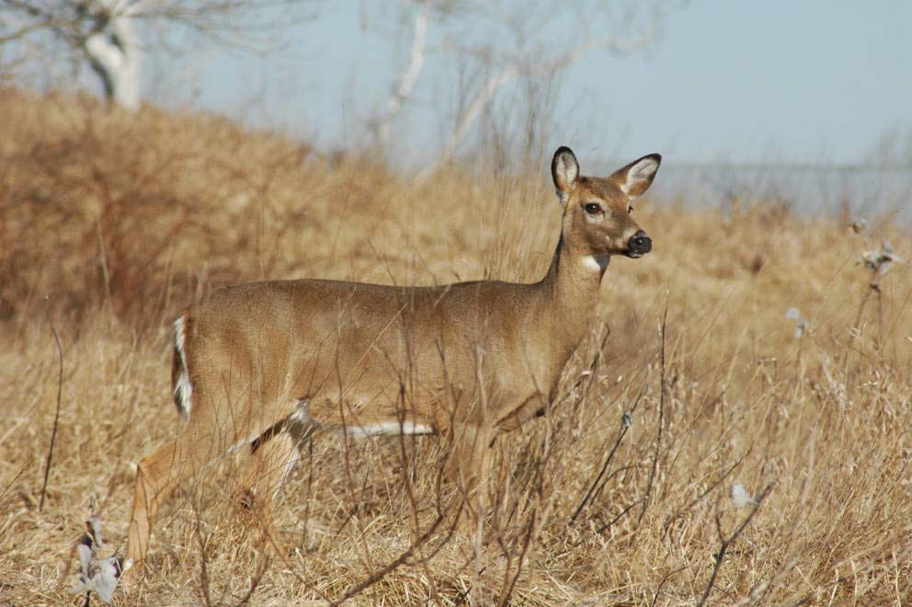
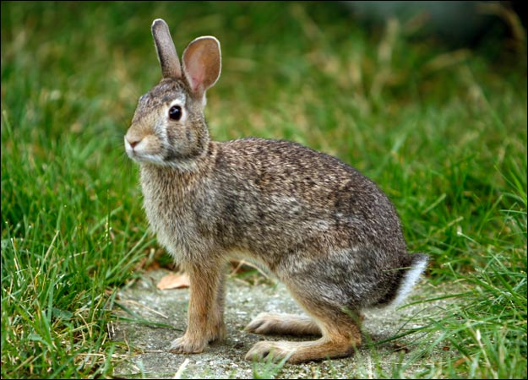
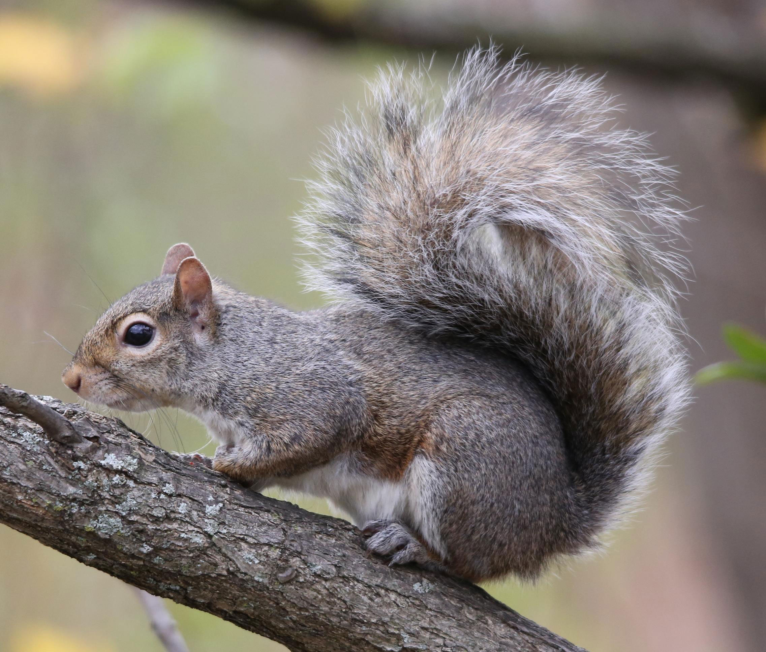

What am I?
I am a mammal.
Eastern cottontail rabbit
Clue #1: I have a spine.
Clue #2: I have fur or hair.
Clue #3: I breathe using lungs.
White-tailed deer
Clue #4: I give birth to live babies.
Eastern gray squirrel
Clue #5: I have four legs.
(or 2 arms & 2 legs)
humans

Slide 5
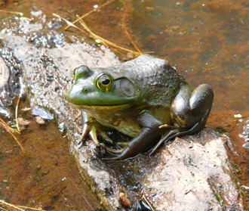
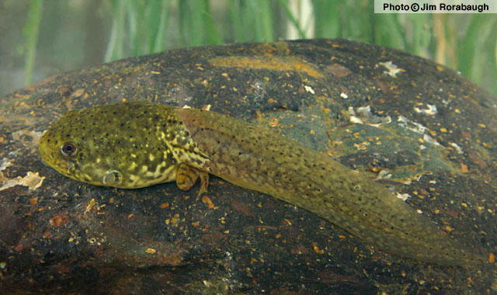
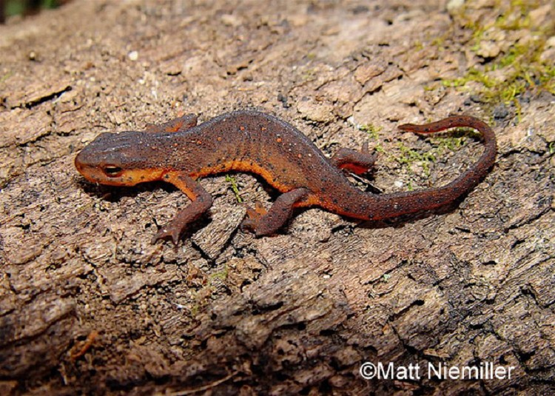
What am I?
I am an amphibian.
American bullfrog
Clue #1: I have a spine.
Clue #2: I have smooth skin.
Clue #3: I lay eggs in water.
American bullfrog tadpole
Clue #4: I am born with gills, but I develop lungs as an adult.
Eastern newt
Clue #5: I am born without legs, but I develop four legs as an adult.

Slide 6
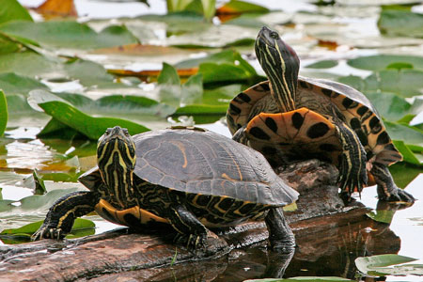
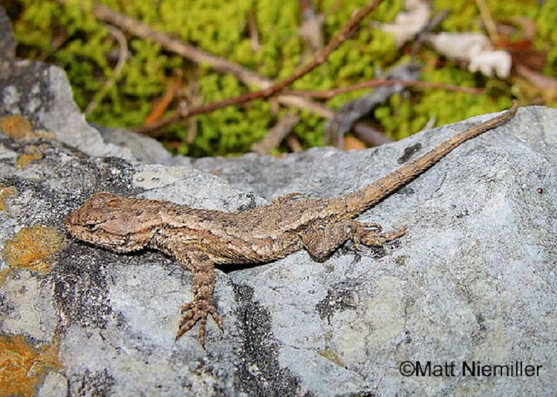
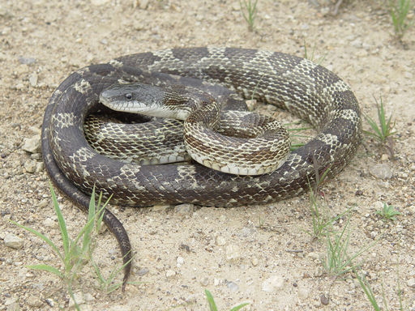
What am I?
I am a reptile.
Clue #1: I have a spine.
Clue #2: I have scales.
Clue #3: I lay eggs.
Eastern fence lizard
Red-eared slider
Clue #4: I breathe with lungs.
Clue #5: I can have four legs or no legs.
Gray rat snake

Slide 7
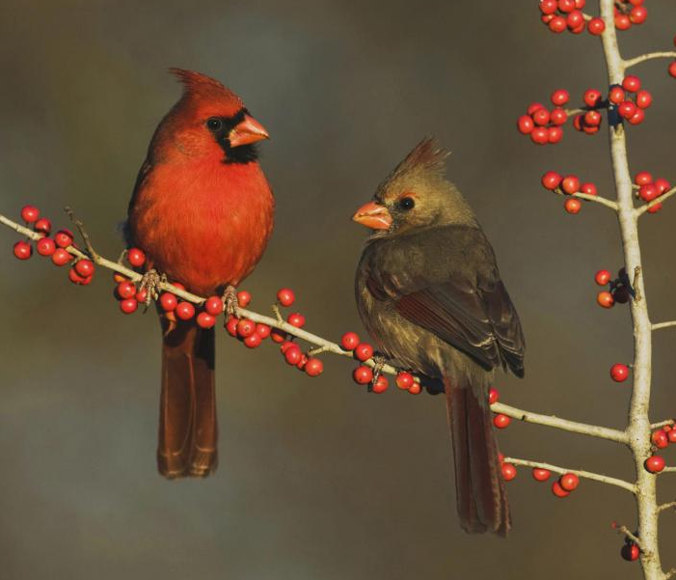
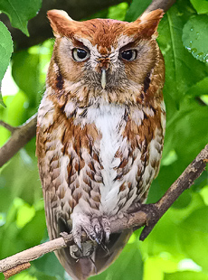
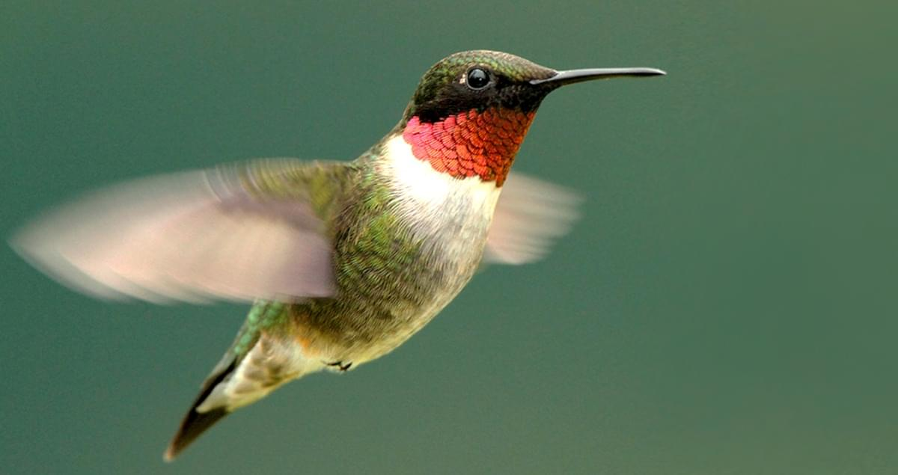
What am I?
I am a bird.
Clue #1: I have a spine.
Clue #2: I breath with lungs.
Clue #3: I have two legs.
Clue #4: I lay eggs.
Northern cardinals
Eastern screech owl
Clue #5: I have feathers.
Ruby-throated hummingbird

Slide 8
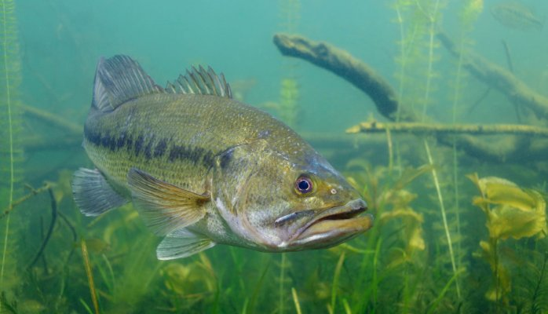
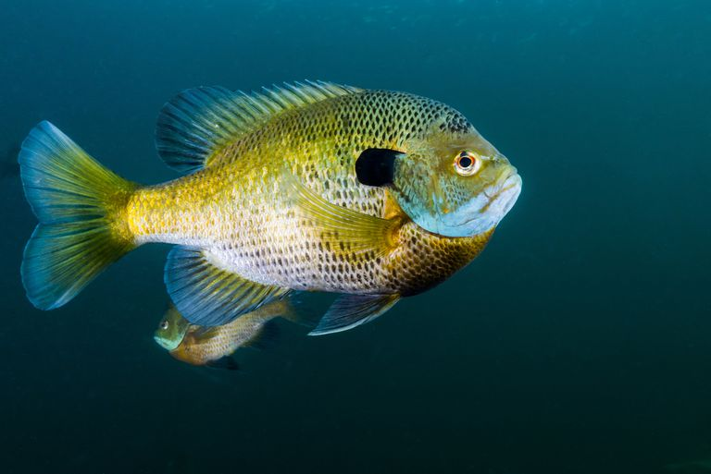
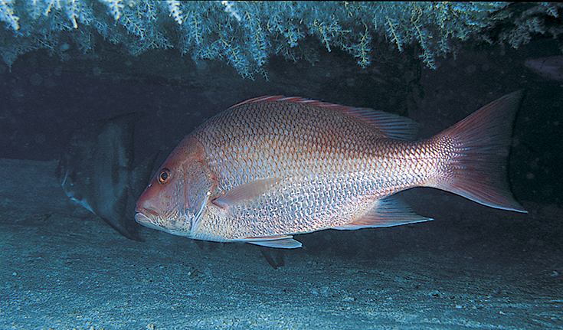
What am I?
I am a fish.
Clue #1: I have a spine.
Clue #2: I have scales.
Clue #3: I breathe with gills.
Large-mouth bass
Clue #4: I have no legs.
Bluegill sunfish
Clue #5: I lay eggs.
Red snapper

Slide 9
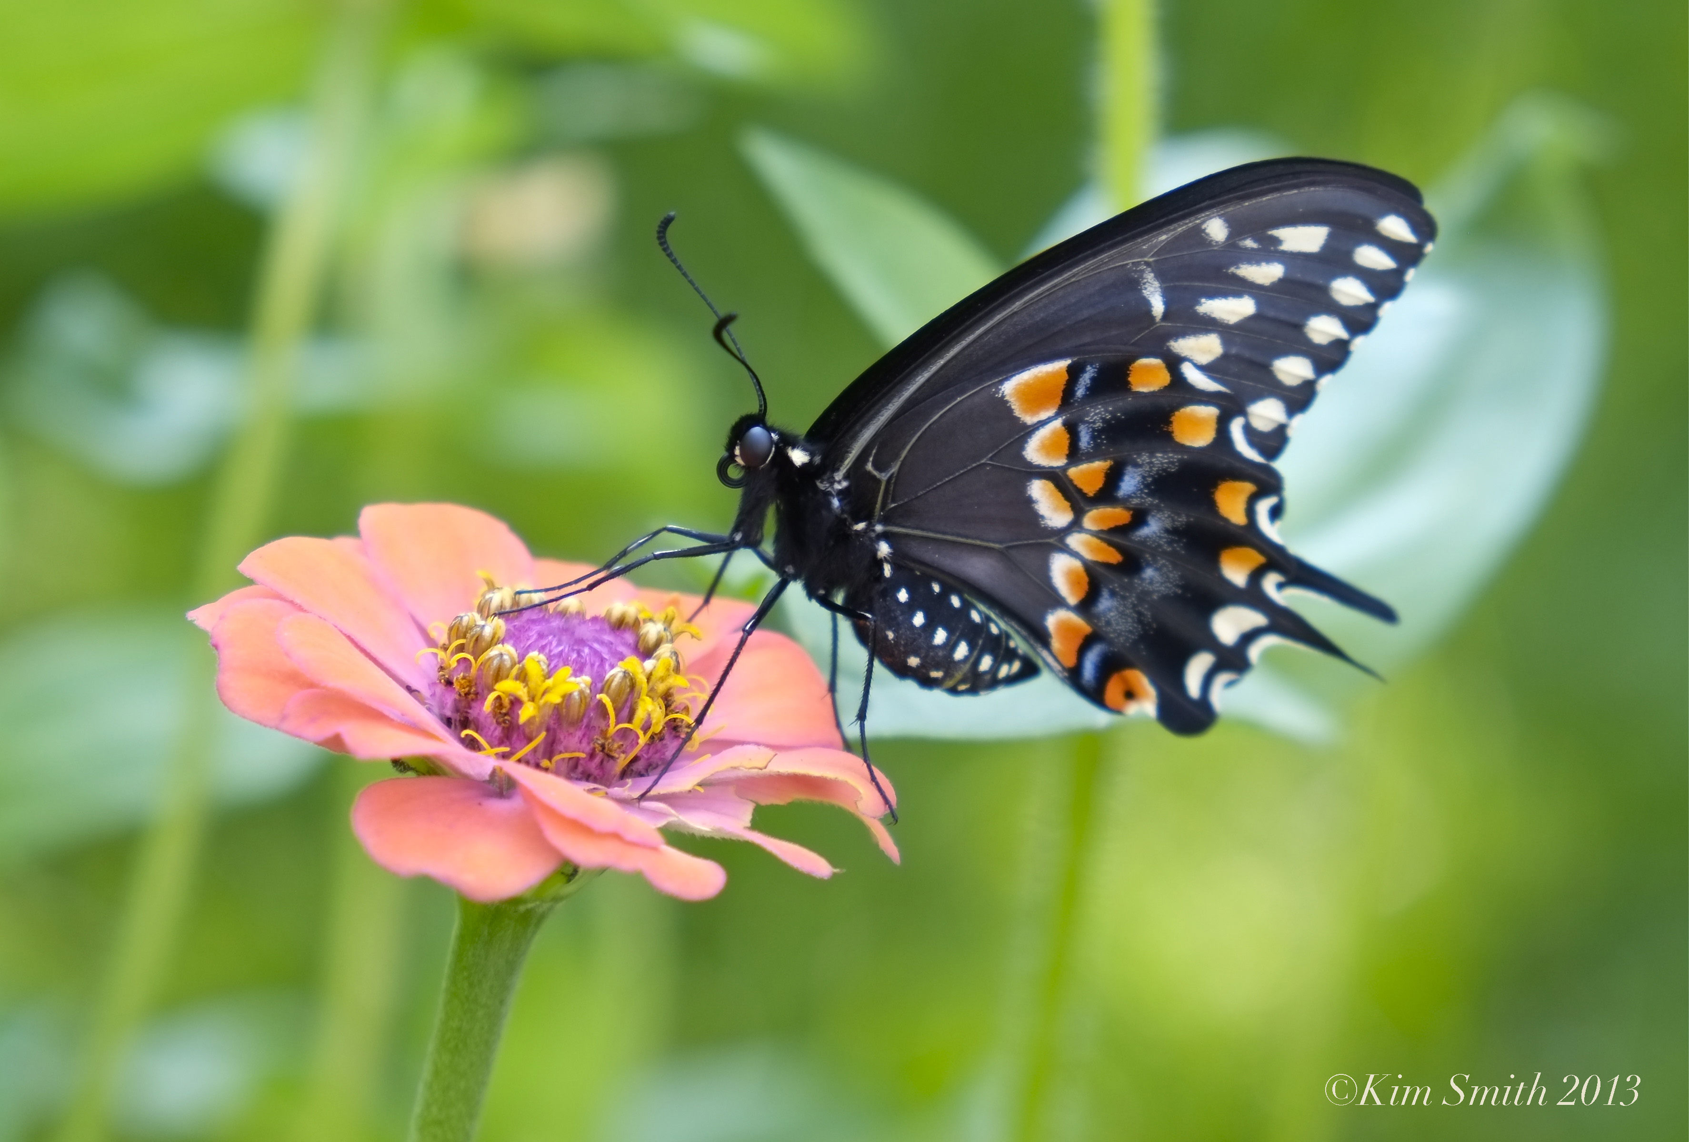
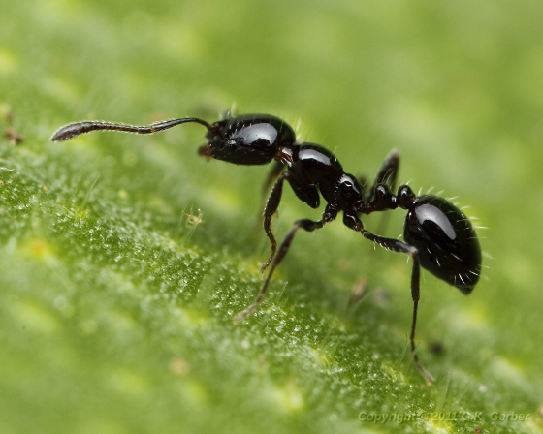
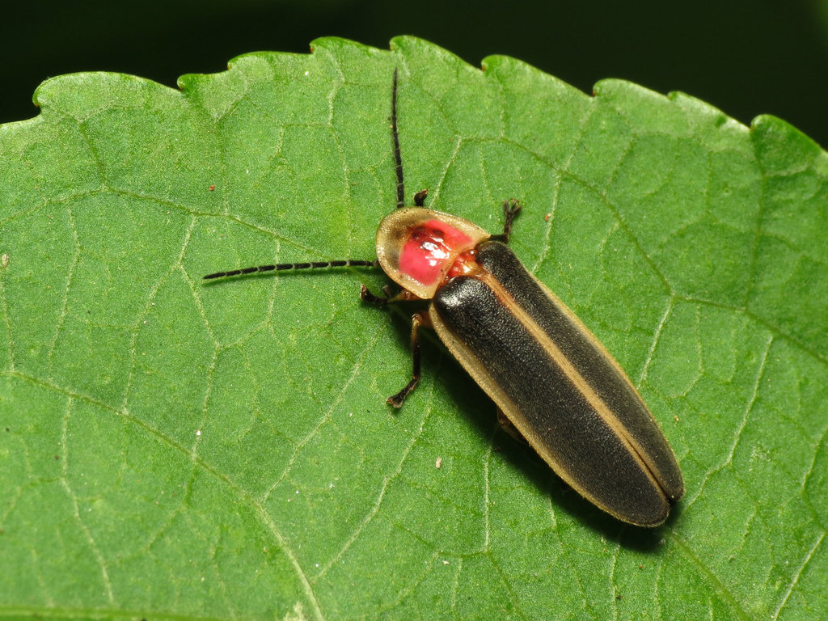
What am I?
I am an insect.
Clue #1: I do not have a spine.
Clue #2: I have a hard exoskeleton.
Clue #3: I have six legs.
Black swallowtail butterfly
Clue #4: I lay eggs.
Black ant
Clue #5: I breathe with a network of
tiny tubes called tracheae.
Eastern firefly

Slide 10
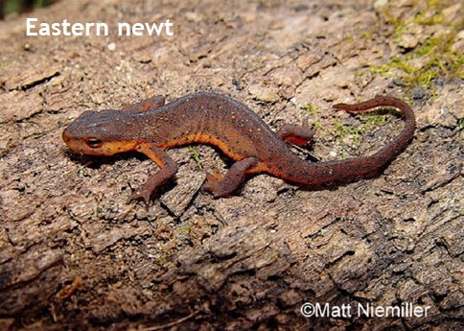
Do all of these animals live in the same habitat (home)? What is different about their habitats?
American bullfrog
Lives in a Forest near a Freshwater Creek
Lives in a Freshwater Pond, Creek or River
Eastern screech owl
Lives in a Woodland or Forest
Although they live in different habitats, their habitats could overlap.

Slide 11
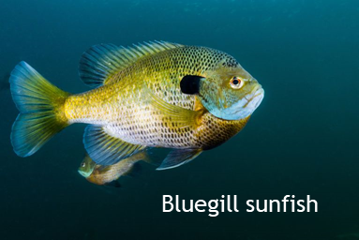
Do all of these animals live in the same habitat?
NO!
Red snapper
Large-mouth bass
Live in the Saltwater Ocean
Live in a Freshwater Lake or River
Although they all live in aquatic (water) habitats, the freshwater fish cannot live in saltwater and visa versa.

Slide 12
Some animals can live in a variety of habitats as long as the habitat provides their food, water & shelter.
Live in a variety of habitats including Forests, Fields, Prairies, Bogs, Wetlands, and in or near human neighborhoods.
Black swallowtail butterfly
Northern cardinals
Eastern cottontail rabbit
Ruby-throated hummingbird
Black ant
Gray rat snake
White-tailed deer

Slide 13
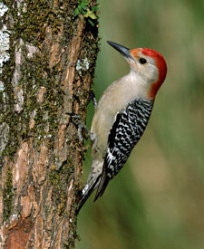
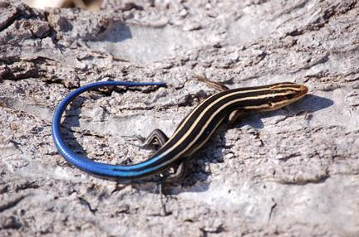
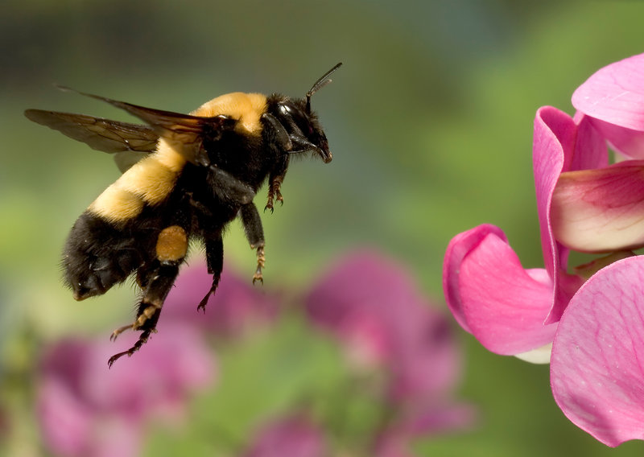
What types of animals could we find in our outdoor classroom? What type of habitat do they need?
Insects…
Birds…
Reptiles…
Bumblebee
Five-lined Skink
Meadow with flowering plants that provide nectar
Red-bellied Woodpecker
Partially wooded habitat with rocks for basking in the sun
Forested habitat with tree cavities for nesting

Slide 14
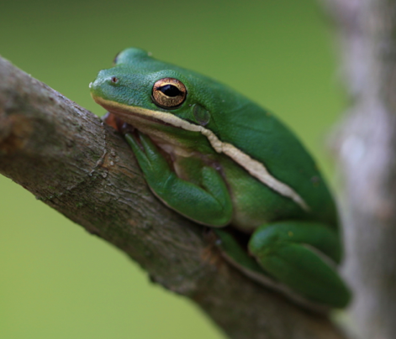
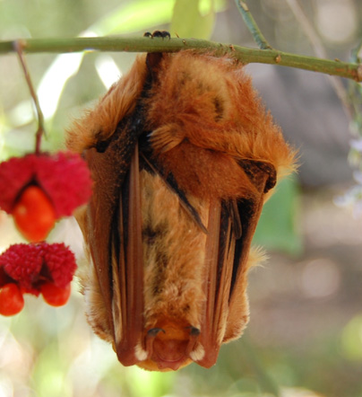
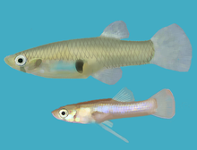
What types of animals could we find in our outdoor classroom? What type of habitat do they need?
Amphibians…
Mammals…
Fish…
Eastern Mosquito Fish
Green Tree Frog
Eastern Red Bat
Freshwater pond or river
Freshwater pond for laying eggs
Forested habitat for cover with a source of insects (food) nearby

