Slide 1
Earth’s Spheres
An Alabama Wildlife Federation Outdoor Classroom Field Journal Activity
*Be sure to click the “Slide Show” tab at the top of the screen & then “From Beginning” to use the interactive features.

Slide 2
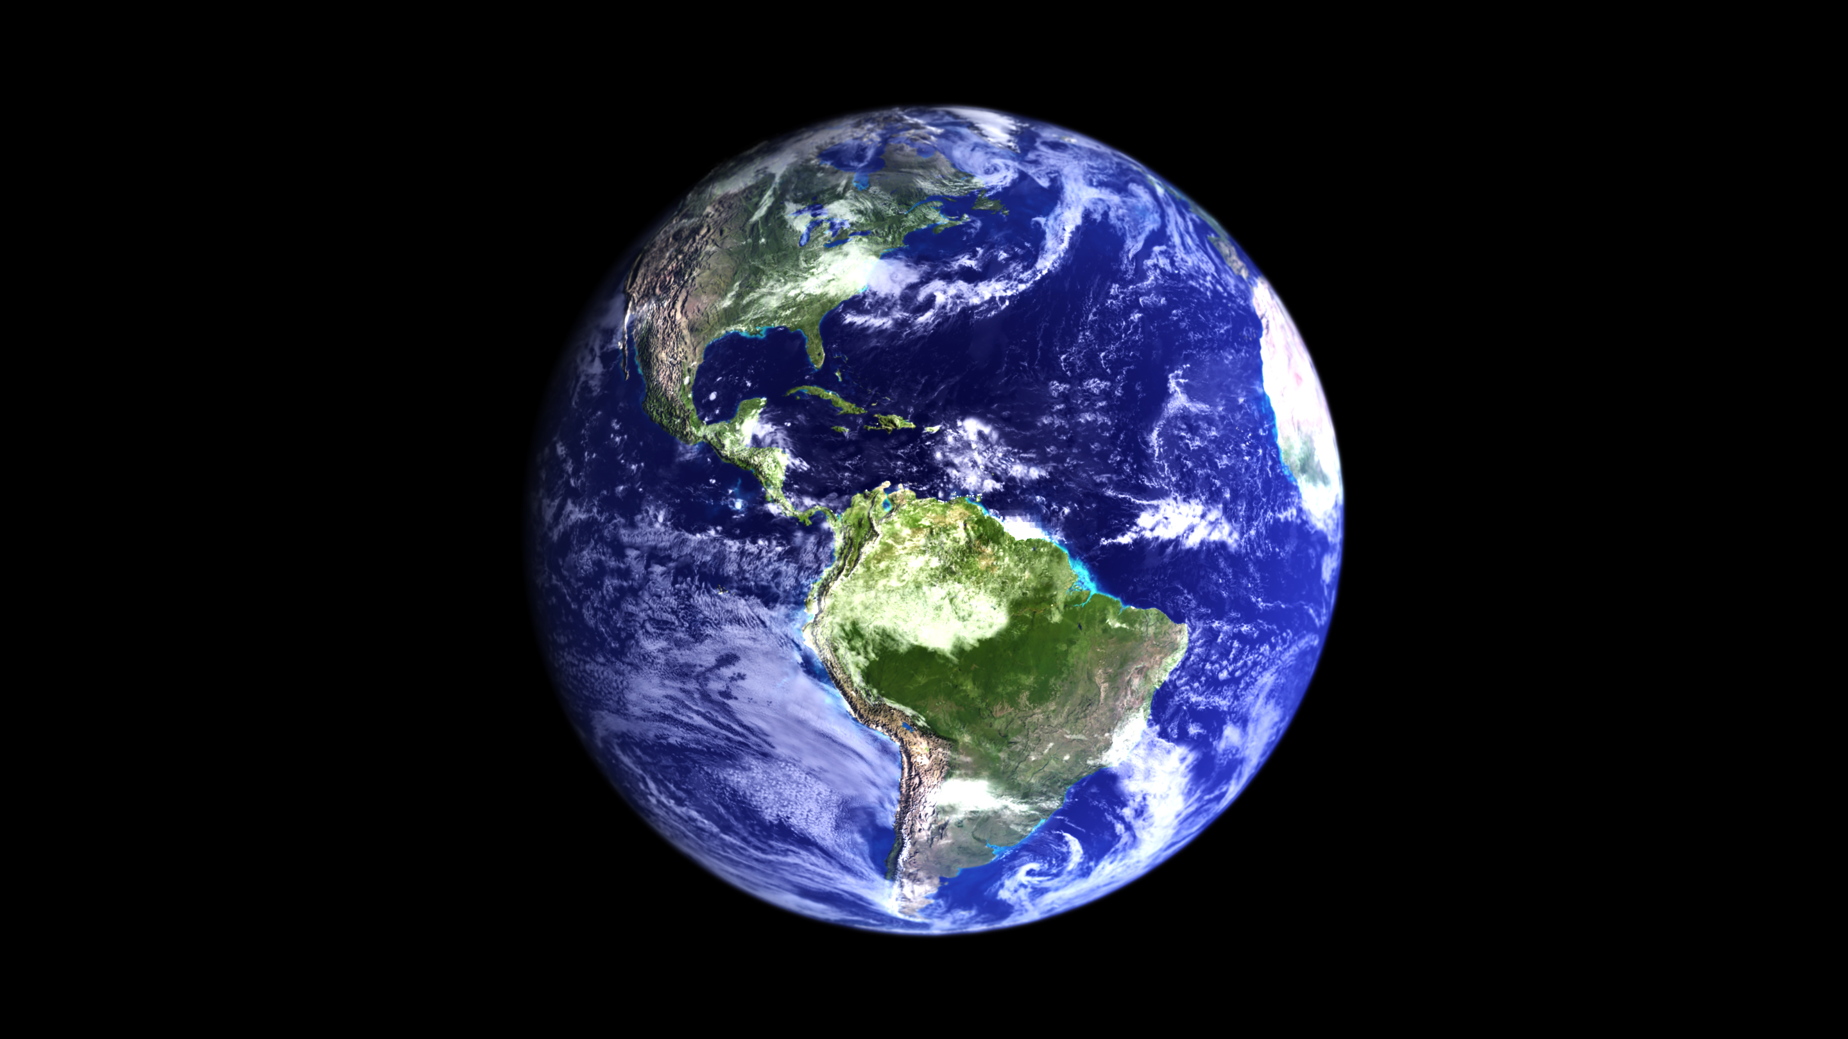
What parts of the Earth are visible from this view?
Some continents (land) and oceans

Slide 3
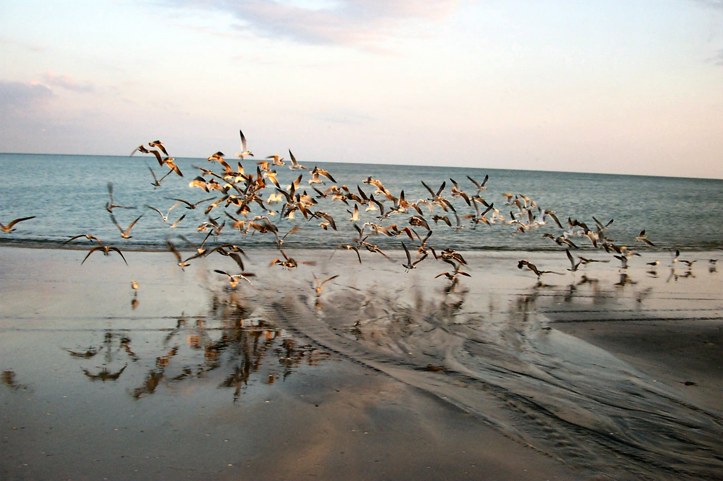
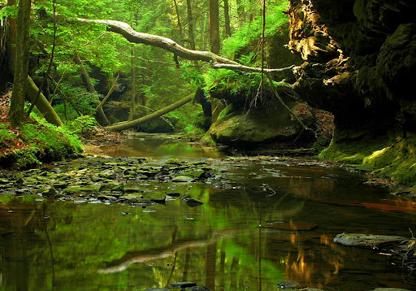
What are some living and non-living things you see in these photos?
Living: birds
Non-living: ocean, sand, and clouds
Living: moss, trees Non-living: stream, rocks

Slide 4
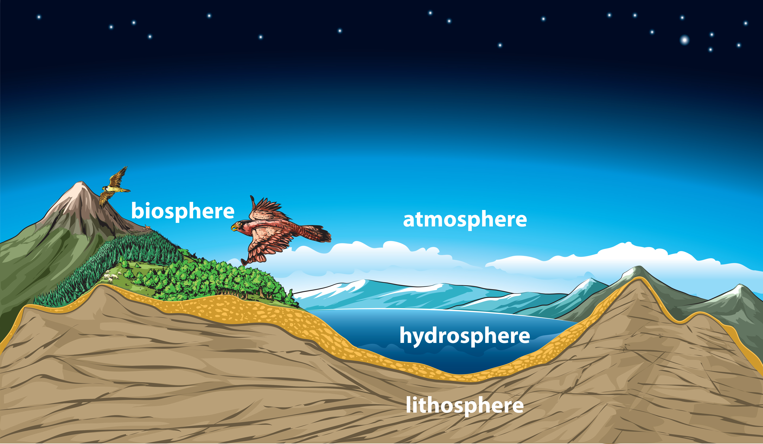
How could you group or categorize the things you saw in the previous pictures?
The components of Earth can be classified into one of four “spheres”.
These include living and nonliving components
They are called “spheres” because the earth is a sphere, and each is a part of the earth.

Slide 5
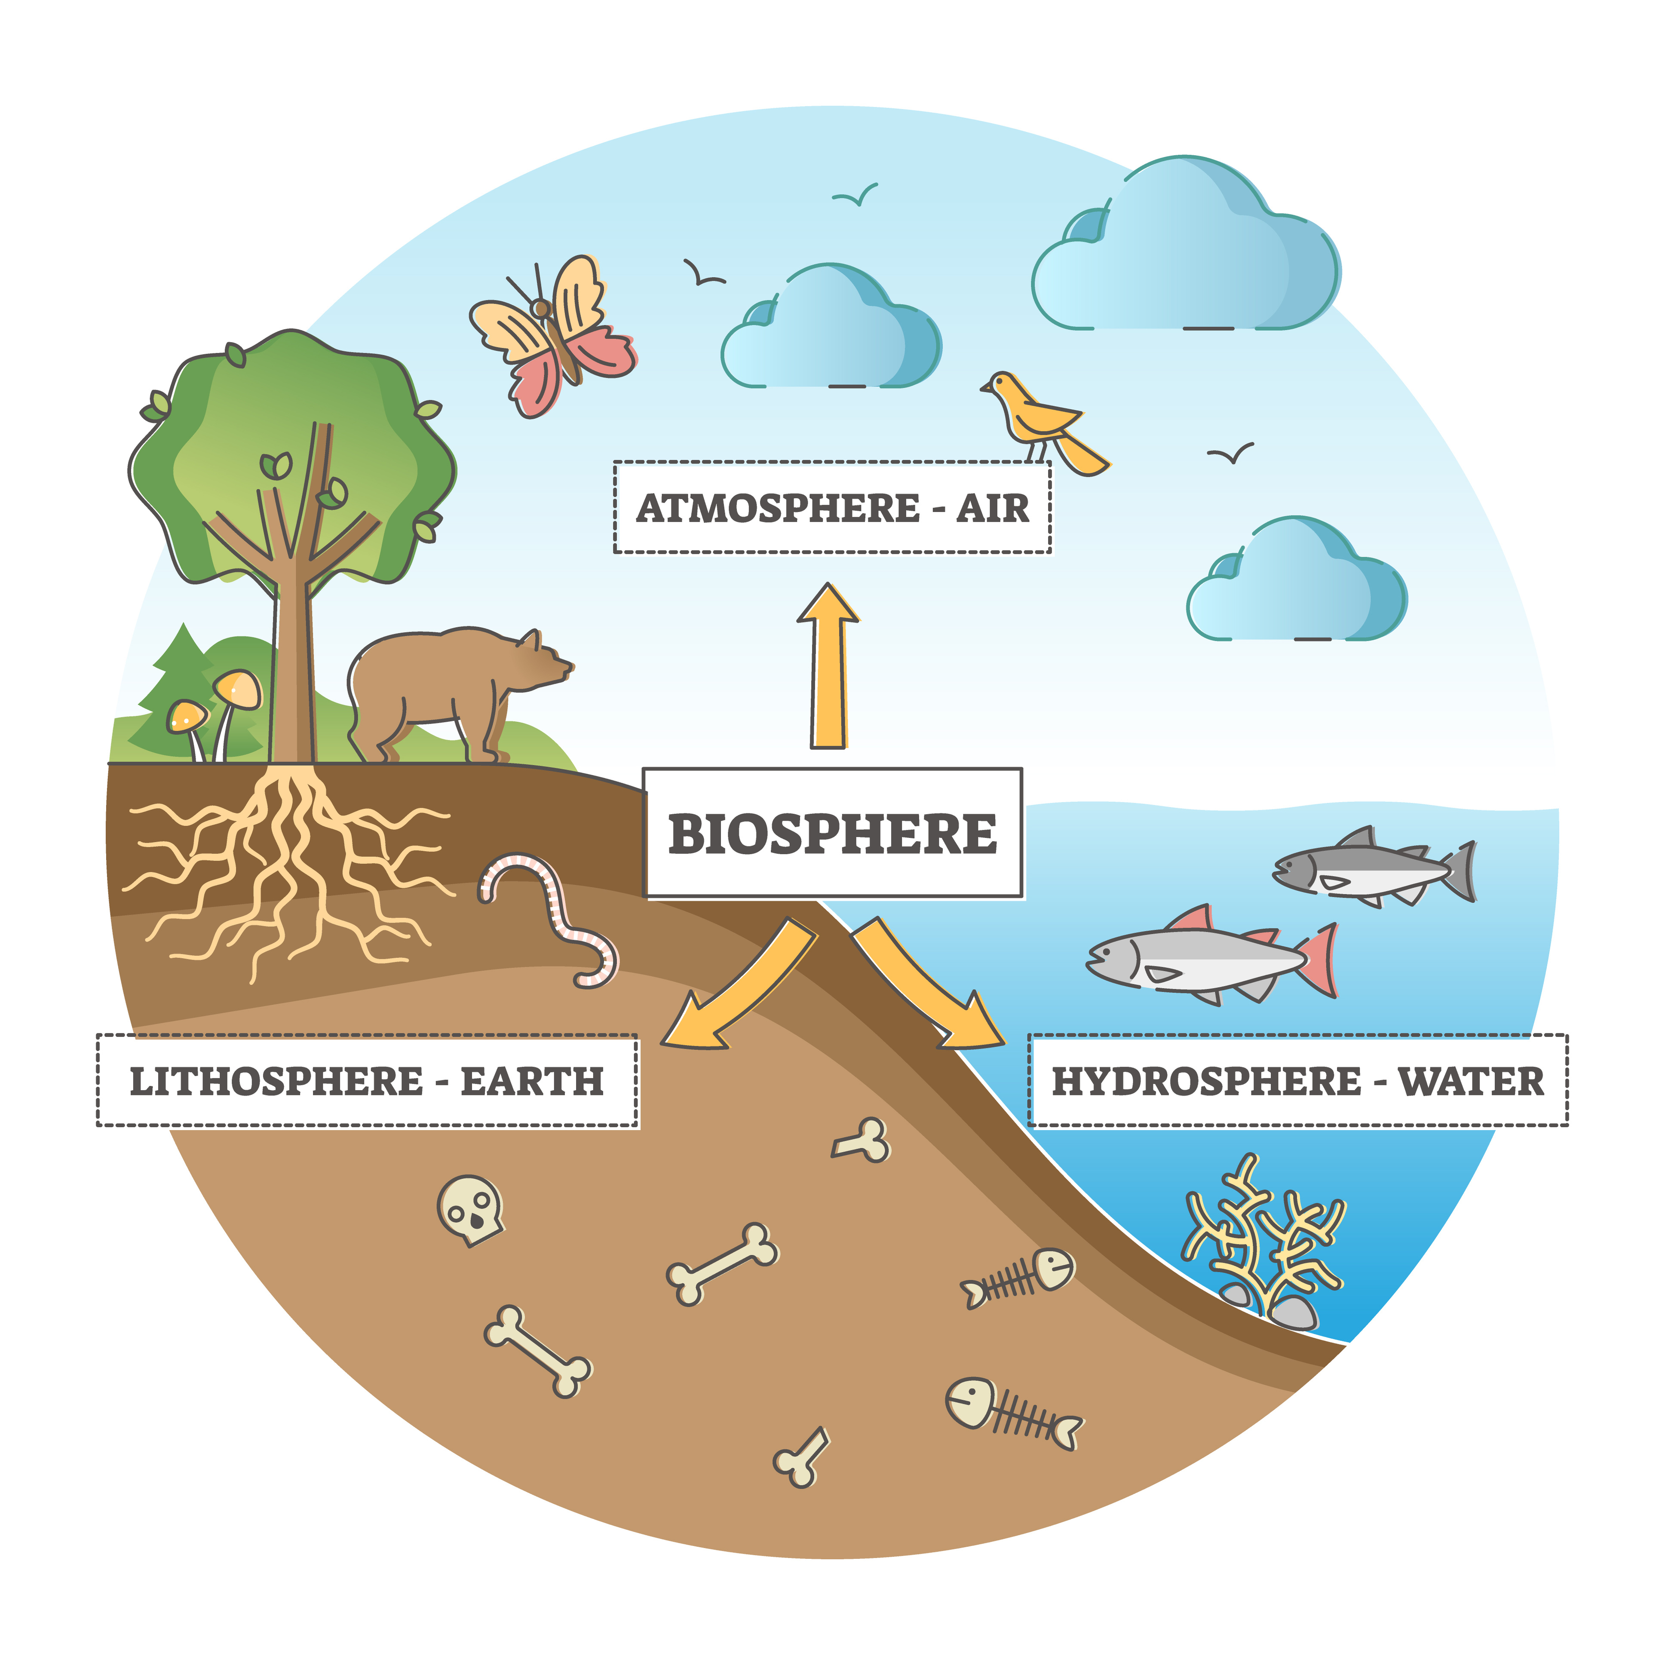
What are the four spheres of Earth?
Geosphere (or lithosphere)
Hydrosphere (includes the cryosphere)
Atmosphere
Biosphere

Slide 6
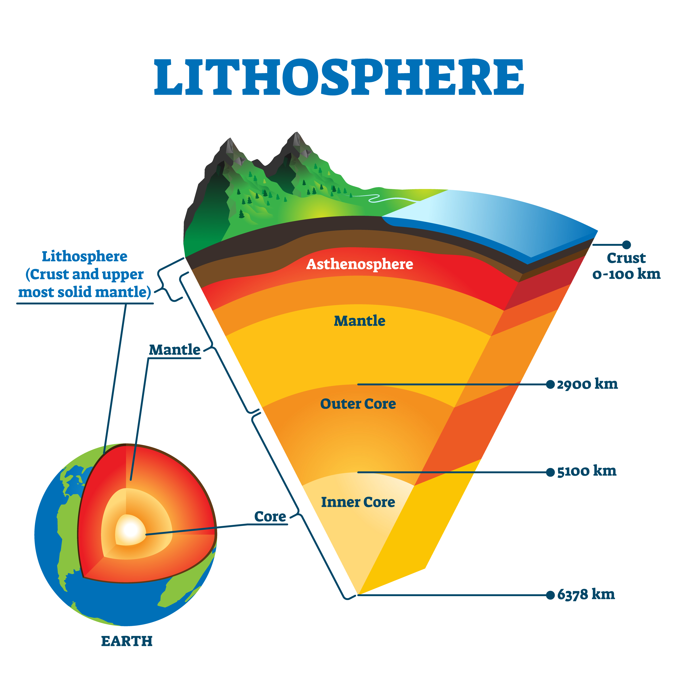
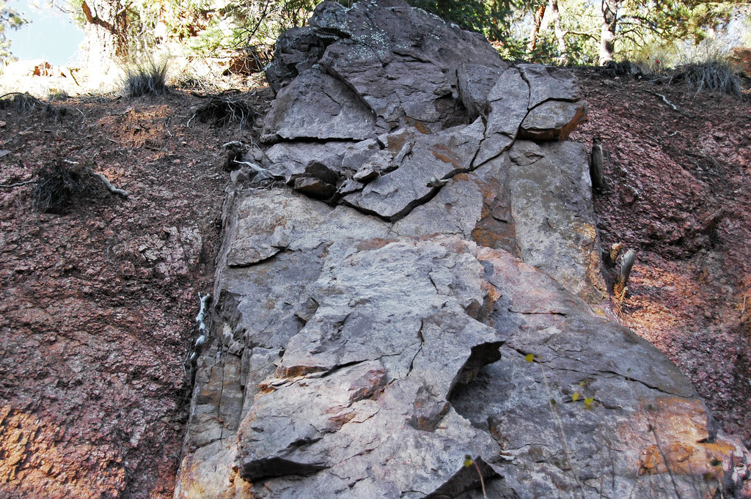
What is the geosphere (or lithosphere)?
Geosphere (or lithosphere): the solid part of the earth consisting of rock, dust, soil, sand, metal, and related materials.
Includes Earth’s core, mantle, and crust.

Slide 7
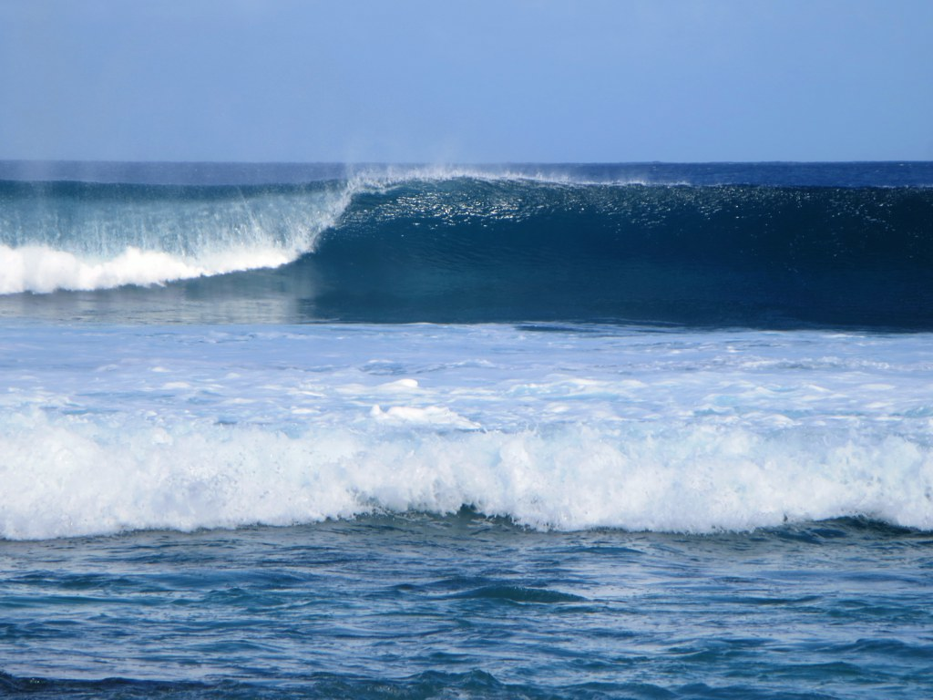
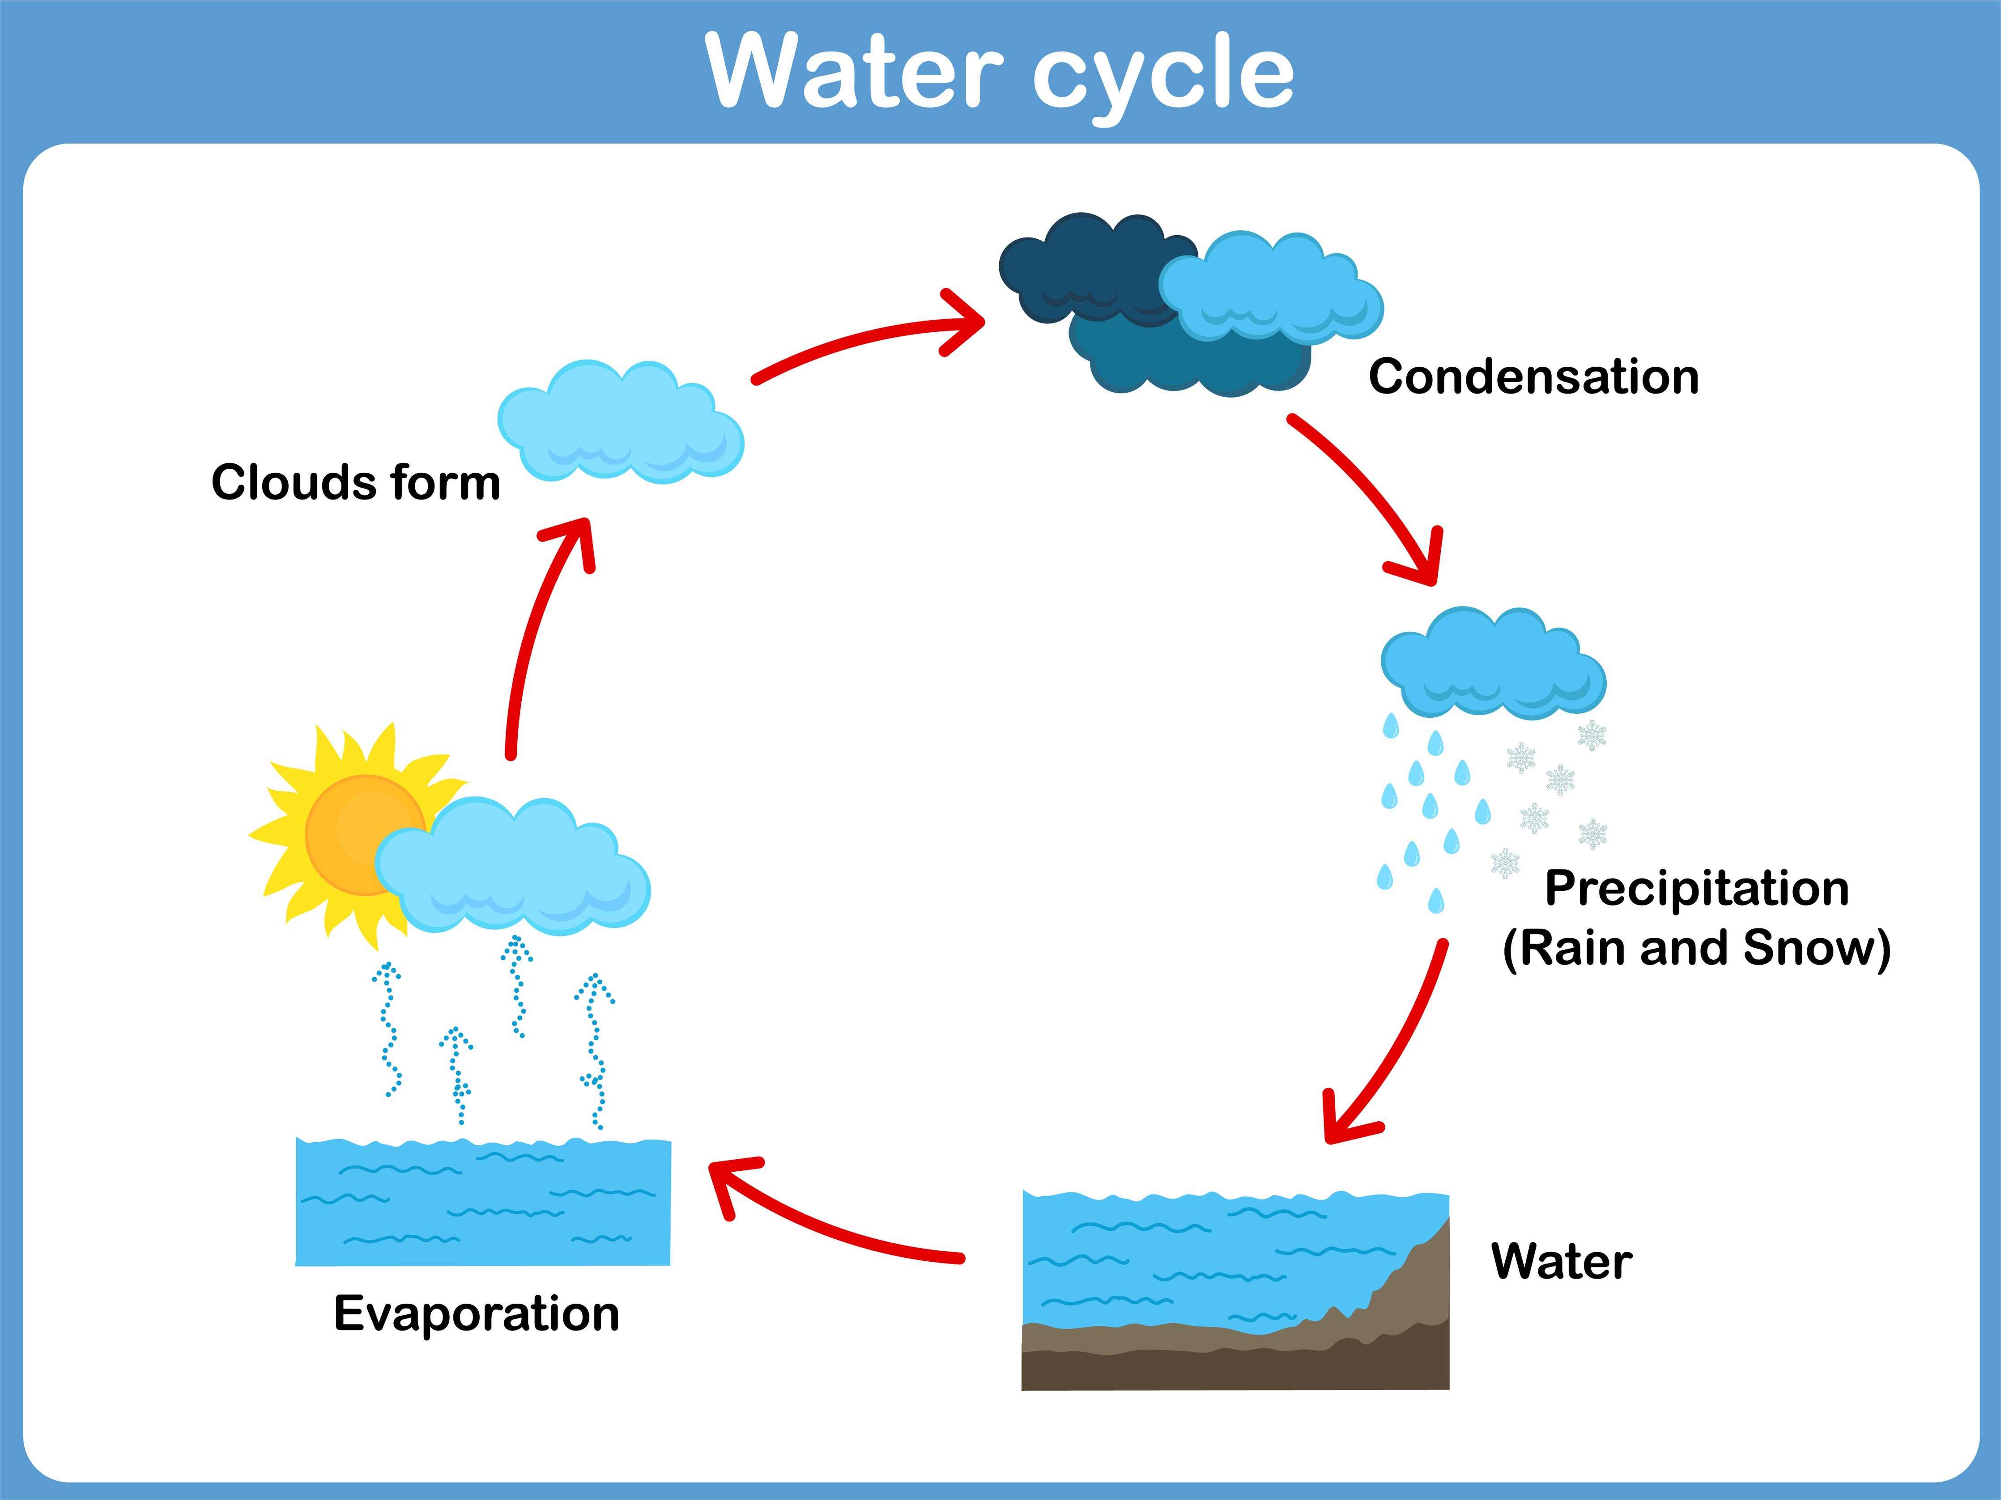
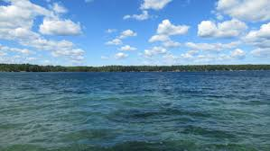
What is the hydrosphere?
Hydrosphere: Earth’s water including oceans, lakes, rivers, groundwater, rain, and snow. Frozen parts including glaciers, ice caps, and icebergs are called the cryosphere.

Slide 8
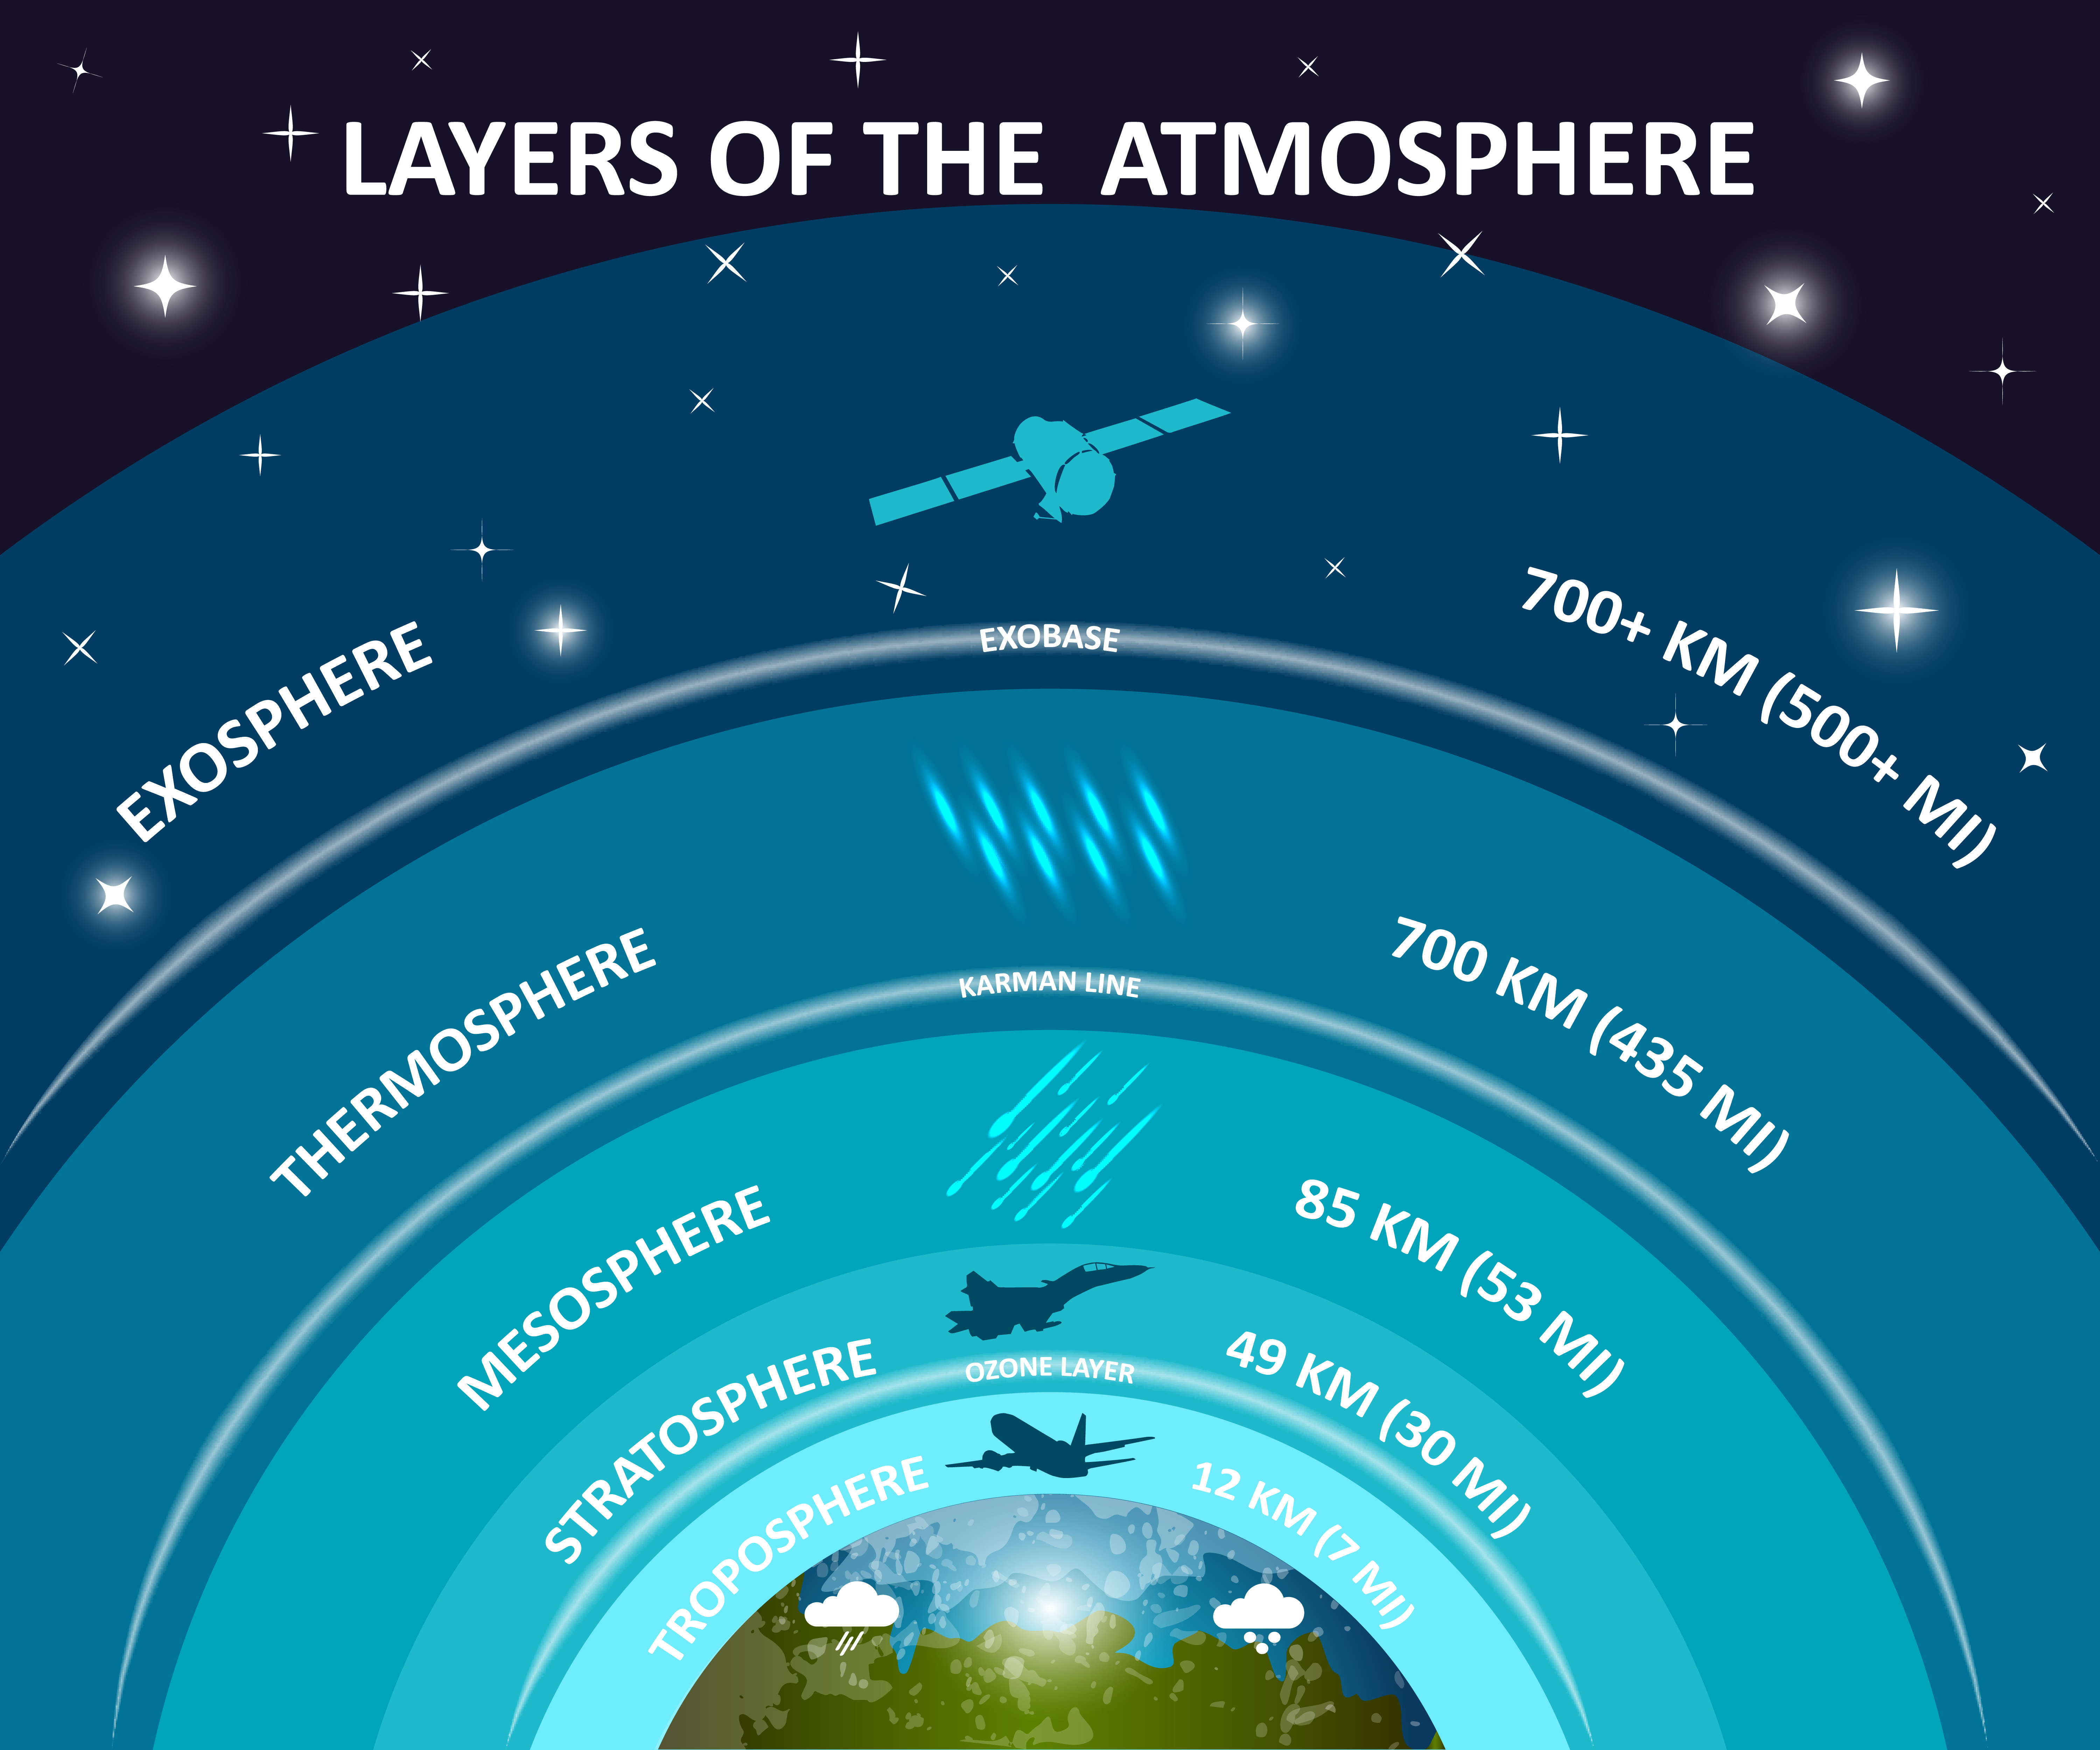
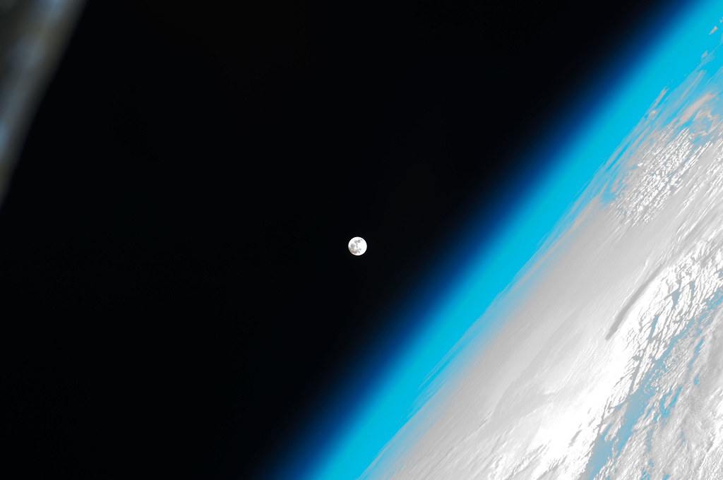
What is the atmosphere?
Atmosphere: The envelope of gases (or air) surrounding the earth. It includes wind, ozone, oxygen, nitrogen, and other gases.

Slide 9
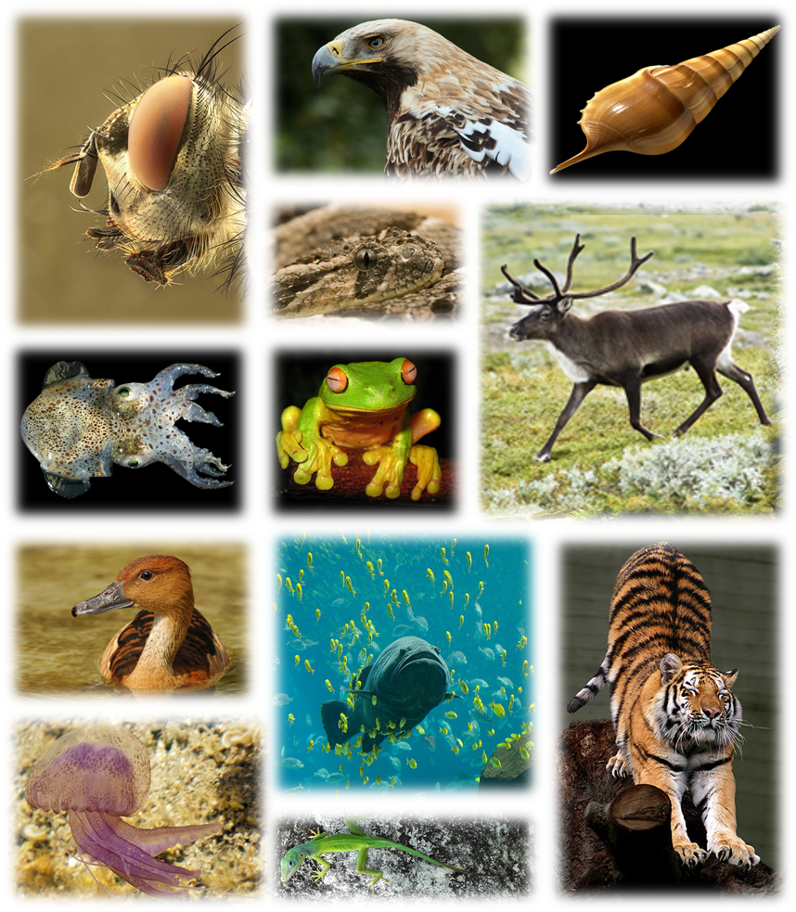
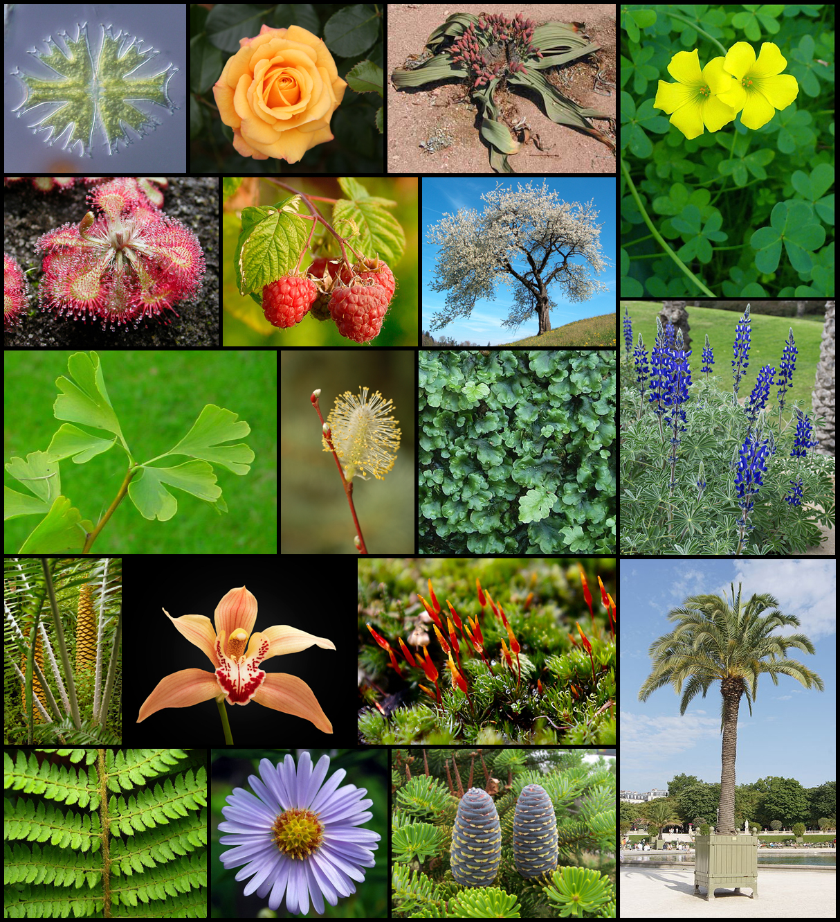
What is the biosphere?
Biosphere: Includes all living organisms on Earth including plants, animals, fungi, and other microscopic life.

Slide 10
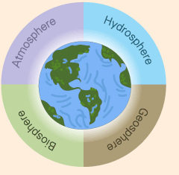
Do interactions occur between the Earth’s Spheres?
YES!!!!
All of Earth’s spheres and cycles are interconnected. They make up the Earth’s system.
What is a system?
A complex whole unit with smaller connected parts working together.

Slide 11
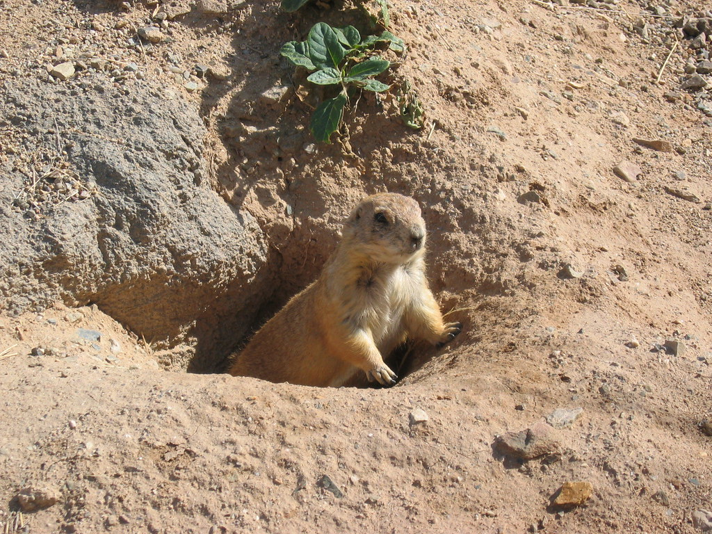
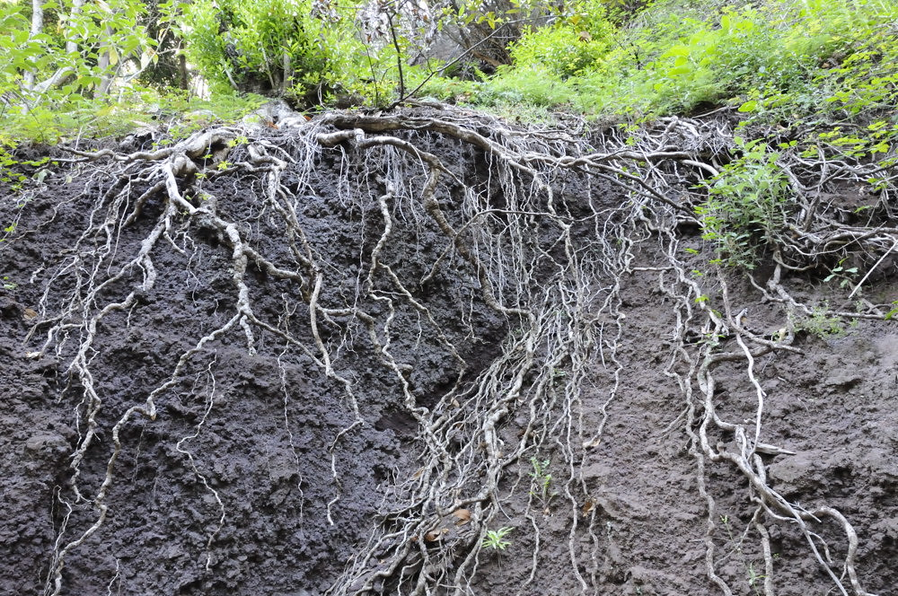
How does the biosphere interact with the other spheres?
Animals interact with the geosphere by digging burrows while plants interact with the geosphere using their roots. Roots provide a way for the plant to anchor and absorb nutrients from the soil.

Slide 12
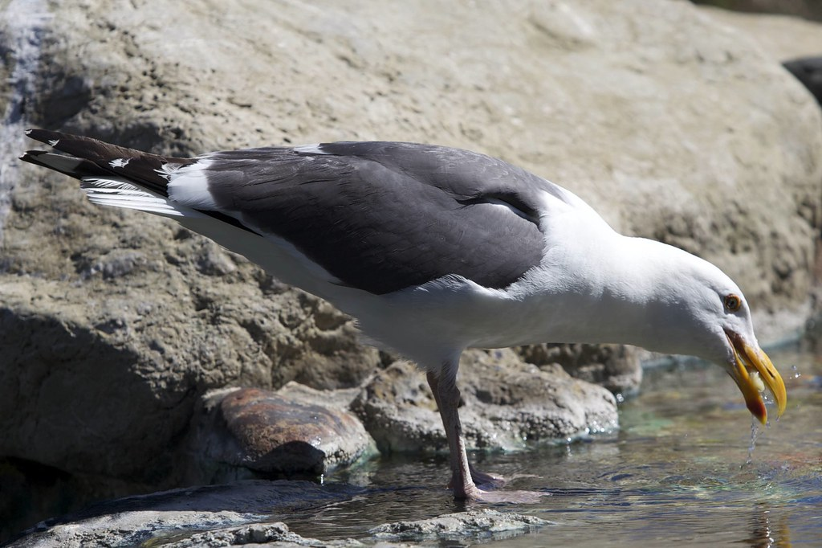
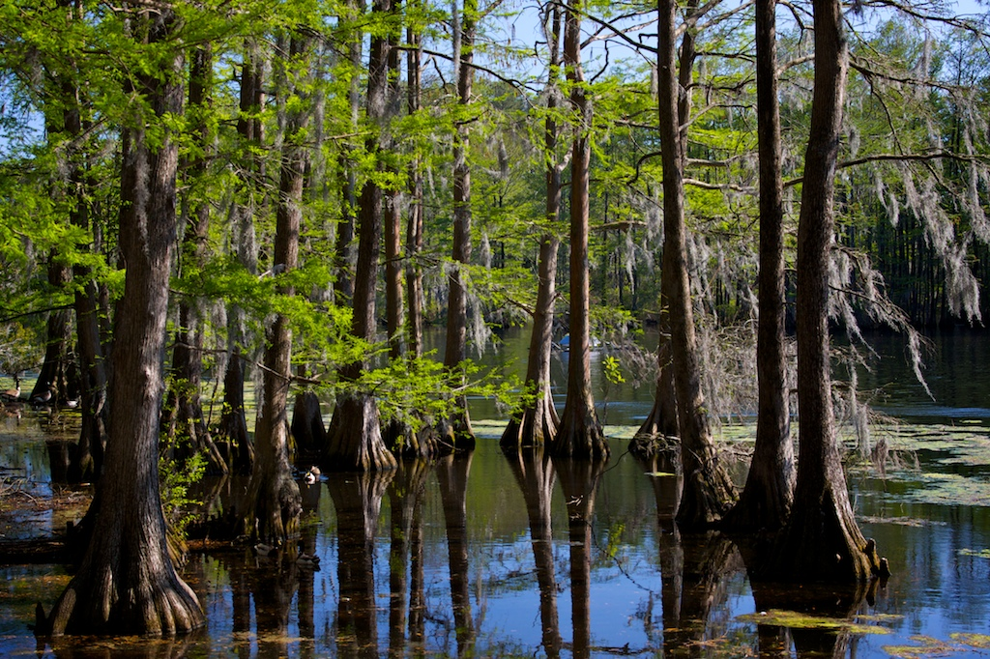
How does the biosphere interact with the other spheres?
Animals interact with the hydrosphere by drinking water or living in the water. Plants take up water through their roots and lose water through their leaves during a process called transpiration.
Animals interact with the atmosphere when they breathe, and plants interact with the atmosphere during the process of photosynthesis.

Slide 13
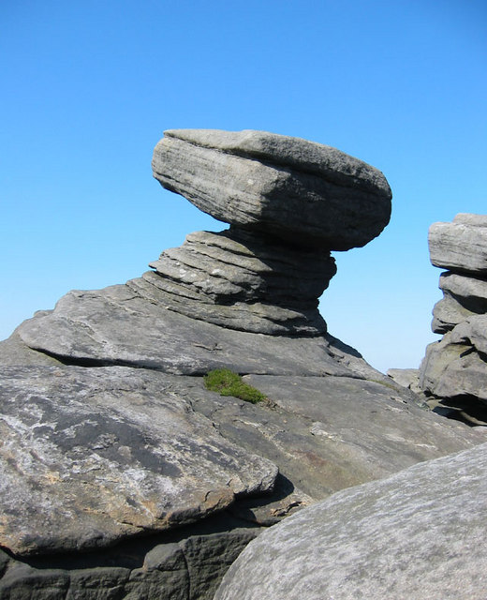
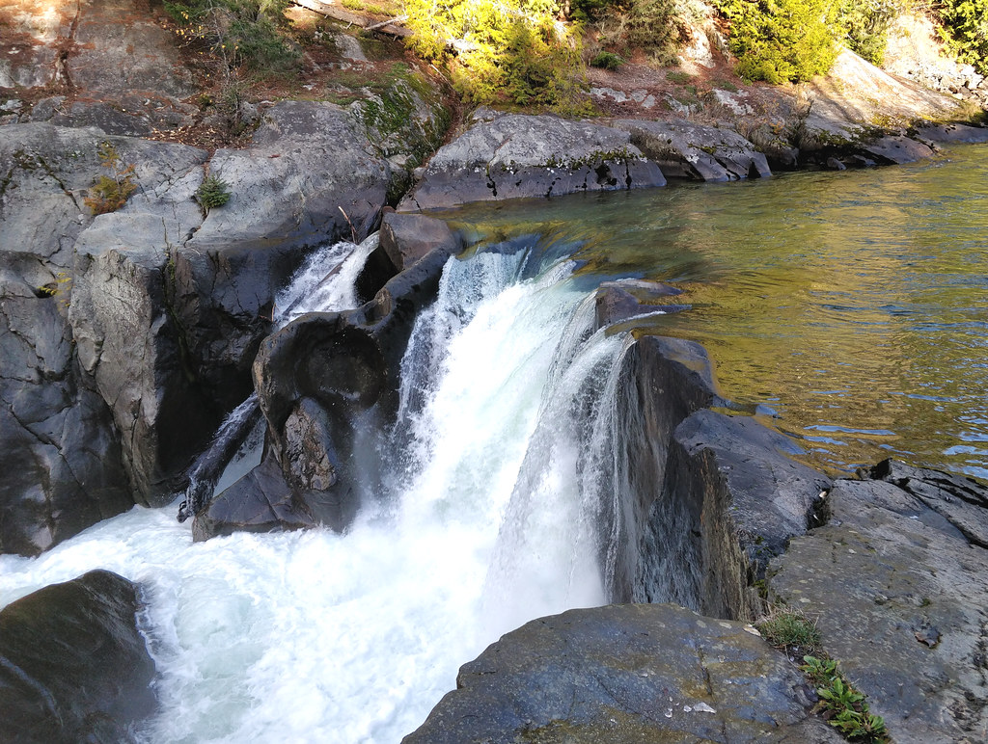
How does the geosphere interact with the other spheres?
Erosion and weathering are examples of how the hydrosphere and atmosphere can interact with the geosphere.

Slide 14

How does the hydrosphere interact with the atmosphere?
When water evaporates, the hydrosphere interacts with the atmosphere. Clouds contain water vapor but are located in the atmosphere.

Slide 15
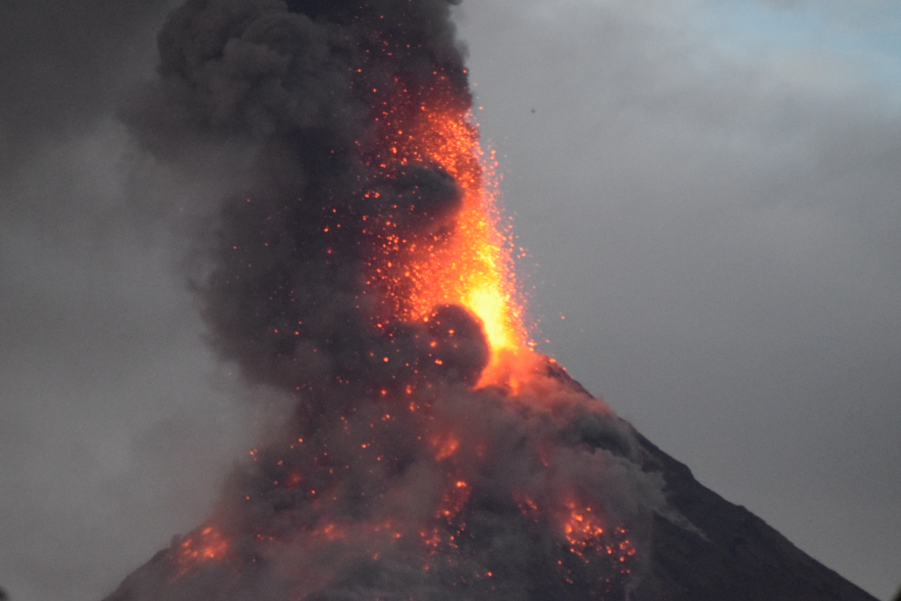
How can multiple systems interact at one time?
Larger events like volcanic eruptions can cause interactions among all spheres. When a volcano (the geosphere) erupts, gases like carbon dioxide are released into the atmosphere. This can cause water vapor to attach to additional molecules, causing an increase in rain (hydrosphere). The increase in rain can promote additional plant growth (biosphere).

