Slide 1

Wildlife Habitat Checklist
Alabama Wildlife Federation Outdoor Classroom Field Journal Activity
To use this interactive PowerPoint with your students:
Click on “Enable Editing.”
Click the “Slide Show” tab at the top of the screen.
Then choose “From Beginning” from the menu.

Slide 2
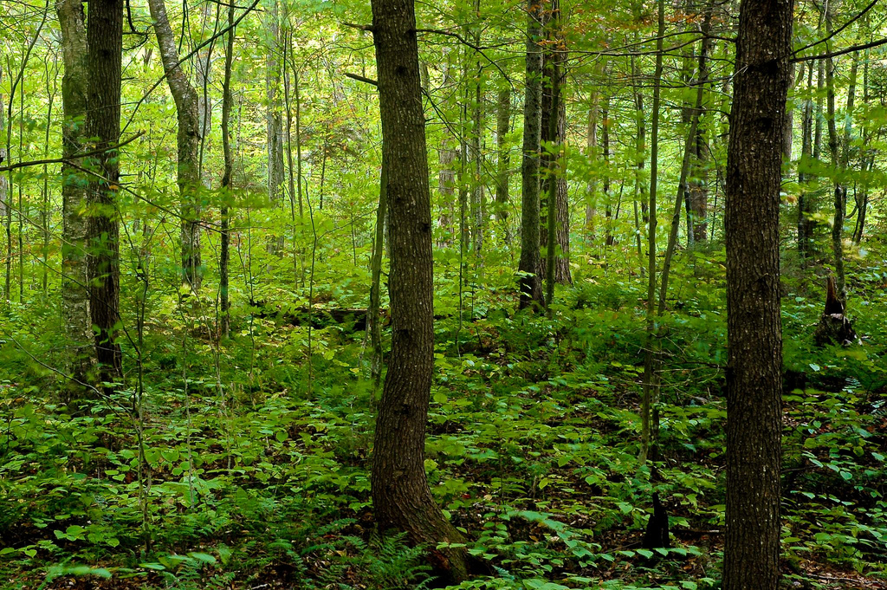
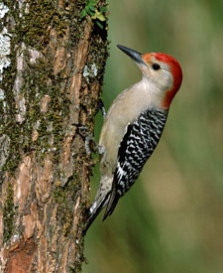
What is a habitat?
A habitat is the natural home or ecosystem where an animal lives.
The animals in a specific habitat are adapted physically and behaviorally to their environment.

Slide 3
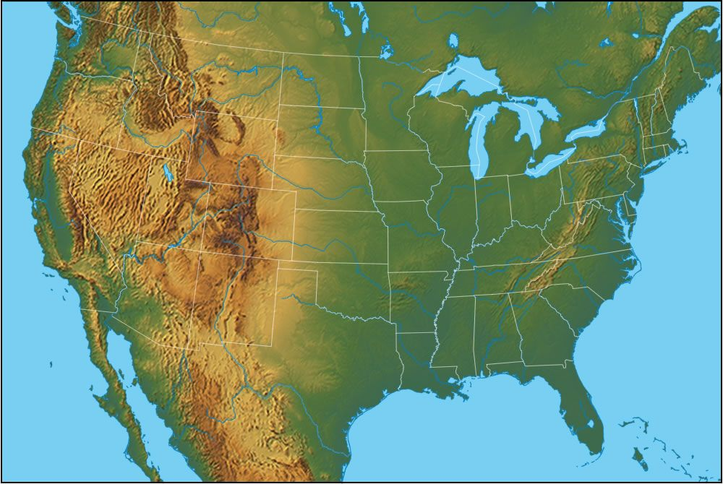
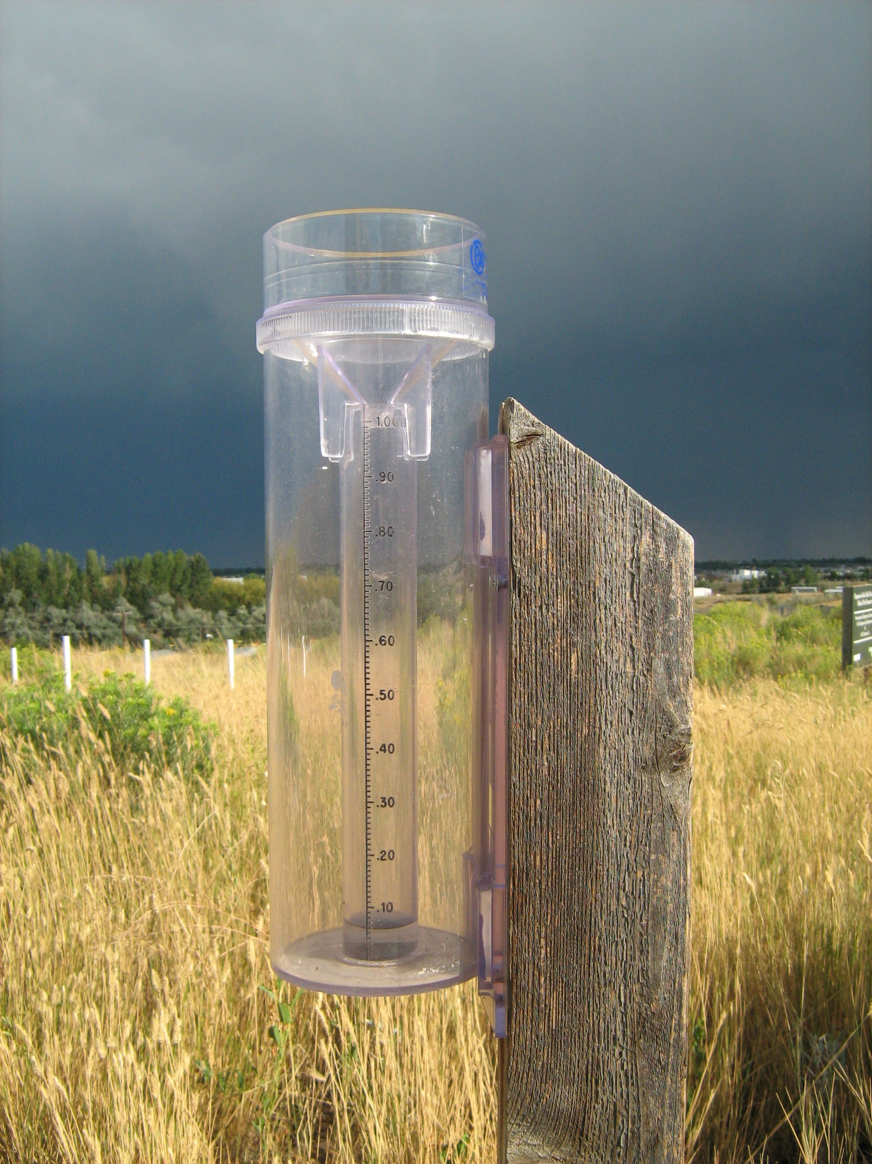
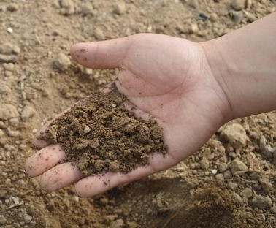
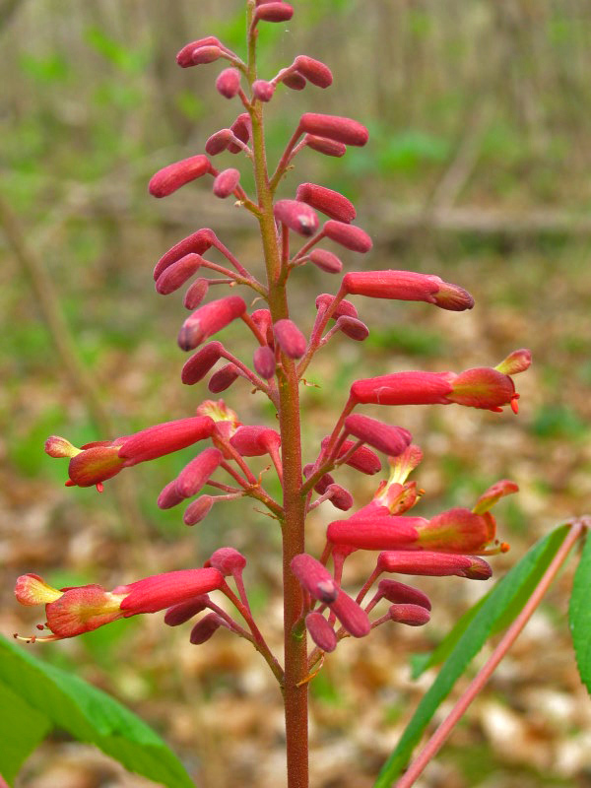
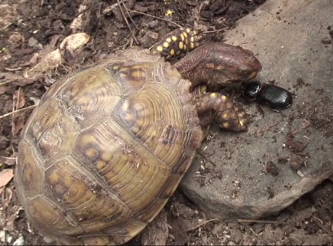
What are the major characteristics of different habitats?
geographical location
climate/ weather conditions
geology & soil structure
plant communities
animal communities

Slide 4
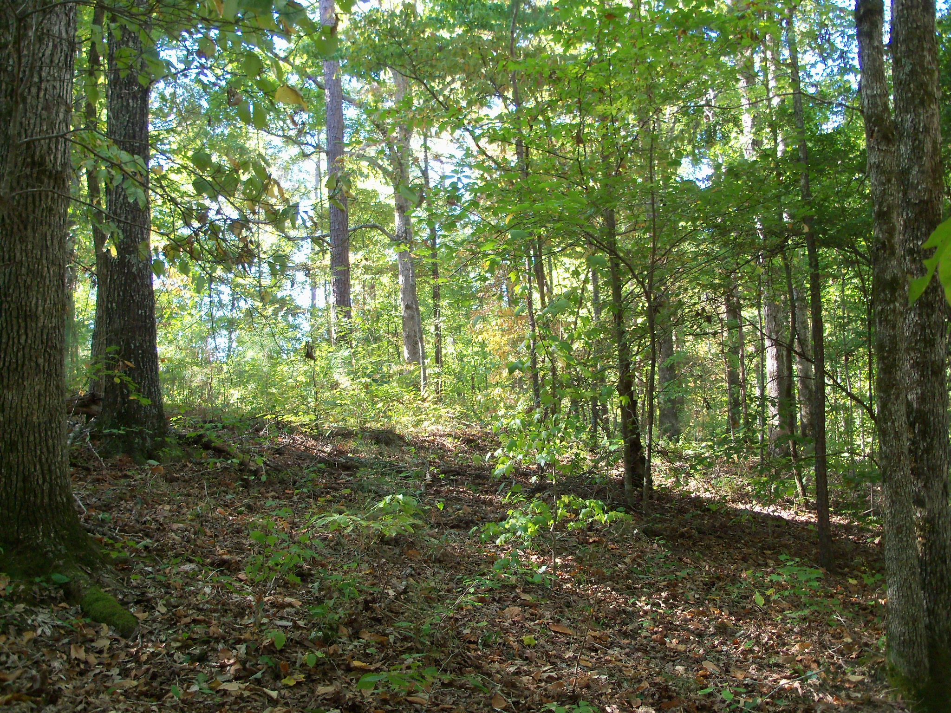


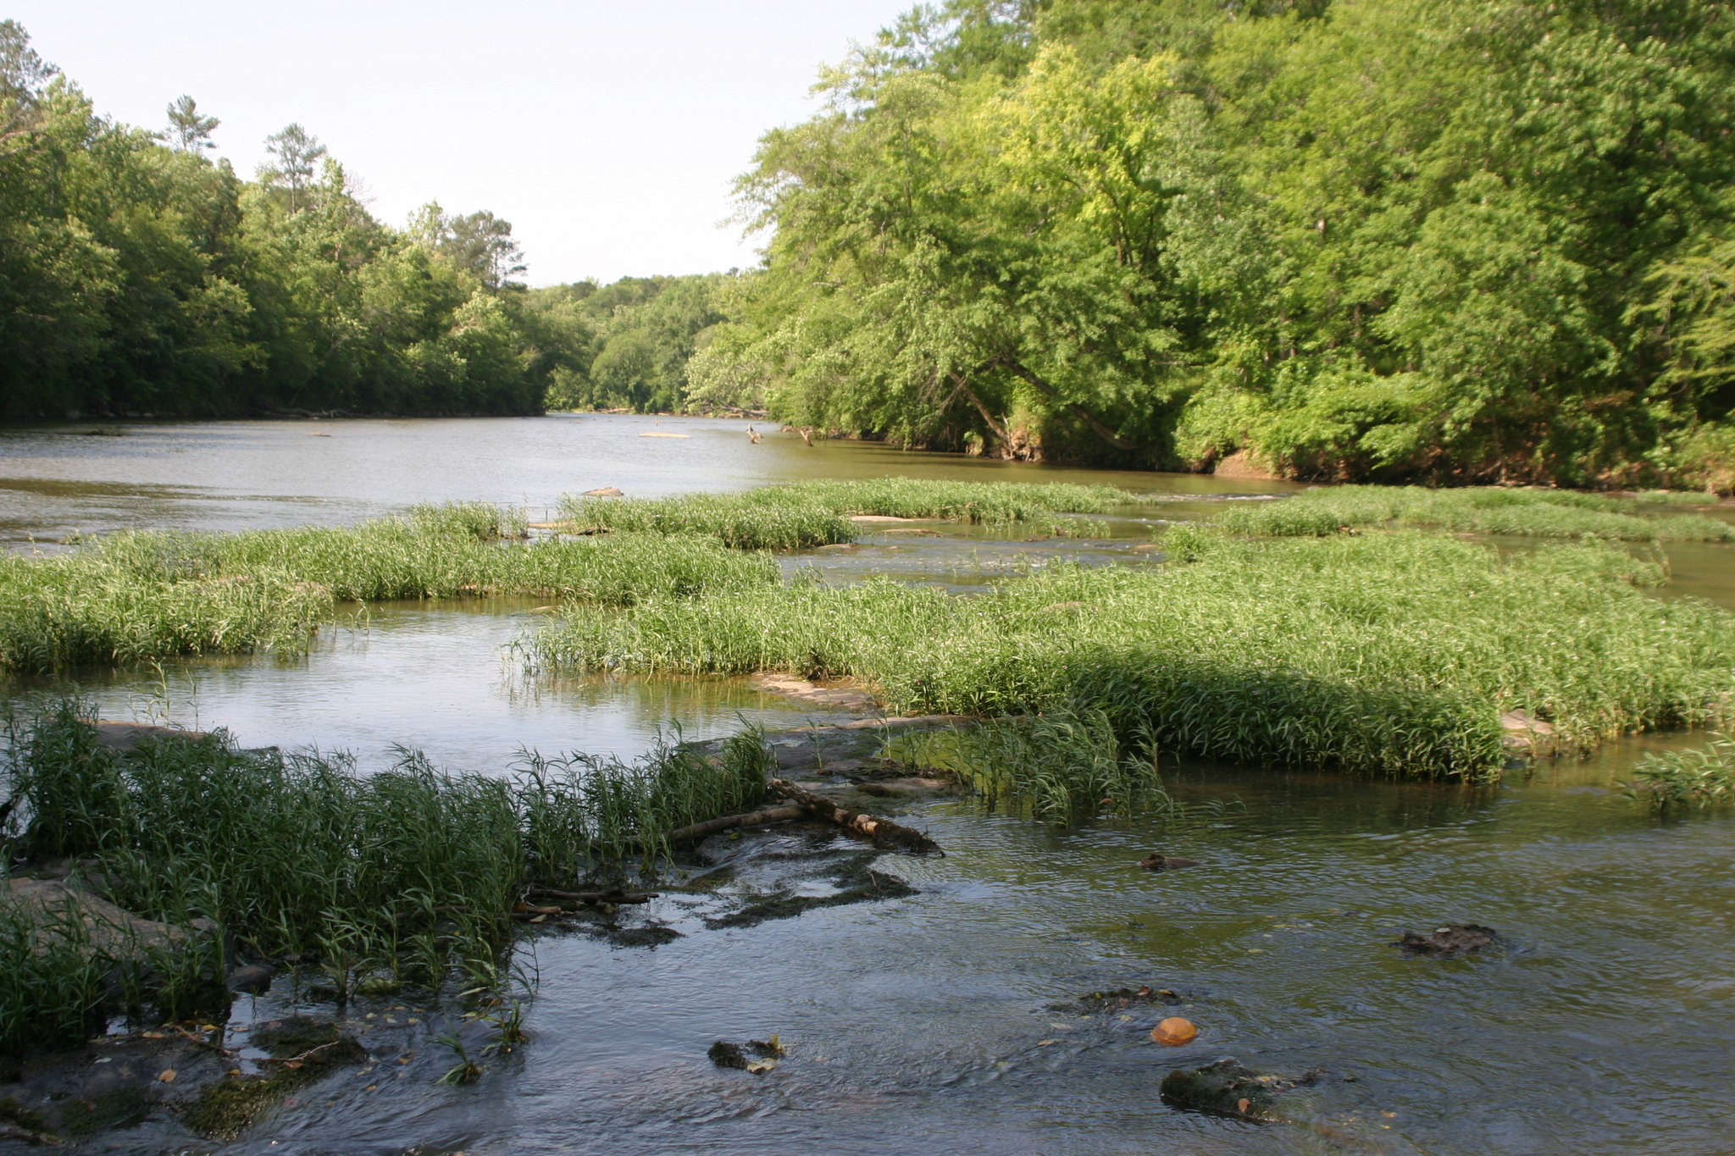
What types of habitat could we find in Alabama?
Forest Habitat
Woodland with tree canopy, understory & forest floor
Temperate Forest – forest with all four seasons
Tropical Rainforest – stays warm and wet all year
Aquatic Habitat
Water habitats
Freshwater Habitat - creek, river, pond, or lake
Saltwater Habitat - ocean

Slide 5
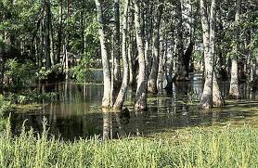
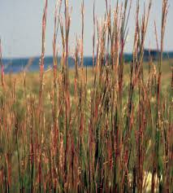
What other types of habitat could we find?
Wetland Habitat
Areas with shallow standing water such as bogs, marshes, or swamps
Desert Habitat
Hot and dry areas with little to no rainfall and few plants
Grassland Habitat
Large areas with grasses, herbs and wildflowers but little to no trees such as meadows, glades or prairies
Polar Tundra Habitat
Land is covered by massive areas of ice and snow with freezing temperatures

Slide 6
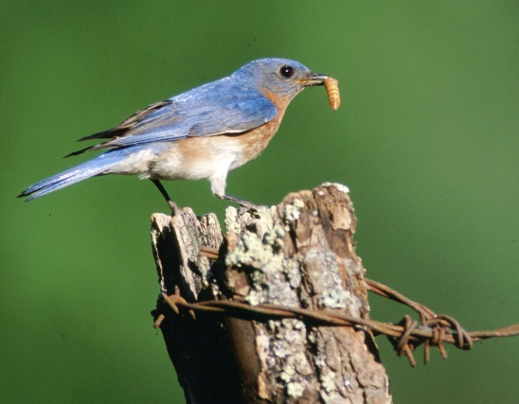
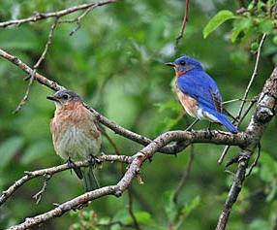
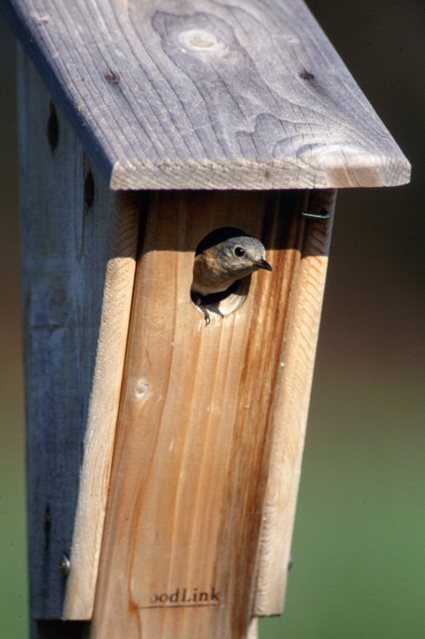
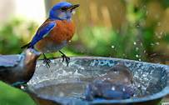
What resources do animals need in their habitat to survive?
ALL animals need…
Shelter/Cover
(bluebirds need bushes & trees to protect them from predators & bad weather)
Food
(Ex: bluebirds eat bugs & berries)
Places to Raise their Young
(bluebirds are cavity-nesters so they need a cavity in a tree or a nesting box)
Water
(bluebirds use creeks, streams & bird baths)

Slide 7
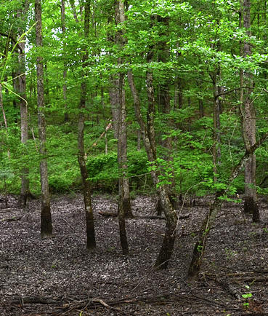
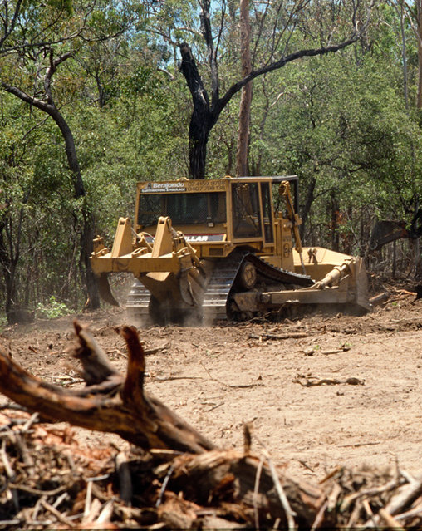
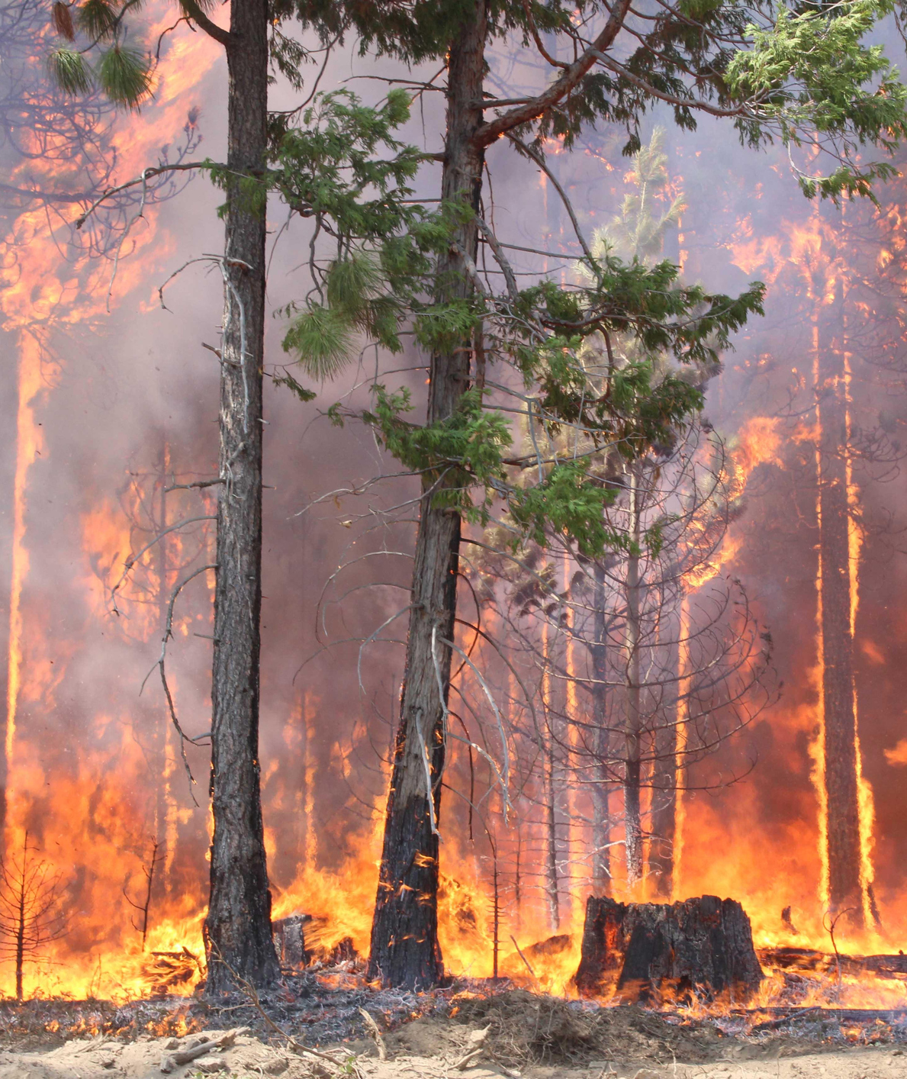
What if the habitat doesn’t have enough resources?
What if the habitat is damaged or destroyed?
The animals may find the resources they need by expanding their territory. BUT…
While searching for these resources, they risk death due to predation (from lack of cover) or vehicle collisions (from crossing roads).
Construction?
Drought?
Forest fire?

Slide 8
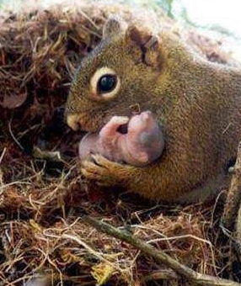
If they cannot find the resources that they need, will they survive? What will happen to their population?
The population will most likely decline due to:
Starvation – if they cannot find enough food
Sickness/Diseases – if they are hungry, dehydrated from lack of water, and weak.
Low Reproduction – if they aren’t healthy then they often cannot reproduce or the babies will not be healthy enough to survive.
*Population is the number of animals of a specific species in a specific area.

Slide 9
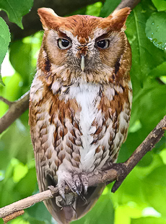
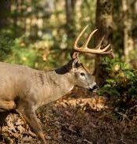
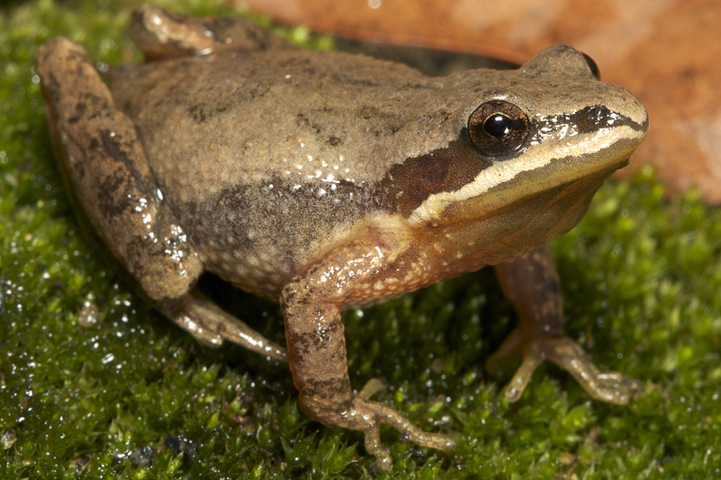
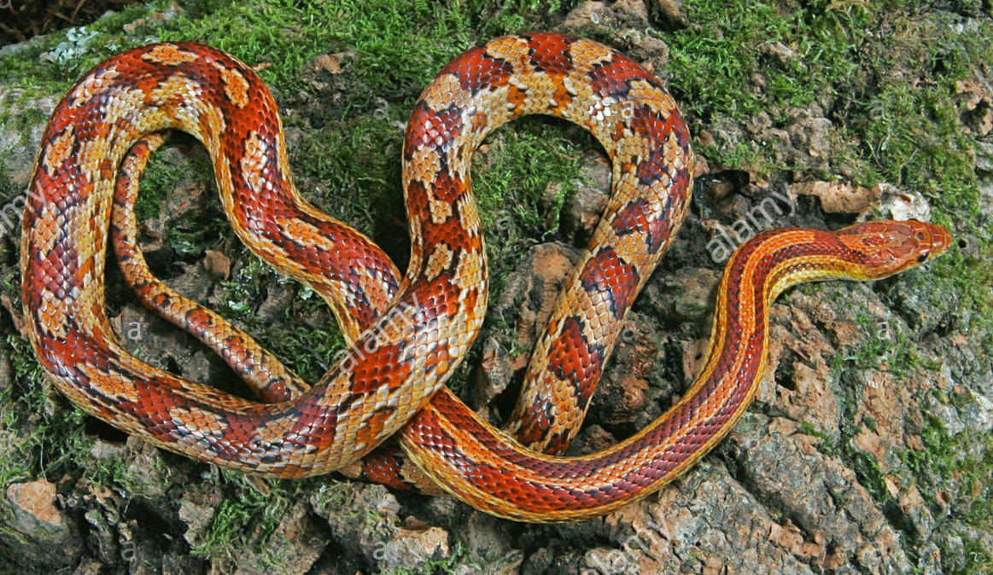
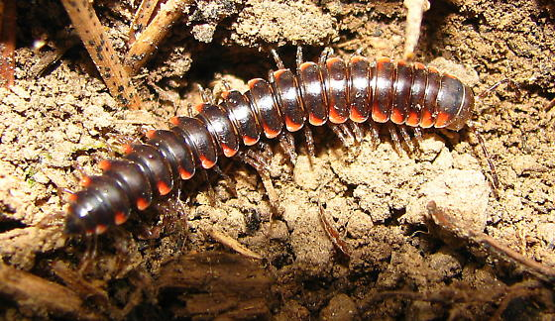
Can a habitat provide a “home” for more than one species (or type) of animal?
Yes! One habitat can provide the resources needed by numerous different species of insects, birds, amphibians, reptiles, and mammals.
For example, you can find all of these different types of animals in a forest habitat:
Upland chorus frog
Red corn snake
Millipede
Eastern screech owl
White-tailed deer

Slide 10
How do the different animals share the resources and interact in their habitat?
All of the organisms (plants and animals) in a habitat make up a system (an ecosystem) in which the organisms depend on each other.
For example:
The upland chorus frog lays its eggs in creeks or streams, and it eats bugs.
The red corn snake hides in the fallen leaves, and it eats rodents, frogs, and other small animals.
The millipedes eat the dead plant and animal matter on the forest floor, and their poop provides food for the plants.
The eastern screech owl hunts from trees for small rodents and bugs, and it nests in the cavities of trees.
White-tailed deer eat the plants and distribute plant seeds that attach to their fur.

Slide 11
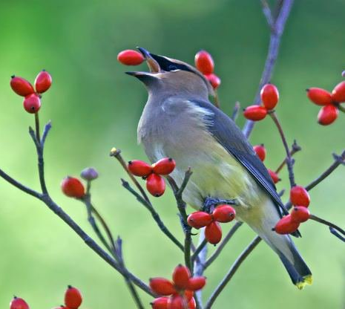
Can we do anything to increase the habitat resources available for local wildlife?
We can research what resources different wildlife species need to survive, and then try to add those resources to our school’s outdoor classroom.
YES!
For Example:
Food – Ex: Native berry-producing bushes
The more diverse the native plant species are in a habitat, then the greater the variety of wildlife species that will use the habitat.
Water – Ex: Small backyard pond
Shelter/Cover - Ex: Evergreen bushes & trees
Places to Raise Young – Ex: Nesting boxes

Slide 12
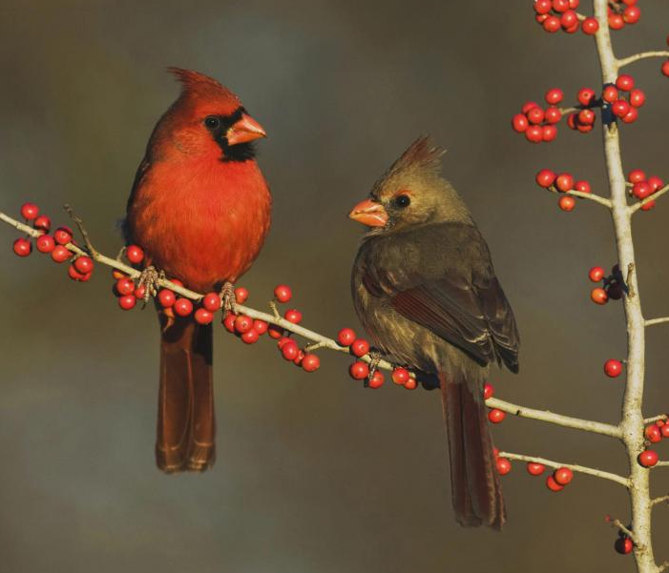
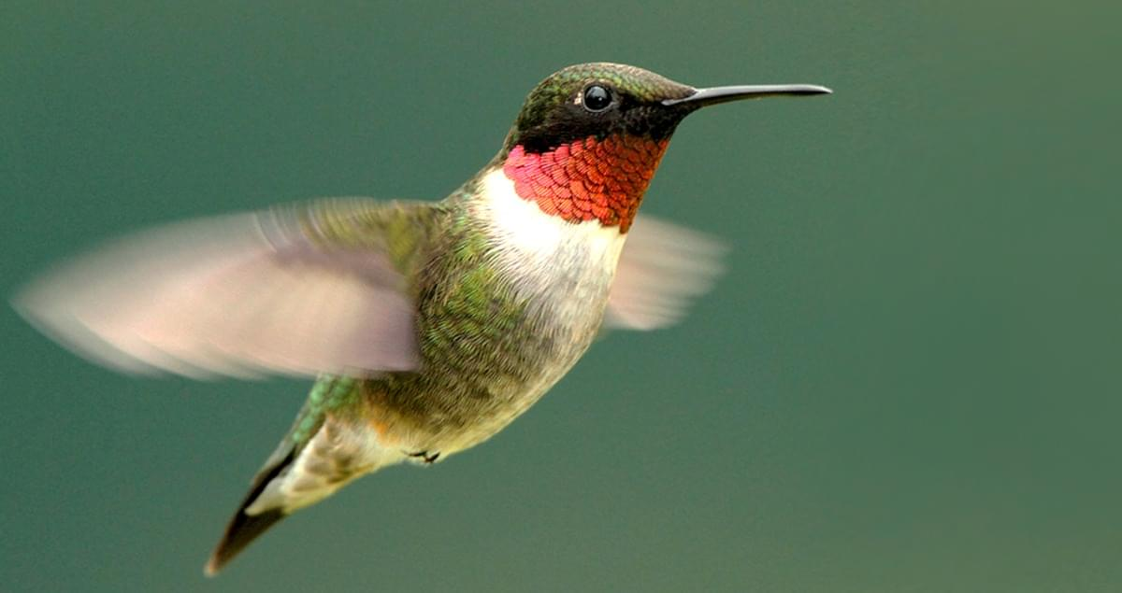
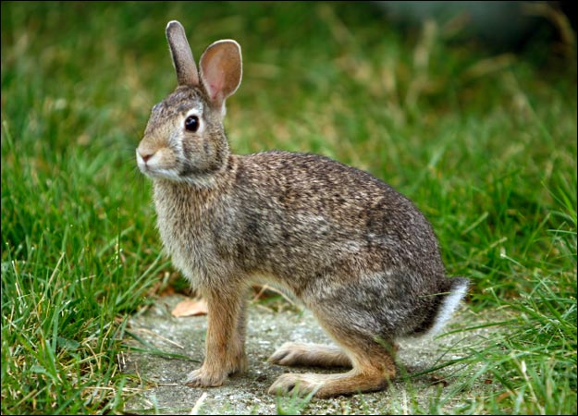
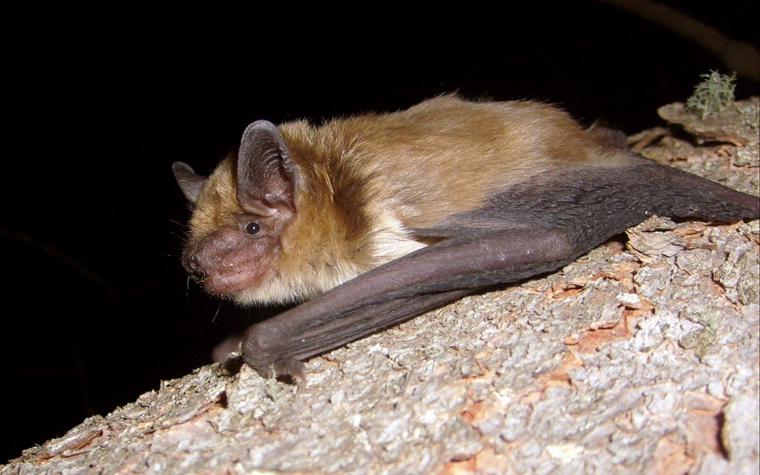
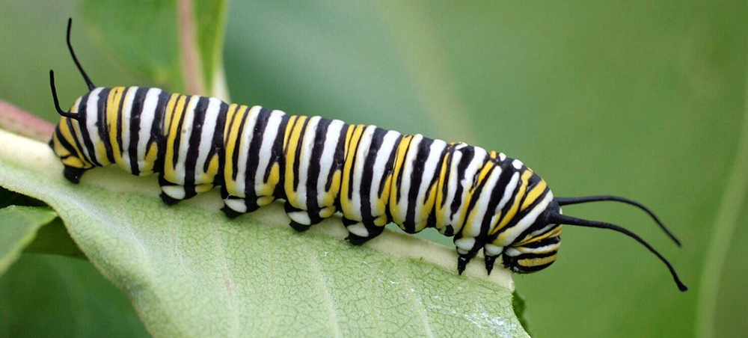
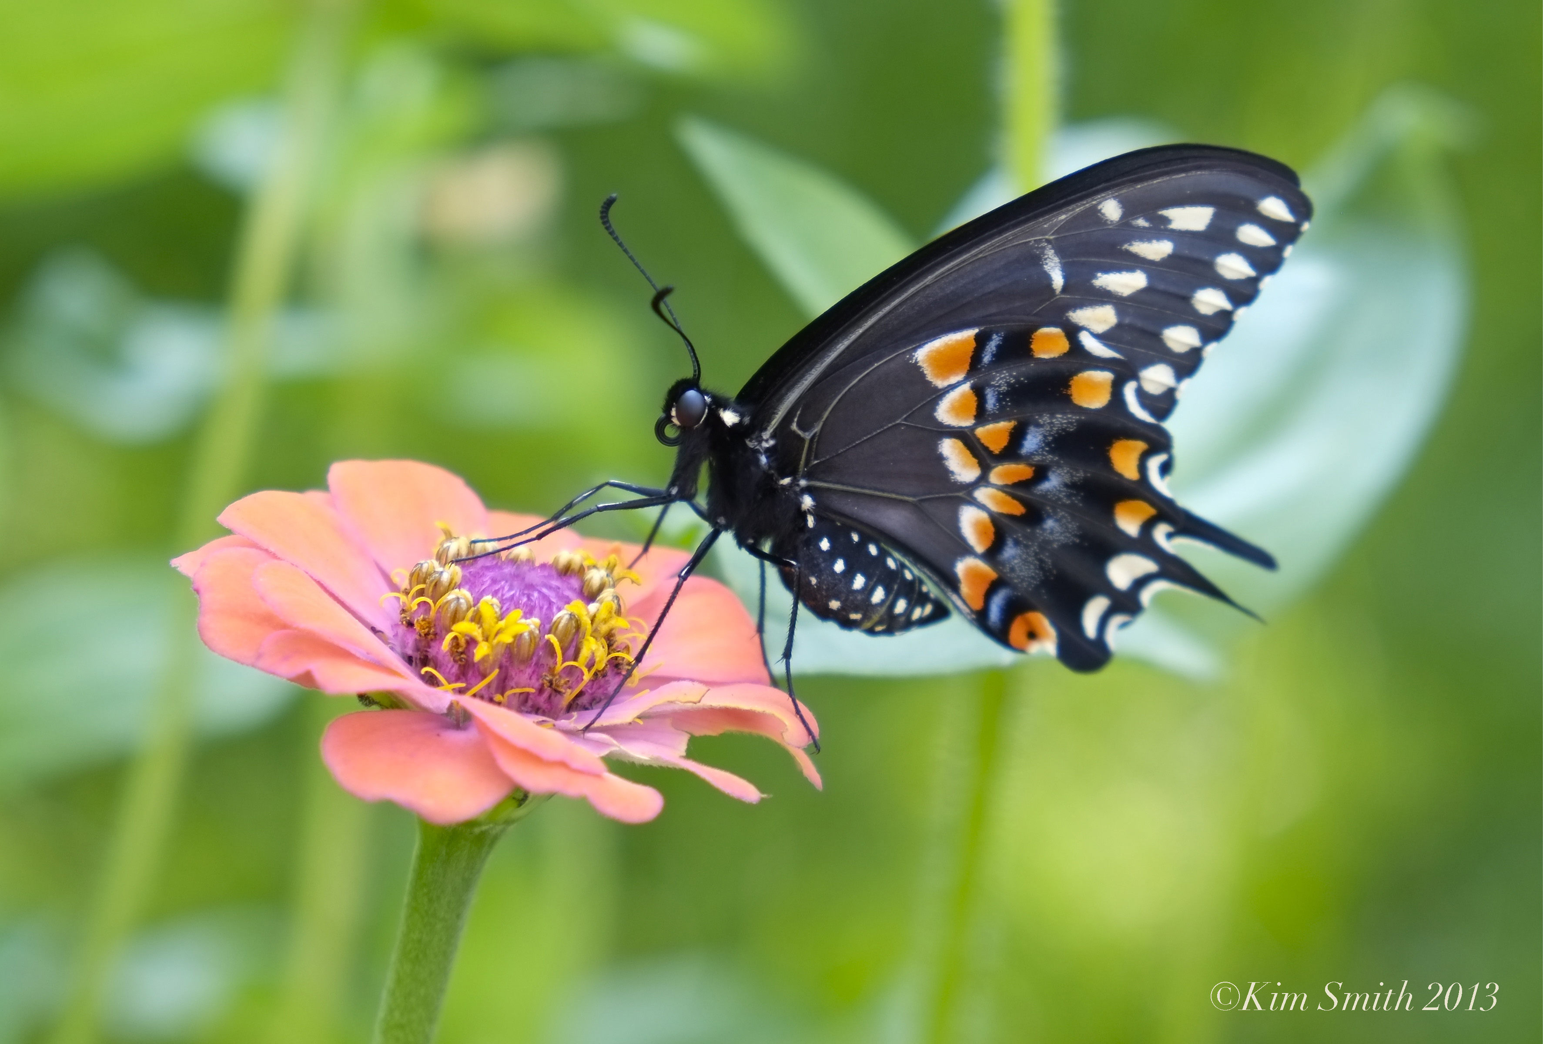
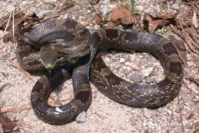
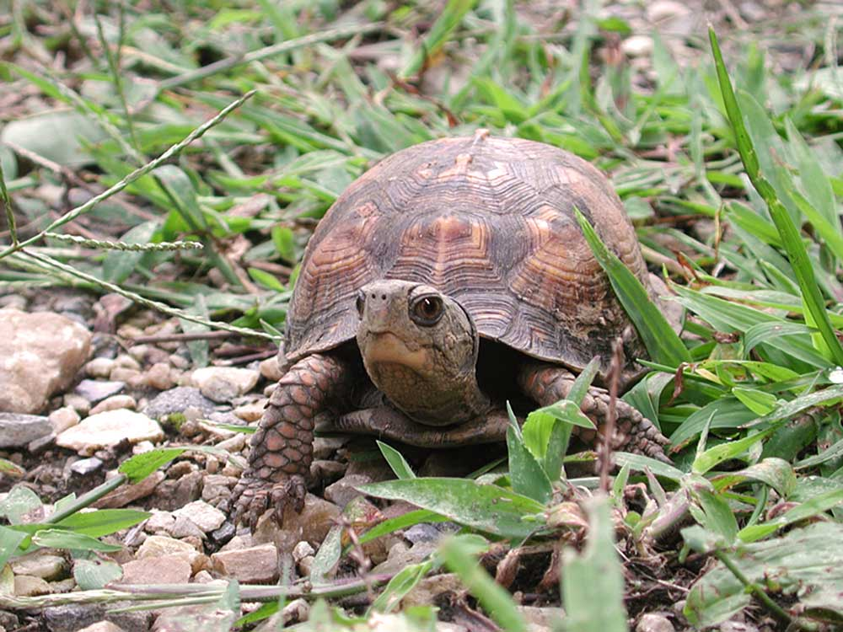
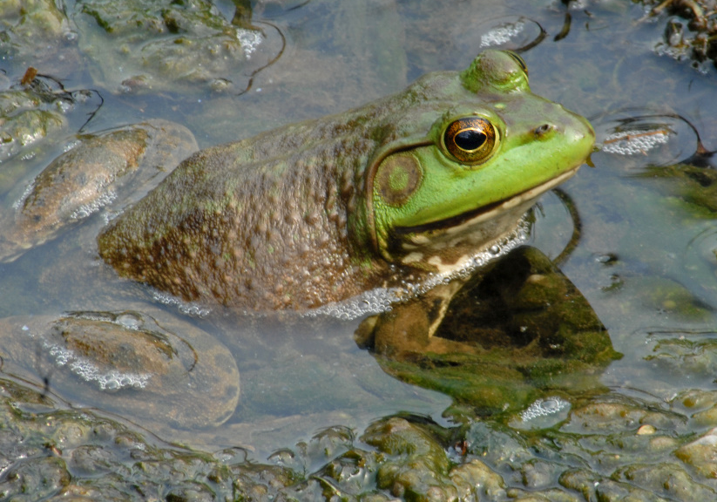
What types of animals could we provide habitat for in our outdoor classroom?
Eastern cottontail rabbit
Ruby-throated hummingbird
Big brown bat
Monarch caterpillar
Northern cardinals
Eastern box turtle
Black swallowtail butterfly
American bullfrog
Gray rat snake

